Slide 1
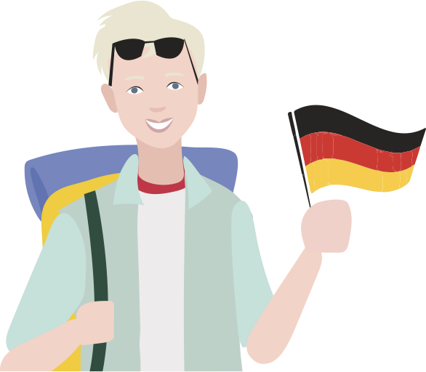
Introduction to Digital Marketing for Tourism Operators in Uganda
Kampala, February 2024

Slide 2
Contributors
This curriculum is initiated by CBI, the Centre for the Promotion of Imports from Developing Countries (CBI), part of the Netherlands Enterprise Agency (RVO).
It is developed by Charlotte Beauvoisin (Diary of a Muzungu & DigiTourism East Africa), Peter Fabricius (Bonfire), Richard Okuti (Asili FORTUNE) and EyeOpenerWorks.
It is reviewed and enriched by Patricia Kahill, Ajena Jafar, Dorothy Oyella, Ram Hadji, Gloria Nanfuka and Grace Achire.

Slide 3
Charlotte Beauvoisin
Founder Diary of a Muzungu Travel Blog & DigiTourism East Africa
Award-winning blogger
Digital Marketing Expert
Tourism Consultant
Community-based Tourism Trainer at Sunbird Hill, Kibale Forest
Notes:
This is a template slide, and can be filled out with the bio and photo of the facilitator(s).

Slide 4
Housekeeping
Wifi
Coffee breaks and lunch
Ask questions and participate - we are here to learn
Timekeeping and starting times

Slide 5
Course Modules
Module 1
Module 5
Digital Marketing Foundations
Digital Marketing Toolkit: SEO and Blogging
Module 2
Module 6
Branding for Digital Success
Digital Marketing Toolkit: Reviews and Online Booking Platforms (OTAs)
Module 3
Module 7
Digital Marketing Toolkit: Your website
Digital Marketing Toolkit: Email Marketing
Module 4
Module 8
Digital Marketing Toolkit: Social media marketing
Practical Technical Skills (Using technologies like Zoom)
Notes:
How to facilitate this slide:
This slide introduces and explains the course outline to everyone in the room or in the online session. The purpose of the course outline slide is to assign a clear learning path for participants, and at the start of each module, to create context around where the content fits into the broader learner journey.

Slide 6
Module 1
Digital Marketing
Foundations
Notes:
About this module
This module forms the foundation of every digital marketing activity and strategy for a Tour Operator. It briefly covers the importance of Digital Marketing in the tourism industry, and introduces two concepts that will be used throughout all modules in this course:
The AIDA sales model
Online Customer Personas
How much time to spend on this module
Allow 45 - 60 minutes for facilitation and discussion, excluding the assignment at the end of the module.

Slide 7
Course Modules
Module 1
Module 5
Digital Marketing Foundations
Digital Marketing Toolkit: SEO and Blogging
Module 2
Module 6
Branding for Digital Success
Digital Marketing Toolkit: Reviews and Online Booking Platforms (OTAs)
Module 3
Module 7
Digital Marketing Toolkit: Your website
Digital Marketing Toolkit: Email Marketing
Module 4
Module 8
Digital Marketing Toolkit: Social media marketing
Practical Technical Skills (Using technologies like Zoom)
Notes:
How to facilitate this section:
This slide introduces and explains the course outline to everyone in the room or in the online session. The purpose of the course outline slide is to assign a clear learning path for participants, and at the start of each module, to create context around where the content fits into the broader learner journey.

Slide 8
Purpose of the session
Gain a deeper understanding of opportunities and benefits of digital marketing for tourism products
A deeper look into why successful Digital Marketing starts with the customer (the traveller)
Notes:
How to introduce this training session:
Acknowledge that the course will include exciting sessions on relevant marketing topics like SEO, website best practices and Social Media (the topics participants likely expect to learn about), but that for those channels and tactics to work successfully, we need to start with understanding the customer(s) who we will be marketing to.

Slide 9
What you’ll learn
Knowledge
Understanding of relevance and opportunities of Digital Marketing in tourism
Understanding the customer journey in digital marketing
Understanding of market knowledge as a success factor for digital marketing
Skills
Being able to build an online marketing persona for market segment(s)
Notes:
Useful talking points and angles to consider:
We’ll briefly look at why Digital Marketing is important to tourism products, take a deeper look at the stages the travellers moves through when researching and booking travel experiences, and discuss what information we need about a traveller to effectively market to them. We’ll end the session with a practical group assignment, demonstrating the basics steps of creation a customer persona.

Slide 10
Group Discussion
Why is digital marketing
so important for tourism brands?
Notes:
How to facilitate this slide:
Use this open-ended, leading question as an ice-breaker for the session, to encourage participants to share opinions and inputs.
Give maximum 5 minutes to this discussion, and note down answers.
Use this as a segue to answer the question with the following 2 slides.

Slide 11
Reason 1:
The traveller has gone digital
Access to a huge amount of information at their fingertips
Expect many options & fast service
Short attention span
Trust other travellers more than they trust your business
Notes:
How to facilitate this slide:
Here you can introduce the concept that the focus of successful digital marketing is on the customer (traveller)
Useful talking points and angles to consider:
Participants should grasp that even though their business might not yet have a presence on digital channels, or have adapted to new marketing trends, their customer is already shaping the way forward.

Slide 12
Reason 2: Marketing is changing rapidly
Opportunity! For $10 you can reach hundreds of people from any country on Facebook
But if you can do this, so can your competitors. How will you stand out?
Mobile phones and online videos rule the world
Notes:
How to facilitate this slide:
The second reason why Digital Marketing is important for tourism marketing is that marketing itself has evolved, compared to traditional offline channels like trade shows and print.
Useful talking points and angles to consider:
Participants should grasp that while digital marketing creates a world of opportunity, it has raised the bar, and created a more competitive environment to sell and promote their products. If they can reach 1000 people for $10, so can their competitors.

Slide 13
Tourism is easily impacted by external factors. We need to be flexible to adapt.
Notes:
How to facilitate this slide:
COVID-19 can be referenced as a specific turning point, in context of traveller behaviour and marketing changing.
EXAMPLE during COVID-19 Airbnb launched virtual experiences amidst lockdowns - a practical example of how quickly travel products and leading travel brands had to adapt. The demand for travel didn’t go away, people still wanted to experience places and culture. Travellers very quickly became more comfortable with using technology for research, booking, and now even having experiences.
As tourism brands, participants need to be aware of this.
The purpose of the slide is not to instruct participants to invest in offering online experience, merely to open their minds to how the industry has evolved.
Useful talking points and angles to consider:
This can be introduced by acknowledging COVID-19’s impact on tourism marketing globally, and the importance of tour operators understanding how travellers think, make booking decisions, and travel.

Slide 14
Things to consider...
Travellers are becoming reliant on touchless technology and services to travel in a health-conscious world
What can we do to adapt?
Notes:
How to facilitate this slide:
On a more practical level for inbound tour operators in Uganda, there are health and safety considerations too as global travel regulations around health and safety have changed. Travellers use mobile apps, and touchless technology during the travel experience.
Useful talking points and angles to consider:
Ask: Use the second bullet ‘What we can do to adapt?” to open a conversation in the room. Give participants an opportunity to share their experience and views on how guest experience and welcoming inbound travellers have changed, and will be different because of health and safety in light of COVID-19.

Slide 15
As tourism brands we need to adapt to change in order to remain competitive and survive.
But how?
Notes:
How to facilitate this slide:
Ask the group to answer this question. Let 2 or 3 people give their opinion.

Slide 16
Successful Digital Marketing means communicating the right message, to the right person, through the right channels at the right time...
Notes:
How to facilitate this slide:
Use this slide to flow from the question and discussion in the previous slide (it’s the answer to the question about how Tour Operators can remain competitive.
In a crowded market, companies need to understand how their target market(s) think, but also how to communicate to them at different stages of their research and booking process.
Stress the importance of tour operators understanding how different travellers think, make booking decisions, and travel.
Ask the group whether they recognize this. Let 1 or 2 people give an example.

Slide 17
!
€
$
UGX
BOOK
Awareness
Interest
Desire
Action
Notes:
How to facilitate this slide:
Introduce the concept of the customer journey to participants, using the example of Gorilla Trekking below. Remember, this will be a concept we use in all modules. After this slide, participants should grasp that travellers don’t wake up one day deciding they want to book a tour to Uganda - they go through a series of questions and emotions before making the decision to book. This will be illustrated by showing a traveller persona as example, moving through the four stages of Awareness, Interest, Desire and Action from left to right on the screen.
To avoid too much technical jargon, we refer to this as the “Customer Journey”, however, the concepts of the AIDA sales funnel can still be introduced and used, to illustrate that the number of potential customers become less, closer to the action stage.
Useful talking points and angles to consider:
Each traveller goes through multiple stages when researching and booking travel experiences. This is called the Customer Journey (also referred to as the purchase funnel)
Not all customers are the same, the customer journey will be unique for different types of travellers
Practical Example: Illustrate the Customer Journey with the example of Gorilla Trekking
Awareness: The traveller sees a video of a baby gorilla posted by a tour company on Instagram while scrolling through photos while enjoying their morning coffee. They have heard about Uganda, and have always dreamed of seeing mountain gorillas, but have not considered booking a trip to Uganda.
Interest: The traveller follows the company’s Instagram account, hoping to find more inspirational photos and videos (including cute gorilla videos), in the future. They also take a minute to visit the company’s website via the link in the company’s Instagram bio, and signs up for their newsletter hoping to receive more information about gorilla trekking and Uganda in their inbox. During this stage, the traveller uses Google and YouTube to find more information and videos of Uganda, and Mountain Gorillas.
Desire: After seeing inspirational Instagram posts and emails from the company for a couple of weeks, the traveller has started to develop a deeper need for visiting Uganda in person. By seeing and reading more practical information about the destinations and experiences available to them, their dreams of seeing mountain gorillas have now grown into real ideas and plans. They have decided that they want to visit Uganda in the next 12 months. They visit the company’s website to explore sample itineraries, and read up about when the best time would be to take a trip, and how much it would cost. During this stage, the traveller uses Google to search for tours and practical information, and visit Online Booking websites to compare different options.
Action: After researching and comparing different itineraries and websites, the traveller contacts the company through their website, as well as two other companies, asking for a quote.

Slide 18
To understand how to speak to our customer during each stage of the journey, we first need to understand their needs, concerns and behaviour.
Notes:
How to facilitate this slide:
Use this slide as a bridge between the customer digital marketing journey concept, and personas. Inform the participants that they will be completing a group assignment around creating personas, to end this module.

Slide 19
Karl
Sylvia
The Thrill-seeker
The Ugandan Abroad
Theo
Emily
The Wildlife Fanatic
The Leisure Sightseer
Notes:
How to facilitate this slide:
Introduce the four travellers we will be referencing throughout this course. Note that this is not a detailed description of each (that follows next), but rather an introduction to the context. Communicate to participants that to apply the knowledge we have covered, that we are going to look at four fictional traveller types, and that we’re going to learn how to build a persona for each traveller through a group assignment.
Useful talking points and angles to consider:
Briefly mention the Name and Traveller Type of each.
Use this a bridge into the next slide where we will be introducing each persona in detail. Eg. “Let’s get to know these four travellers in more detail.”

Slide 20
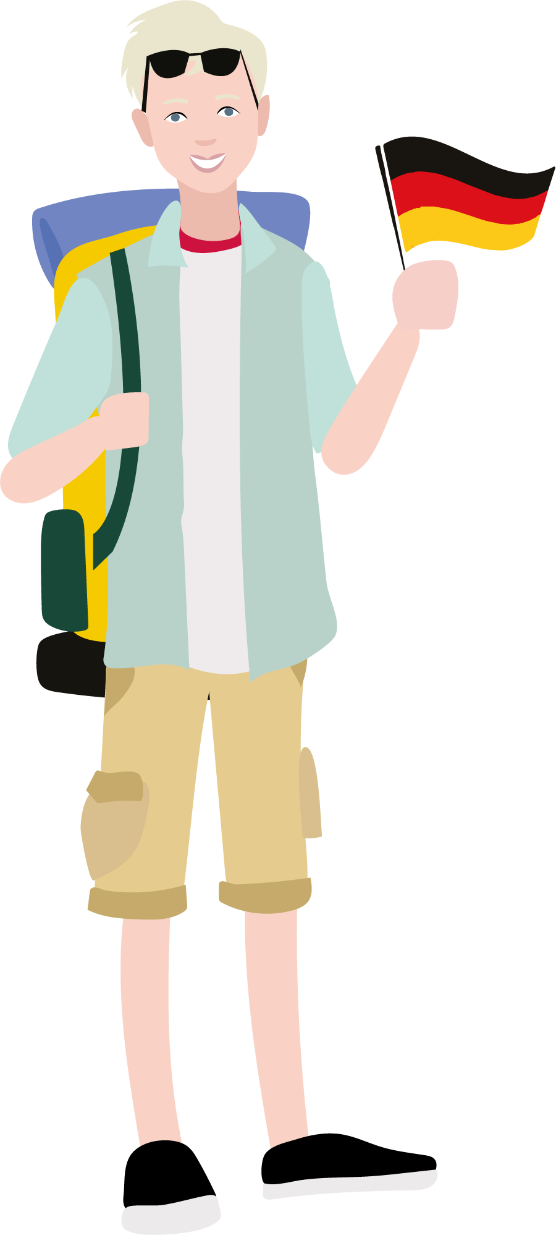
Karl
The Thrill-seeker
Hallo, I’m Karl, a adventure-loving traveller from Germany. I’m 22 and excited to experience as much authenticity and active adventure as Uganda has to offer. I love an adrenaline rush, though I’m serious about the impact my activities have on the environment - after all, we all need to help protect the planet! I’ve saved up for an Ugandan adventure, and I’m more interested in meaningful memories than luxury and comfort.
Notes:
How to facilitate this slide:
Let a participant read out this bio. Ask him/her whether they know people that resemble Karl.

Slide 21
Sylvia
The Ugandan Abroad
Hello, my name is Sylvia. Originally from Kampala, I moved to Belgium with my family seven years ago, and have been living in Europe since. My sister is getting married soon, and we’ll be travelling to Uganda to celebrate with her - we can’t wait! After the wedding we plan to tour our homeland to reconnect with Ugandan culture, introduce our children to their heritage, and spend quality time together as a family.
Notes:
How to facilitate this slide:
Let a participant read out this bio. Ask him/her whether they know people that resemble Sylvia.

Slide 22
Theo
The Wildlife Fanatic
Hoi, my name is Theo. I have a passion for two things: wildlife and travel! As a serious birder living in the Netherlands, I have returned to Africa many times. I join small groups of wildlife and safari enthusiasts each year, to experience Africa’s natural beauty. The next experience on my bucket list is to spot a Shoebill!
Notes:
How to facilitate this slide:
Ask a participant to read out this bio. Ask him/her whether they know people that resemble Theo.

Slide 23
Emily
The Leisure Sightseer
Good day! I’m Emily - recently retired and residing in the United Kingdom with my husband, George. We’re so excited to finally plan the holidays we have been dreaming about for years, especially now that we have the time and savings to travel for extended periods of time. We hope to visit as many “must-see” destinations on or travels as possible. We travel at a slower pace these days, comfort is important to us.
Notes:
How to facilitate this slide:
Ask a participant to read out this bio. Ask him/her whether they know people that resemble Emily.

Slide 24
A marketing persona is a profile of your ideal customer. You can build out one or more personas for your business, and use them as a guideline when planning your digital marketing activities and content.
Notes:
How to facilitate this slide:
Use this slide as a bridge between the customer digital marketing journey concept, and personas. This slide leads participants into the practical assignment.

Slide 25
Who are they? (Demographic and Behaviour) | What do they want and desire when booking travel? | What are their concerns and fears when booking travel? | What do they look for in a tour operator?
Country:
Age:
Family and Relationship:
How often do they travel?
How far in advance do they book?
Notes:
How to facilitate this slide:
Populate this template an example version of a persona using a facilitator or a volunteer participant as the subject.
Useful talking points and angles to consider:
Having the location and age of our personas is important (it helps us know how to speak to them, which budgets they have, and what their preferences are), but, those are not enough detail to create targeted marketing messaging that will lead them through all stages of the customer journey.

Slide 26
In groups, build a marketing persona using market information and group knowledge. Present your persona.
Group Assignment
5
20
5
5 Minute Preparation
Read the market research summary to gather insight about your Traveller Profile
20 Minutes Discussion
Complete the table by filling out details about your persona. Try to get at least two points per column.
5 Minutes Sharing per group
Nominate a team member to share your findings.
Notes:
Time Allowance
Minimum 60 minutes depending on number of groups and participants
Learning outcome for this assignment:
Participants are able to apply the process of building a persona to their own business and target markets
How to facilitate this assignment:
Assign one of the four traveller profiles to each group, along with supporting information
Participants break away in their groups, and have 20 minutes to add information to the blank persona template, building a complete persona for their traveller
Each group nominates a representative to present their persona to the rest of the room. Each group has 5 minutes to share their findings
Give participants opportunity to share feedback and review the personas of other groups to make it conversational and to encourage learning from each other
Complete the assignment with a “what did we learn” moment. Participants should be encouraged to apply this to their own businesses within their own teams after the session.
Prepare:
Participants should already be assigned to groups
Each group must be provided with a print-out of the blank persona template for their traveller type
Optionally, participants can also be provided with supporting marketing information (e.g. CBI’s European market information) to help build their persona. The Market information can be found here: https://drive.google.com/drive/folders/12ku2NI6qpmLLMtIElmsd128C3ew3VYal?usp=sharing

Slide 27
Karl
The Thrill-seeker
Who are they? (Demographic and Behaviour) | What do they want and Desire when booking travel? | What are their concerns and fears when booking travel? | What do they look for in a tour company?
Country: Germany
Age: Early twenties
Family and Relationship: Single
How often do they travel? Internationally, twice a year for 3-4 weeks
How far in advance do they book? 1-2 months

Slide 28
Sylvia
Ugandan Abroad
Who are they? (Demographic and Behaviour) | What do they want and Desire when booking travel? | What are their concerns and fears when booking travel? | What do they look for in a tour company?
Country: Belgium
Age: 37
Family and Relationship: Married, 2 children
How often do they travel? Return to Uganda every +-3 years
How far in advance do they book? 6 months

Slide 29
Theo
Wildlife Fanatic
Who are they? (Demographic and Behaviour) | What do they want and Desire when booking travel? | What are their concerns and fears when booking travel? | What do they look for in a tour company?
Country: Netherlands
Age: 45
Family and Relationship: Married
How often do they travel? Internationally 1-2 times per year
How far in advance do they book? 6-8 months

Slide 30
Emily
Leisure Sightseer
Who are they? (Demographic and Behaviour) | What do they want and Desire when booking travel? | What are their concerns and fears when booking travel? | What do they look for in a tour company?
Country: UK
Age: 65
Family and Relationship: Married
How often do they travel? Internationally once per year
How far in advance do they book? 6-8 months

Slide 31
What about B2B?
Like with travellers, online personas can be developed for international travel agents and buyers
How are their needs and challenges different from that of a traveller persona?
Notes:
How to facilitate this slide:
While the course content is primarily focussed on marketing to travel to a B2C audience (selling to the traveller directly), it is worth acknowledging that many tour operators sell to agents or buyers (B2B) as a primary or important market.
This slide explains the importance of creating online personas for B2B markets, even though they will look different from traveller market segments
Useful talking points and angles to consider:
Discuss the the differences between online personas of travellers and travel buyers (focus on the individual, rather than company)
Examples of B2B Persona:
Anna, the new business development manager at ABC Tours in Germany. Anna is interested in partnering with reliable local tour operators in Uganda. She values professional communication, and unique products to sell to her clients in Europe. Her concerns include the ability for the local operator to communicate effectively and quickly, and responsiveness if anything goes wrong during a tour. She is looking for a established local partner, with sustainability certification, a network of quality products, and a track record of happy clients.

Slide 32
?
Questions and Answers
?
?

Slide 33
Module 2
Branding your business
Notes:
About this module
This module introduces participants to the importance of creating and maintaining a professional brand, when marketing a tour operator business online. It encourages participants to think about the meaning behind the emotional connection travellers form with tour operators, and how branding can help build a relationship with market segments.
Why social media is important for tour operators
Best practices for using Facebook, Instagram and YouTube
How much time to spend on this module
Allow 45-60 minutes for facilitation and discussion, excluding the assignment at the end of the module.

Slide 34
Course Modules
Module 1
Module 5
Digital Marketing Foundations
Digital Marketing Toolkit: SEO and Blogging
Module 2
Module 6
Branding for Digital Success
Digital Marketing Toolkit: Reviews and Online Booking Platforms (OTAs)
Module 3
Module 7
Digital Marketing Toolkit: Your website
Digital Marketing Toolkit: Email Marketing
Module 4
Module 8
Digital Marketing Toolkit: Social media marketing
Practical Technical Skills (Using technologies like Zoom)

Slide 35
What you’ll learn
Knowledge
Understand why branding is important for successful marketing
Understand what makes a good brand
Skills
How to use a branding checklist to create or improve your brand identity
How to plan your brand identity

Slide 36
!
€
$
UGX
BOOK
Sees your brand for the first time, starts to develop a feeling and idea of your company
Recognises your brand. Feels familiar and starts to develop trust
Sees themselves as consumers of your brand and company, and what you stand for
Trusts your brand enough to choose you over competitors
Awareness
Interest
Desire
Action
Notes:
How to facilitate this slide:
This slide leverages the customer journey discussed in Module one, to explain the value of a strong brand throughout the different stages.
A strong brand is recognisable, and builds a relationship with travellers over time, as they interact with the brand
Useful talking points and angles to consider:
Awareness: First impressions count - the first time someone sees your company name or logo in an advert or social media posts, they will develop a feeling about it. That feeling won’t necessarily make them book a tour right then and there, but it can leave a strong impression.
Interest: As they encounter your company’s logo, content and messages more frequently, they will develop a liking and loyalty to what you say and what you stand for
Desire: At this stage, someone believes in what your company stands for, and start developing the need to travel with you, and to experience what you offer
Action: They are ready to book a trip to Uganda, and they only have one brand in mind - yours!

Slide 37
Group Discussion
What is a brand?
Notes:
How to facilitate this slide:
The purpose of this discussion is to look at some common misconceptions about branding, and to start creating an understanding the difference between branding and identity/logo design.
Useful talking points and angles to consider:
A brand is not:
Just your company’s logo
A symbol (like a gorilla, or bird)
A brand is:
Your company’s identity - how others see your company, and how your company make them feel?
How your company is communicated to people (“look and feel”, words, images)

Slide 38
Notes:
How to facilitate this slide:
Use Coca-Cola as a case study about what a brand.
The take-away must be that a string brand is recognizable and memorable. This takes clear messaging and consistency.
Useful talking points and angles to consider:
Ask the participants: Who can tell me what brand this is? Participants will recognise Coke as the brand.
Play into the question - “Are you sure? How did you know that, there’s no logo?!”
Acknowledge that it is Coke. Do a follow up question:
“How do you feel when you look at this image of think about Coke? What thoughts, images, or words come into your head?”

Slide 39
What is a brand?
BRANDING
How you communicate points 1-4 to your customer
Company Name
Logo
Tagline
Colours
Fonts
Images
Words and Messages
Who you are as a company
What is your mission?
Why does your company exist?
What makes you unique?
How do people feel when they travel with you?
Notes:
How to facilitate this slide:
Show participants the connection between a company’s mission and values, and how that translates to the things we often think about when we hear “brand”, like colours, logos and fonts

Slide 40
Case study: Much Better Adventures
Who you are as a company
Active and fun holidays
For Adventurous People
Serious about sustainability
Notes:
How to facilitate this slide:
Use the UK-based online tour operator, Much Better Adventures a s case study to illustrate how a company’s values, impacts what we see in their logo and design

Slide 41
A clear tagline
Notes:
How to facilitate this slide:
Much Better Adventures is clear about its purpose and what what they stand for. They have a simple, short sentence to describe this
Slide References:
The screenshot is Much Better Adventures’ Home Page

Slide 42
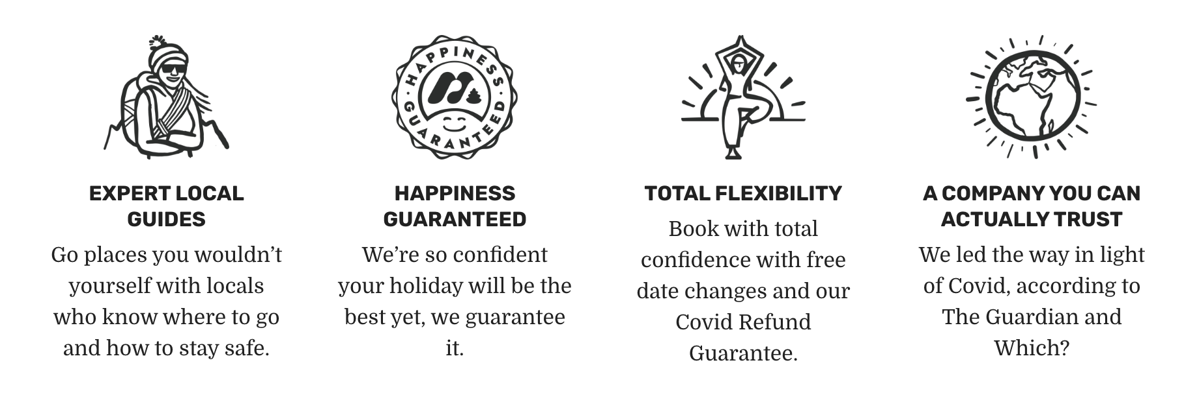
Informal use of language
Notes:
How to facilitate this slide:
Much Better Adventures use casual and informal language. They are not pretentious, and speak to travellers who value simplicity.
Slide References:
The screenshot is Much Better Adventures’ Home Page

Slide 43
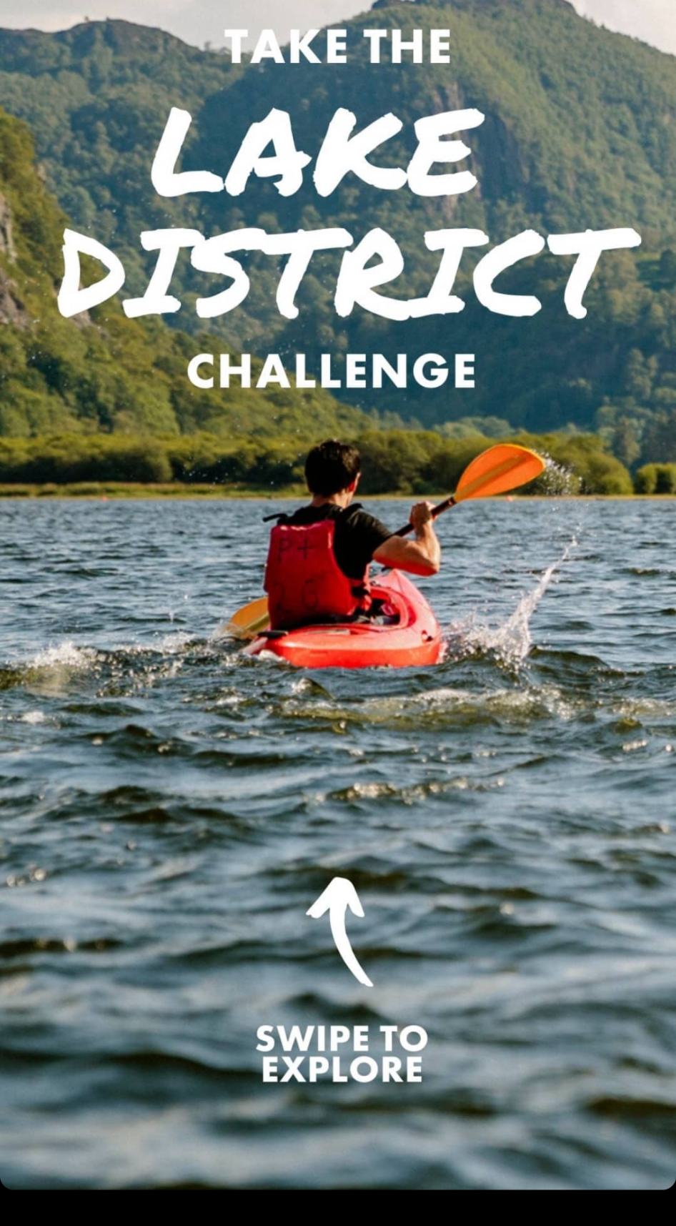
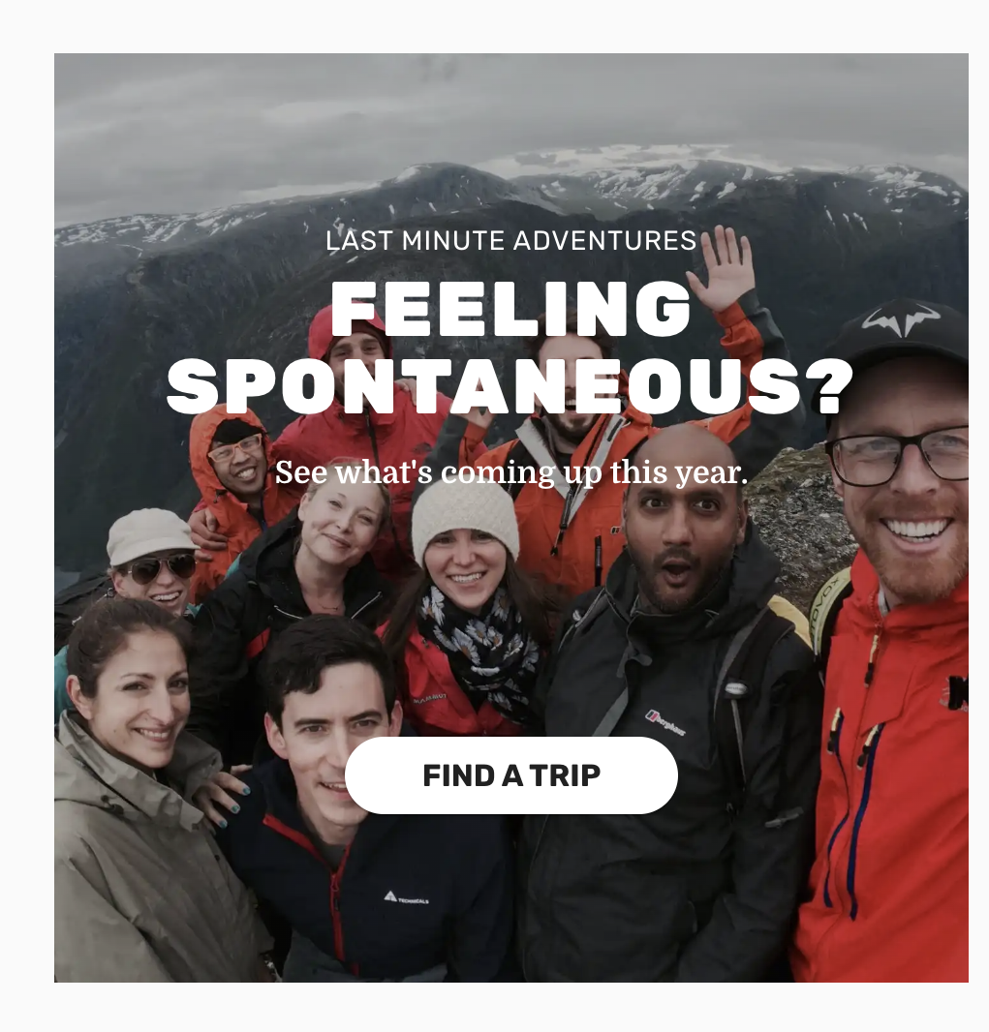
Adventurous fonts and styles
Notes:
How to facilitate this slide:
Much Better Adventures use bold, informal and hand-drawn fonts to match the adventurous brand
Slide References:
The screenshot is from Much Better Adventures’ social media posts

Slide 44
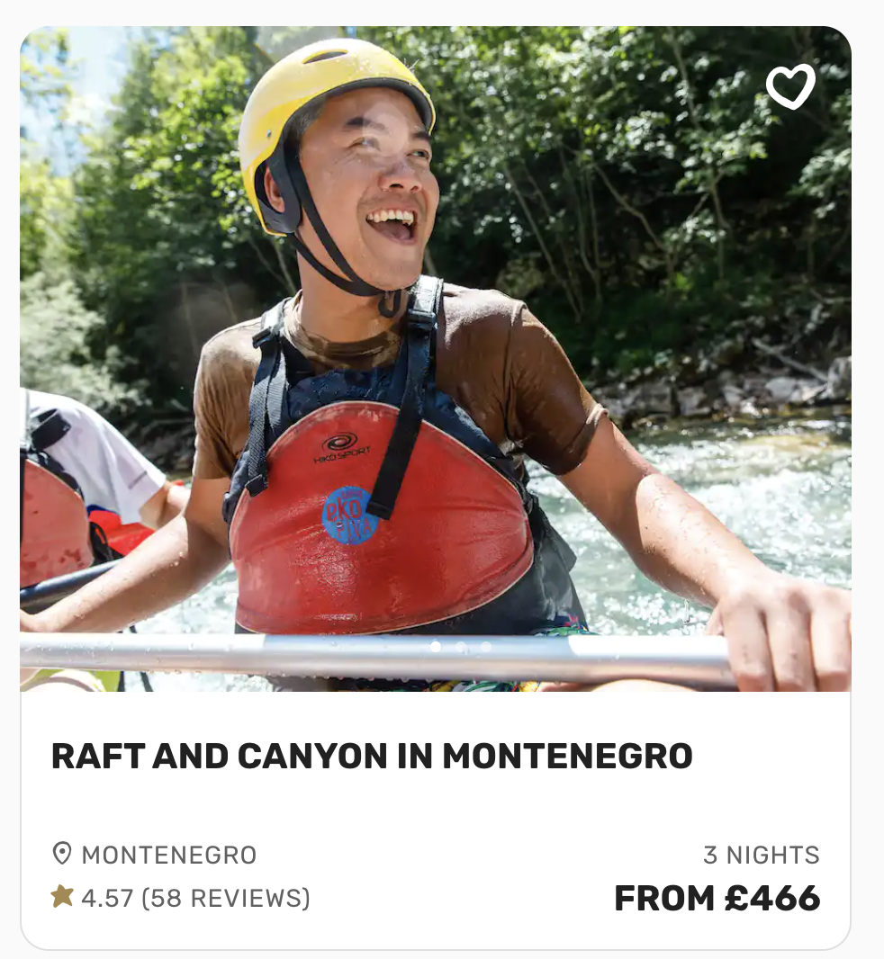
Communicating “fun” through images
Notes:
How to facilitate this slide:
Much Better Adventures use images of laughing guests (having adventure, while having fun)
Slide References:
The screenshot is from Much Better Adventures’ website

Slide 45
Why branding is important
A good brand indicates professionalism and trust
Branding makes your business memorable and recognizable
Brands communicate on an emotional level
Notes:
How to facilitate this slide:
Some participants may see branding as a luxury, use this content to convince them of the value of a good brand
Useful talking points and angles to consider:
The vectorstock image is intentional - can be used as an example that simply having a good graphic (which is not difficult or expensive these days..) is not automatically a meaningful brand.

Slide 46
What makes a good brand?
Simple: Easy to understand and recognise
Consistent: Used in the same way over time, across your channels and collateral
Notes:
How to facilitate this slide:
The following 3 slides explain why complex logos rarely work well. A common mistake is for tour operators to include “everything” about their destination in their logo. The best logos, are simple.
Useful talking points and angles to consider:
MTN has an example of a simple, yet recognisable logo and identity

Slide 47
Notes:
How to facilitate this slide:
The example from Malaysia is meant to represent an ineffective logo design from the tourism industry. This logo received worldwide criticism. It is an example of how despite a big budget, a brand identity can become overly complex when too many ideas are included and forced into the design.
Useful talking points and angles to consider:
Ask participants what the think. Regardless of whether some people in the room like this logo, the opinions from the design and marketing industries were all negative. This logo is objectively poorly designed.
Article from BBC: https://www.bbc.com/news/world-asia-42869491

Slide 48
Notes:
How to facilitate this slide:
This slide represents two examples of strong branding in tourism, both using symbolic images from the destination, and a simple colour palette. The purpose is to show how branding can be intentional without complex.
Useful talking points and angles to consider:
This slide represents two examples of strong branding in tourism, both using symbolic images from the destination, and a simple colour palette. The purpose is to show how branding can be intentional without complex.
The shape in the “%” sign of New Zealand is a Map of the country
The the “A”’s of Rwanda, there is use of Rwandan traditional shapes, but could also represent Volcanos
These logos were done by professional agencies, and had huge budgets, and therefore they are worth looking at as case studies and best practices

Slide 49
A brand checklist for your business

Slide 50
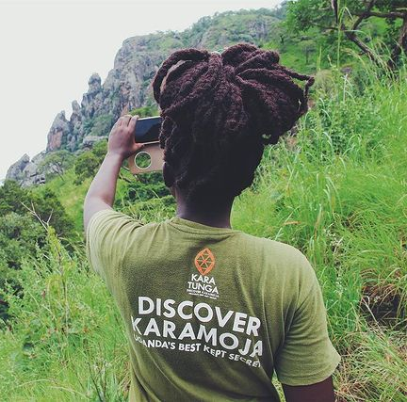
Your logo
Don’t try to include too many elements and concepts - keep it simple
Make sure it can be viewed in different sizes (small to big)
Make sure it can be used in different formats (social media icons, website, clothing)
Notes:
How to facilitate this slide:
Kara Tunga’s example showcases how a logo can be used in different formats when designed intentionally - from a full logo for websites and marketing materials, to a “icon” logo for social media avatars, and versions for printed material and clothing. A logo designer should offer a tour operator advice on these options, as well as the correct file formats.

Slide 51
Colours
Did you know that 9% of top brands use no more than 2 colours in their logos?
Colours make you recognisable, but also create emotions
Choose colours carefully, use them wisely. Use the same colours on all your documents and designs
Notes:
How to facilitate this slide:
Show participants why colour is important in branding - not just because some colours look nicer than others, there are some rules about using colours - as we see in the image on this slide.

Slide 52
Fonts
Fonts create emotions too!
Don’t use too many fonts
Make sure fonts are easy to read and understand
make sure your fonts match your brand’s personality
Fun: Hand drawn or Cursive
Luxury: Elegant and fine
Adventurous: Round and Bold
Notes:
How to facilitate this slide:
Practical examples of best practices for fonts could also include:
To avoid overused fonts and styles like Comic Sans, or Microsoft Wordart (these appear unprofessional, rather rely on tools like Canva for guidance on fonts and good design templates)
Stretched logos: Avoid stretching logos out of proportion to fit a frame, and don’t stretch logos bigger than they are meant to (if you see the logo is losing quality and appearing blurry, you have made it too big :)

Slide 53
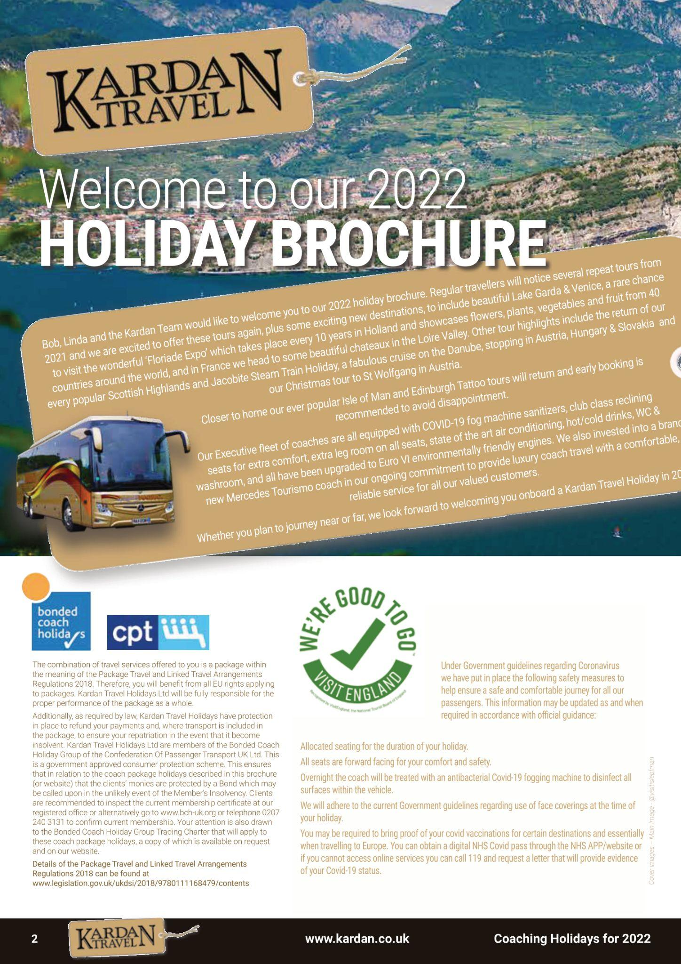
Unclear value
Too much text
Difficult to read
No emotion
Notes:
How to facilitate this slide:
The following two slides show examples of brochure designs by tour companies. Discuss this with participants to draw opinions from the room, and to highlight positives and negatives about both. The intention is show this slide’s examples as less professional with more design mistakes.

Slide 54
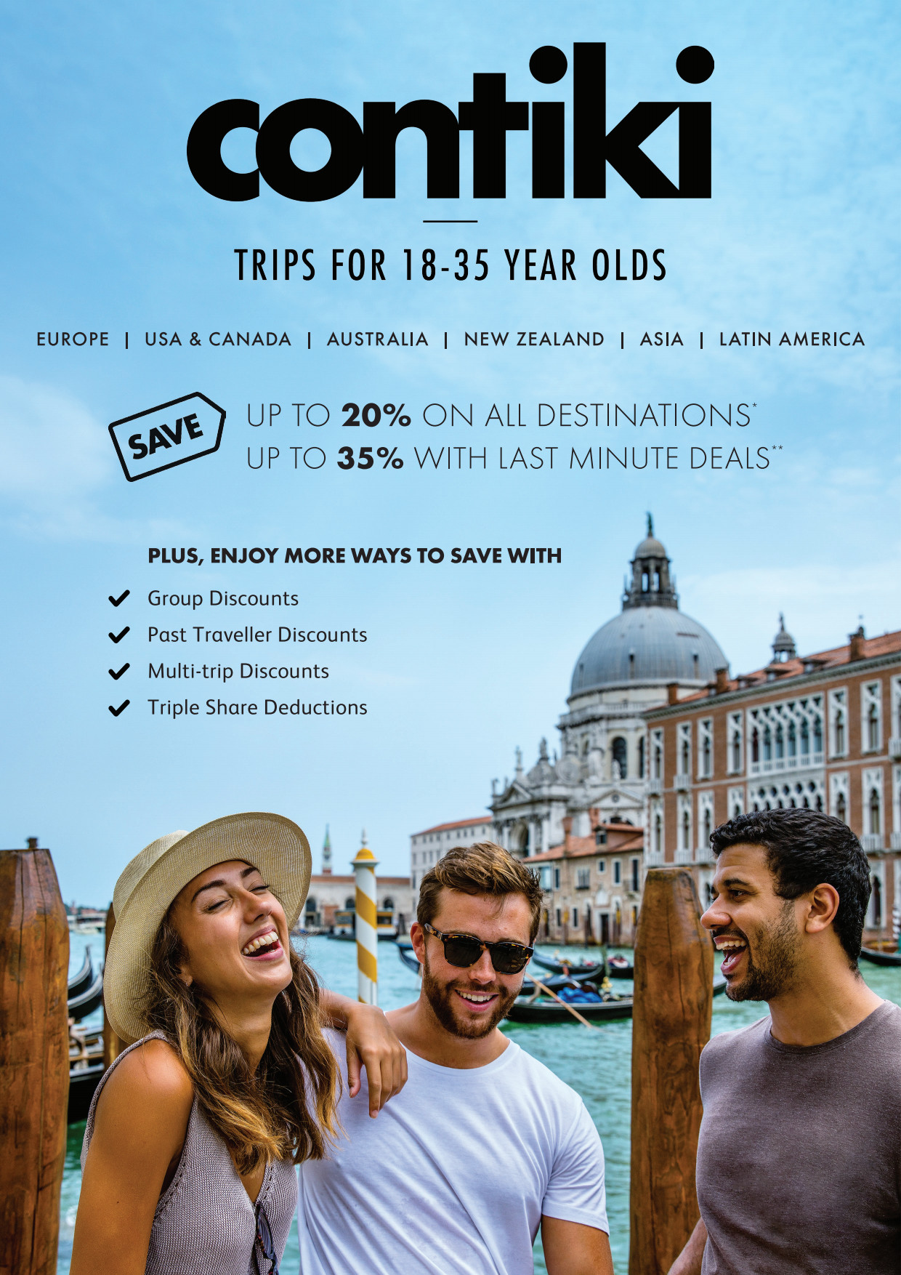
Value proposition an clear information
Sales hook (discount and pricing)
Single image, showing the target market and destination
Notes:
How to facilitate this slide:
Discuss why this brochure design is better than the previous one. The learning outcome for participants is not to want to say too much on promotional material. That can lead to crowded and unprofessional design.

Slide 55
Preparing your brand for Digital Marketing activities

Slide 56
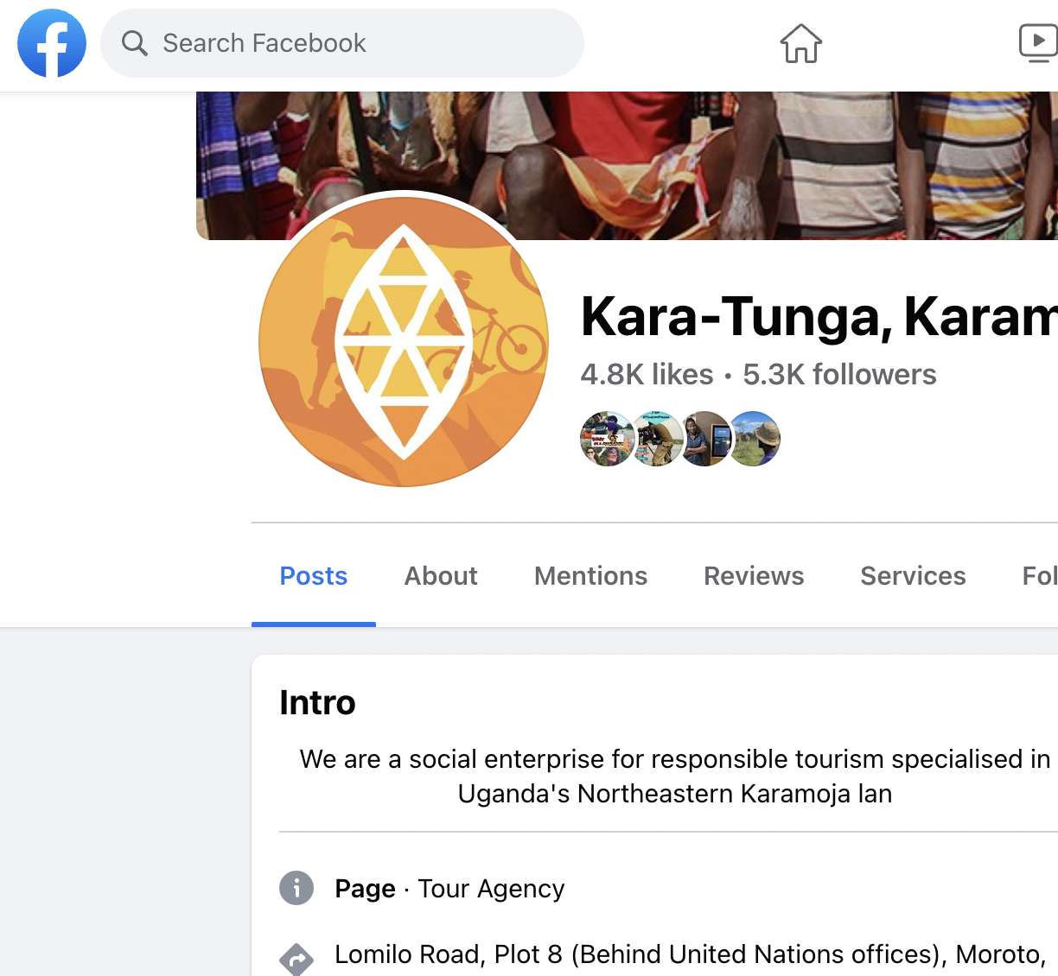
Profile pictures and “Avatars”
An Avatar is used to show your logo on social media platforms and other sites. It is usually a small square or circle
Make sure your logo can be cropped as a square or a circle, without cutting off parts of the design
Tip: Ask your designer to leave some space around the logo
Notes:
How to facilitate this slide:
The purpose of this slide is to show how a logo needs to be adaptable for online use. Kara Tunga has a variation of their full logo, used for Avatars and Profile pictures

Slide 57
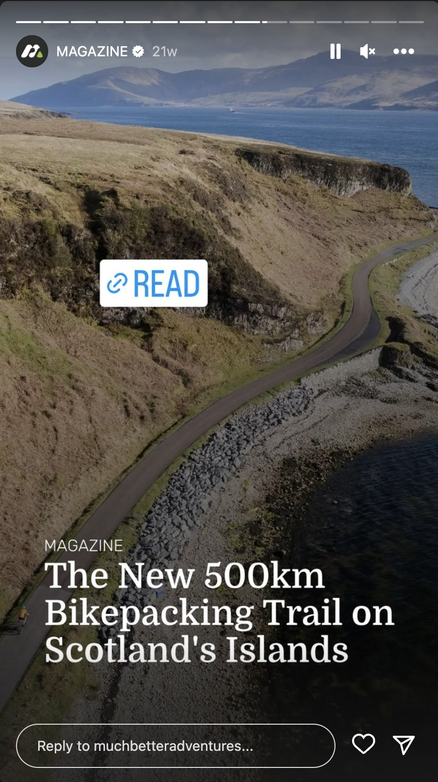
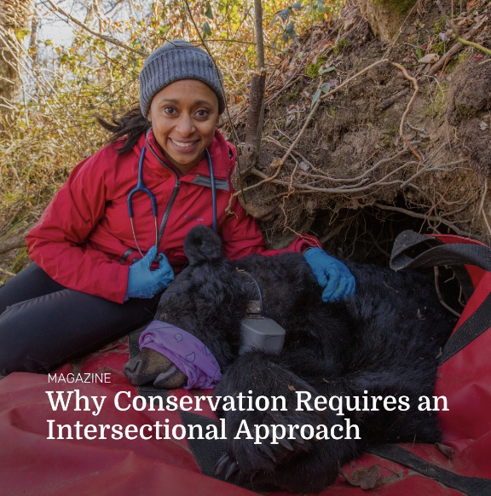
Social Media sizes and layouts
Facebook Cover Photo
Square graphics for Instagram and Facebook
Tall graphics for Instagram Stories
Search for “social media dimensions 2024”
Notes:
How to facilitate this slide:
Introduce participants to the different sizes and formats of online content. The example uses Instagram, to show square posts, and portrait “stories”. When developing a brand, companies need to create content for different platforms and screens.

Slide 58
Assignment
What’s your brand personality?
From the list choose the 10 words that describes your business (the list will be shown on the next slide, and will remain on the screen)
Narrow it down to 4 words
Which colours, style of fonts, and images will complement the words you have chosen?
15
3
15 Minutes
Use a notepad to complete this exercise, writing down your thoughts and ideas, following the 3 points above
3 Minutes Feedback
Volunteer if you’d like to share yours!
Notes:
Learning outcome for this assignment:
Participants are able to describe their company brands using a vocabulary of words, and visualize their brand identities
How to facilitate this assignment:
This can be facilitated in groups, using made-up companies as examples, or individually, using the participants’ real company and brand
Participants break away in their groups, and have 15 minutes to write down their answers to the three bullets on this slide
Each groups has to nominate a person to present their persona and share their findings in 5 minutes
Give participants opportunity to share feedback and review the concepts of other groups to make it conversational and to encourage learning from each other
Complete the assignment with a “what did we learn” moment. Participants should be encouraged to apply this to their own businesses within their own teams after the session.
Prepare:
Participants should already be assigned to groups if relevant
Show the following slide on the screen during the activity.

Slide 59
Assignment
From the list choose the 10 words that describes your business (the list will be shown on the next slide, and will remain on the screen)
Narrow it down to 4 words
Which colours, style of fonts, and images will complement the words you have chosen?
Accommodating
Active
Adaptable
Adventurous
Bold
Brave
Calm
Carefree
Caring
Casual
Cheerful
Cool
Creative
Curious
Disruptive
Easygoing
Elegant
Energetic
Exclusive
Fearless
Feminine
Flexible
Formal
Fun Helpful
Humble
Luxurious
Modern
Natural
Old-Fashioned
Rebellious
Responsible
Romantic
Serious
Traditional
Youthful
Notes:
Show this slide on the screen during the activity.
Learning outcome for this assignment:
Participants are able to describe their company brands using a vocabulary of words, and visualize their brand identities
How to facilitate this assignment:
This can be facilitated in groups, using made-up companies as examples, or individually, using the participants’ real company and brand
Participants break away in their groups, and have 15 minutes to write down their answers to the three bullets on this slide
Each groups has to nominate a person to present their persona and share their findings in 5 minutes
Give participants opportunity to share feedback and review the concepts of other groups to make it conversational and to encourage learning from each other
Complete the assignment with a “what did we learn” moment. Participants should be encouraged to apply this to their own businesses within their own teams after the session.
Prepare:
Participants should already be assigned to groups if relevant

Slide 60
?
Questions and Answers
?
?

Slide 61
Module 3
Digital Marketing Toolkit:
Your Website
Notes:
About this module
This module covers best practices for planning and developing a professional and user-friendly tour operator website. The module encourages participants to think about websites as a sales tool, rather than simply an online information source. Key topics covered:
Navigation and Usability
How to approach website budgets
Mobility and Speed
How to make a strong first impression
Live Chat and Messaging
How much time to spend on this module
Allow 45 - 60 minutes for facilitation and discussion, excluding the assignment at the end of the module.

Slide 62
Course Modules
Module 1
Module 5
Digital Marketing Foundations
Digital Marketing Toolkit: SEO and Blogging
Module 2
Module 6
Branding for Digital Success
Digital Marketing Toolkit: Reviews and Online Booking Platforms (OTAs)
Module 3
Module 7
Digital Marketing Toolkit: Your website
Digital Marketing Toolkit: Email Marketing
Module 4
Module 8
Digital Marketing Toolkit: Social media marketing
Practical Technical Skills (Using technologies like Zoom)
Notes:
How to facilitate this slide:
This slide introduces and explains the course outline to everyone in the room or in the online session. The purpose of the course outline slide is to assign a clear learning path for participants, and at the start of each module, to create context around where the content fits into the broader learner journey.

Slide 63
Purpose of the session
Gain a deeper understanding about the purpose of having a website, and what the standards are for having a professional website in the current age
Strategically think about your own website content and structure, rather than simply replicating what others are doing
Notes:
How to introduce this training session:
Now that we have defined who we plan to reach through our digital marketing efforts, let’s take a deeper look at the how you can reach them. There are different channels you can include in your Digital Marketing “Toolkit”, each with its own advantages. Arguably the most important of all, is a professional website.

Slide 64
What you’ll learn
Knowledge
Understanding of the role of a website in the customer journey
Understanding how to create a budget for website projects
Understanding of website best practices
Skills
Being able to assess a website and develop an improvement plan
Notes:
Useful talking points and angles to consider:
We’ll discuss the benefits of having a professional website for your business, and how your website plays a role in your marketing through each step of the customer journey.
We’ll cover best website practices for tour operators, and learn how to develop an improvement plan for your own website.
Gain a deeper understanding about the purpose of having a website, and what the standards are for having a professional website in the current age
Strategically think about your own website content and structure - don’t just replicate what others are doing

Slide 65
!
€
$
UGX
BOOK
Blog Articles
Destination pages
Itinerary and product pages. Live Chat.
About Page and FAQs. Reviews. Live Chat.
Enquiry page or booking Engine
Awareness
Interest
Desire
Action
Notes:
How to facilitate this slide:
A common mistake on tour operator websites, is assuming that visitors will spend a lot of time searching for relevant information on a website, or that they will only visit a website once - when they book. In reality, a traveller will visit a website multiple times throughout the customer journey, each time with different needs.
Walk participants through the 4 stages of the customer journey, at each stage sharing examples of the types of pages or content that will be useful or relevant to the visitor.
Useful talking points and angles to consider:
Awareness: Visitors might find blog articles on your website via search engines while doing research on specific topics, or asking broad questions about your destination or product.
Interest: Visitors might want to look at specific sample itineraries, to get a better idea of potential experiences they can expect to find in Uganda. At this stage they might even use Live Chat to ask a question about a specific destination or experience.
Desire: Visitors are beyond initial research and seeking information to help them make a decision about the company they plan to book with. They might want to look at your company’s profile and team page, take the time to read your FAQs and booking terms, or have a conversation with you over live chat about some practical questions (this will also help them to verify that you are available and reliable in communication)
Action: Visitors might send an official enquiry with their travel needs, asking for a quote. If you use a booking engine, they might book and pay for an experience directly.

Slide 66
Group Discussion
With so many online channels available, how important is your website really? Why?
Notes:
How to facilitate this slide:
Use this open-ended, leading question as an ice-breaker for the session, to encourage participants to share opinions and inputs. Give maximum 5 minutes to this discussion, and note down relevant points made by participants. Use this as a segue to answer the question with the following slide.
Keep in mind that with new social media channels, and Online Travel Agents, participants might see the value of their website in their digital marketing Toolkit as less important. The purpose of this module is to challenge that.

Slide 67
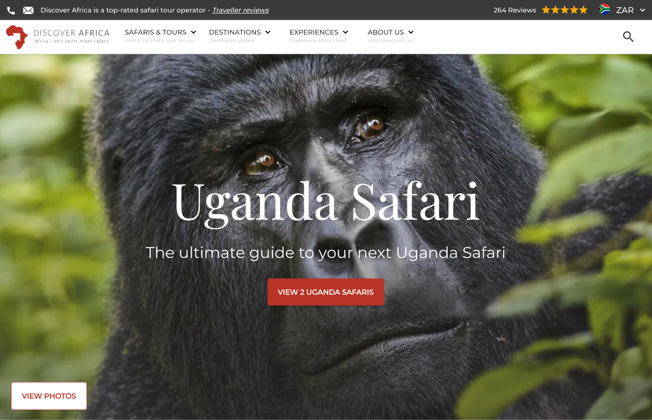
A website is your brand’s most valuable online asset
Full control and ownership
Your point of conversion
Let’s look at 8 best practices for your website:
Notes:
How to facilitate this slide:
Social media channels, and online platforms present certain risk for tour operator: They are built to expose to visitors to alternative and competitor products, or they often take commission from bookings. The operators’ website on the other, offers full control and ownership. It’s the one place the operator has full control of how they are presented, without sharing attention or exposure with other brands. It’s also most likely the place of conversion (while social media channels are powerful tools for creating awareness and driving traffic to the operator’s website, it’s not often a platform for converting bookings.
The screenshot shows a snippet of Discover Africa’s’ website

Slide 68
Design and Navigation: Sometimes, less is more
Don’t add pages and menu items for the sake if adding them, or because your templates allows it
Each page and menu item should have purpose and value
Heard of Hick’s Law?
Notes:
How to facilitate this slide:
Help participants to shape a healthy value perception around web design and development - having more content, pages, and functionality does not necessarily mean that your website is good, or that you received good value from your website provider. Focus on quality over quantity.
Useful talking points and angles to consider:
Ask: “Which pages and feature will be helpful and valuable to your persona?”
Use Hick’s Law as an example (the illustration on the left). The more options you offer someone, the longer they take to make a decision. Keep your website navigation simple, only show links, navigation items and content with a purpose.

Slide 69
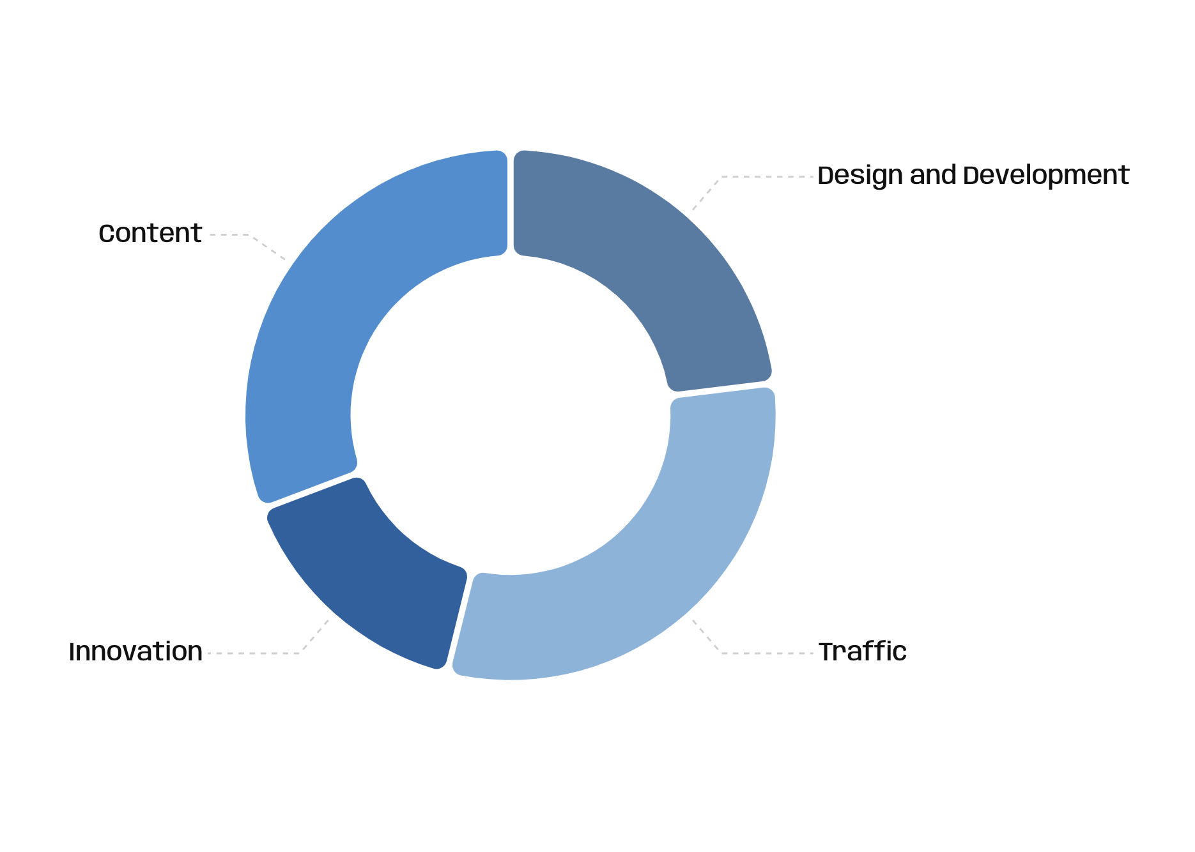
2. Approaching your website budget
Make provision for new content, marketing activities and new features/innovation
Budget for quality, secure hosting
Invest in a good content management system - being able to make changes yourself will save you money in the long term
Notes:
How to facilitate this slide:
The purpose of this slide is to educate participants about how to budget for a web design project, and to better use budget for website success.
Useful talking points and angles to consider:
Most brands take their website budget, and split it between design, and development, leaving little room for creating or buying good content, quality hosting, or most important for feature updates and upgrades and technology changes.
The pie chart shows a suggested model for website budget planning, clearly showing generous budget allocated to “innovation” (being able to afford technical updates and enhancements) and “traffic” (having budget left for marketing activities). There’s not use having a beautiful website if you no one sees it, or if it is irrelevant or broken in two years. Note that the exact split between these parts should not be taken too literally. The purpose is simply to show participants how they should budget, and that a website costs more than just design and development - it needs to be kept relevant and up to date, and that costs money.
Encourage participants to work with webmasters who understand the tourism industry
Practical case study: compare a website project to buying a safari vehicle - you need to budget for fuel, services, and repairs to make sure you get value from your vehicle.

Slide 70
3. Mobile, security and speed
82% of all travel bookings in 2018 were made online via a mobile app or website, without human interaction.
Important for your website visitors, but also for search engines like Google.
There’s no value in having a beautiful website if it’s not enjoyable to use it…
Notes:
How to facilitate this slide:
Address Mobility (how mobile friendly a website is, security (how secure a website is) and speed (how fast a website loads) as one concept: ‘Website performance”
The purpose of the slide is to confirm the importance of these 3 factors in web design.
The following slide of Lazy Lagoon Island Lodge discusses a practical example of a website with a good Speed and Mobile score
Useful talking points and angles to consider:
Lead with a statistic about % of mobile bookings in 2018 (this includes all travel sites, including airlines, which is why this figure is quite high). This % will likely increase in the coming years as mobile usage and the quality of mobile booking experience increases.
Having a mobile friendly website is important for your visitor (if they visit your website from a phone, but it does not work properly, they will leave), but it’s also important for your search engine ranking - Google now looks at how mobile friendly a website is as an official ranking factor!

Slide 71
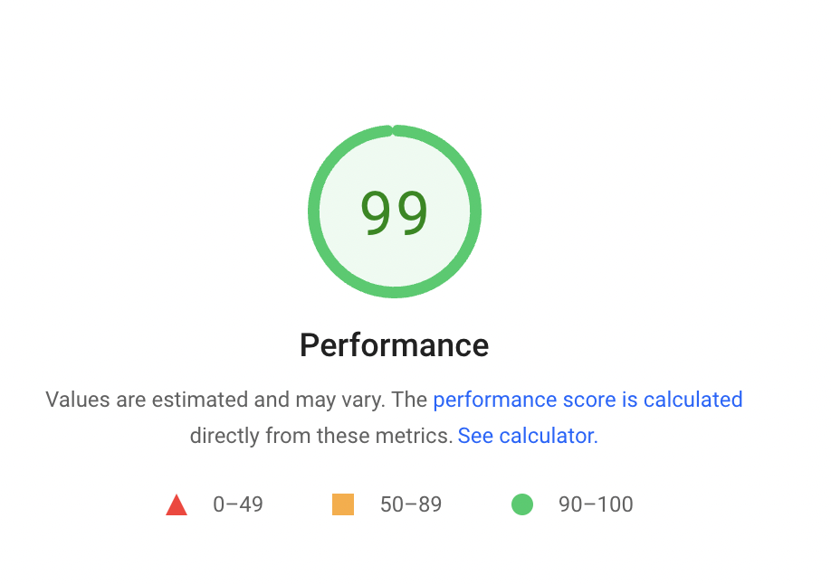
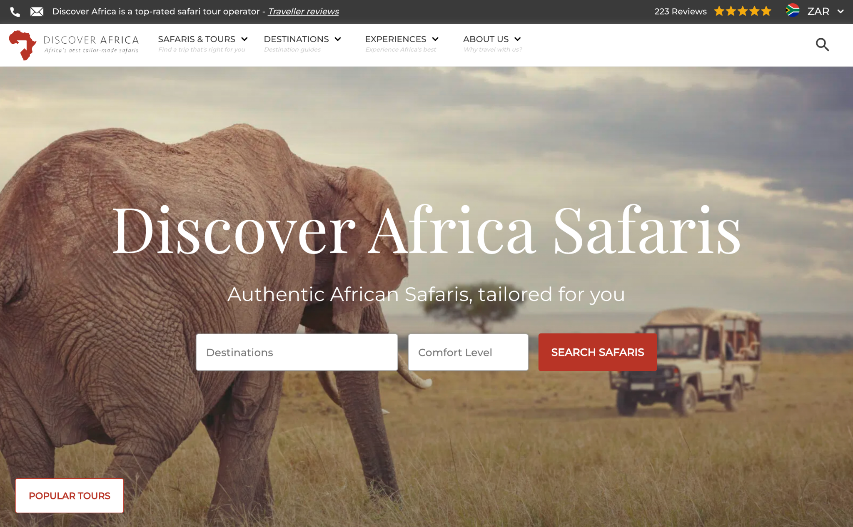
Notes:
How to facilitate this slide:
Use a real case study to show best practice for how a website can have modern design with big photos, and still perform well. The screenshot is from Discover Africa, a tour operator based in South Africa
This slide should provide the context, the next two slides show results from speed and mobile tests of this site.
Useful talking points and angles to consider:
Discover Africa use big banner images and bold photography to give their website visitors a real taste of their product. This type of content usually takes long to download, and can slow down a website. Lazy Lagoon is a great example of how a website can be built to use big visuals, without slowing the loading speed, or sacrificing mobility.

Slide 72
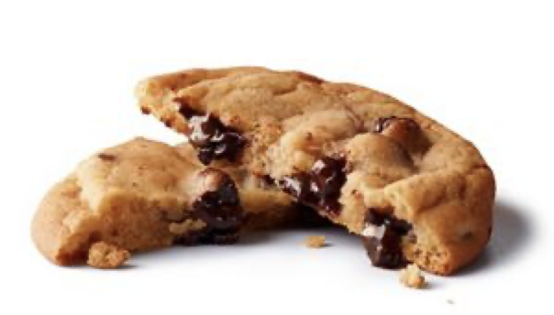
4. Website Privacy
You need to let visitors know how you will collect and use their information (Such as contact forms & analytics)
Don’t have a privacy policy yet?
freeprivacypolicy.com
Notes:
How to facilitate this slide:
Introduce the importance of having a privacy policy on a tour operator website. This is especially important to comply with international laws that exist to protect people’s information.
Useful talking points and angles to consider:
A general feeling in the room might be that a privacy policy is not important, or that it only applies for business in Europe. Guide participants through the importance of complying with privacy laws, and the requirement for all business who attract website visitors from countries outside of Uganda.
An example is Europe’s GDPR law (General Data Protection Regulation). This law requires all business who target visitors in European countries, to follow specific guidelines around how to gather, process and store personal information about their website visitors. For a simple summary of GDPR, view this video.

Slide 73
5. The Importance of Good First Impressions
A dose of reality: Littledata surveyed over 400 travel websites in 2020 and found that the average pages viewed per session was 2.6 (people viewed under 3 pages, on average, before leaving a website)
Notes:
How to facilitate this slide:
Help participants understand that visitors do not spend a lot of time browsing a website - businesses have a limited amount of attention and time to communicate their message before a visitor might leave the website and move on to another. Therefore it is important to make a strong first impression on your home page, telling the visitor what they offer, and why they do it better than their competition.
this slide is followed by a practical exercise to make this point clear
Useful talking points and angles to consider:
The photo of the shaking hands can be used to compare a company’s home page, with meeting a client for the first time. Ask participants how the will act when meeting a client (Smile? Stand up straight? Look them in the eye to greet them?). A website is an online version of meeting a client - it needs to give a pleasant and clear impression of the business.

Slide 74
Group Discussion
15 seconds
What do they offer, who do they cater for, what’s their unique selling point, which emotions come to mind?
Notes:
How to facilitate this slide:
The purpose of this activity is to make participants understand the importance of instantly communicating what they offer, who they offer it to, and why someone should choose them, on their website. Use two good examples, and a bad example to illustrate the point. Let the participants open up. If it’s always the same people that give their opinion, ask some of the more silent participants by using their name.
Useful talking points and angles to consider:
Get participants to discuss on why they feel certain examples are better or worse than others

Slide 75
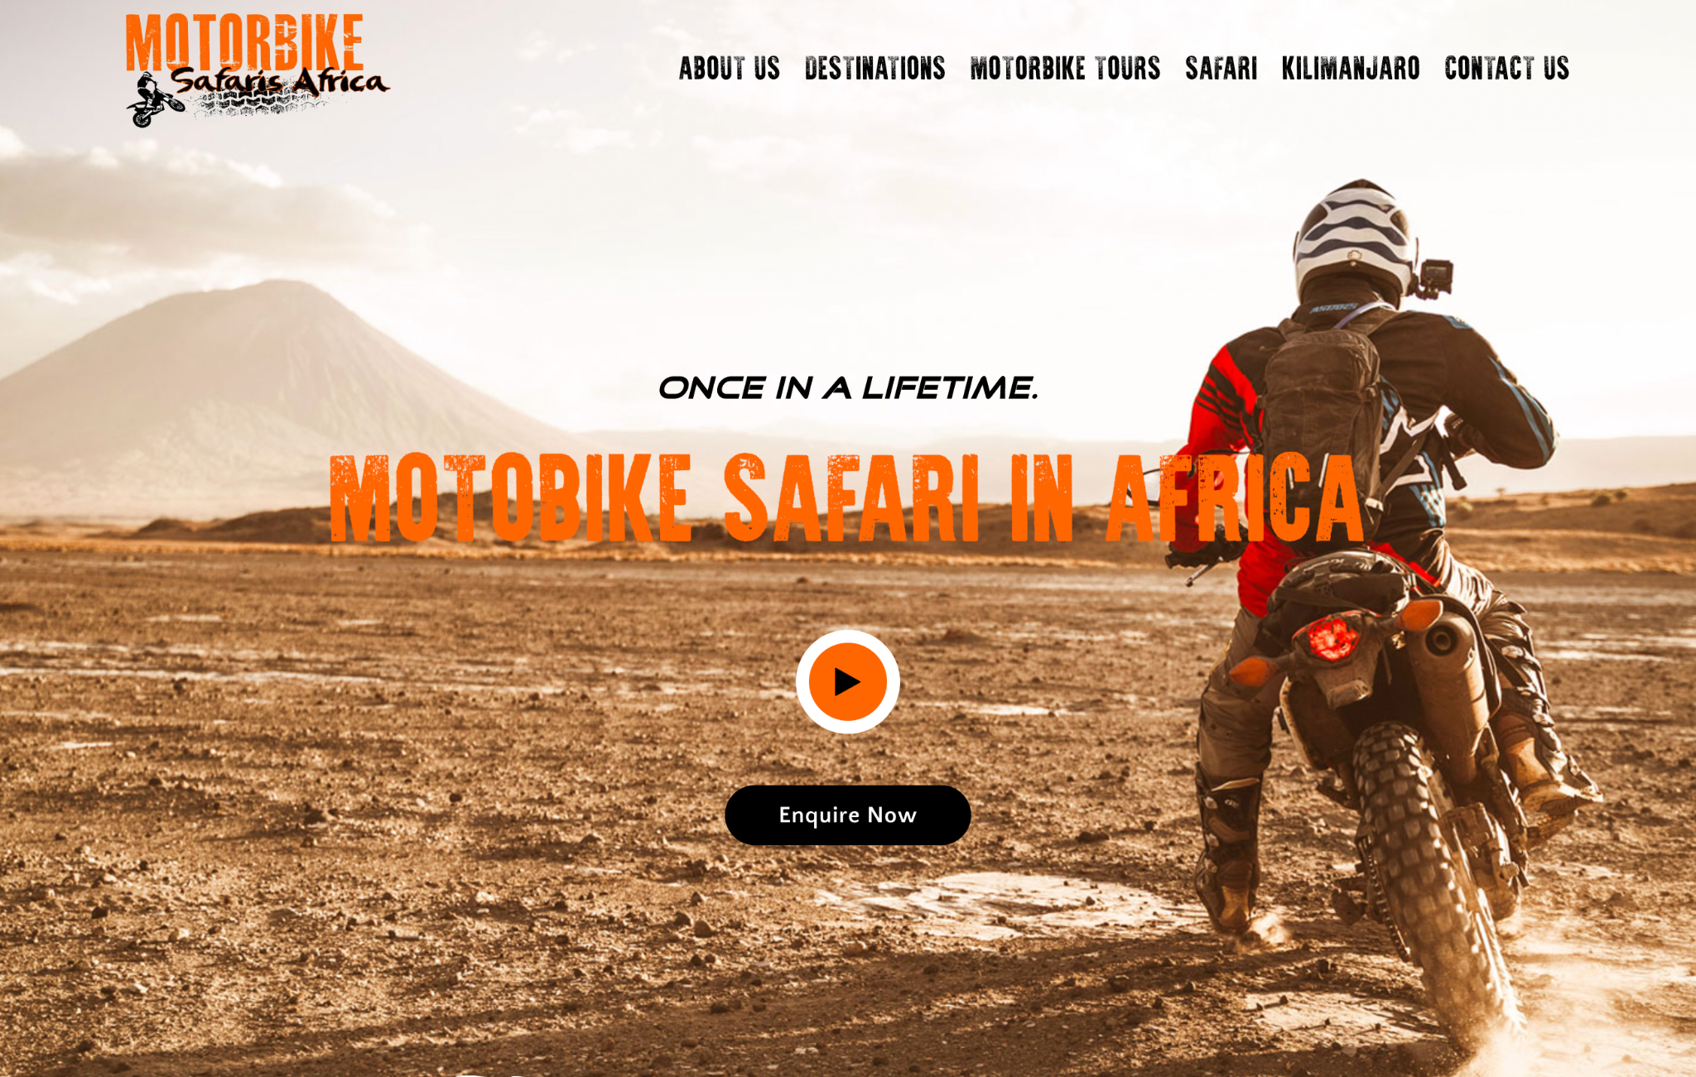
Notes:
How to facilitate this slide:
Keep this slide on the screen for 15 Seconds. Participants must gather as much information about the product and business as possible in that timeframe. After 15 minutes, skip to the next slide and ask for feedback.
Slide References:
The slide shows the homepage of a motorcycle safari operator. The photo, text and company name all make it clear what the experience is about, and who it is for.

Slide 76
Group Discussion
What do they offer, who do they cater for, what’s their unique selling point, which emotions come to mind?
Notes:
How to facilitate this slide:
Following the previous slide, ask participants to share their feedback.
Useful talking points and angles to consider:
Ask specific questions to lead the discussion, for example: Who was in the picture, what were they doing?

Slide 77
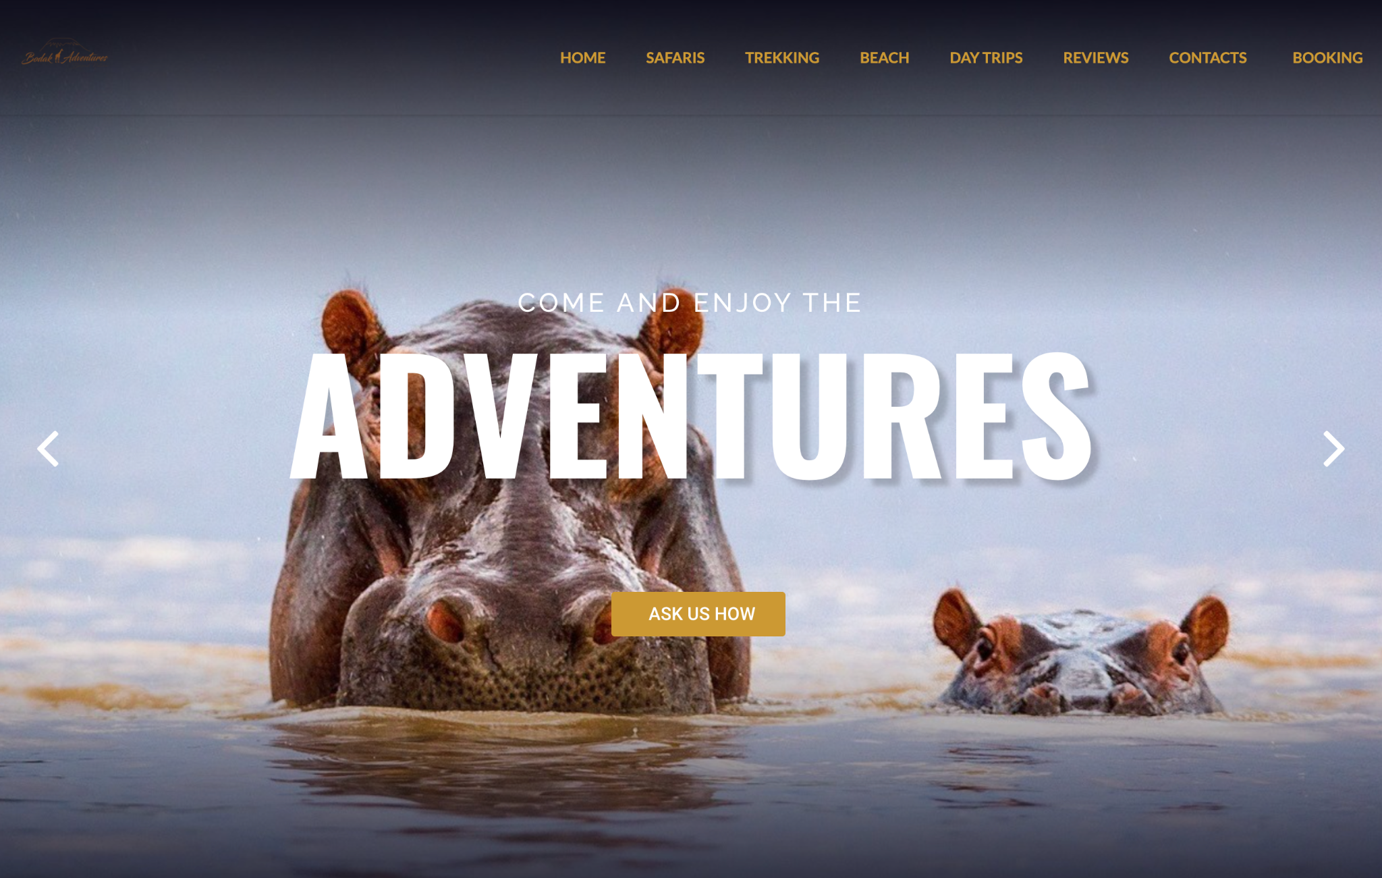
Notes:
How to facilitate this slide:
Keep this slide on the screen for 15 Seconds. Participants must gather as much information about the product and business as possible in that timeframe. After 15 minutes, skip to the next slide and ask for feedback.
Slide References:
The slide shows the homepage of a safari operator. It is intentionally generic. Neither the message or the photo make it clear who this company’s target markets are, or why they are different from other operators. The logo is not easy to notice.

Slide 78
Group Discussion
What do they offer, who do they cater for, what’s their unique selling point, which emotions come to mind?
Notes:
How to facilitate this slide:
Following the previous slide, ask participants to share their feedback. The outcome of the discussion should be that the first example is more descriptive, and has a better chance of grabbing the attention of the visitor.
Useful talking points and angles to consider:
Get participants to discuss on why they feel certain examples are better or worse than others.

Slide 79
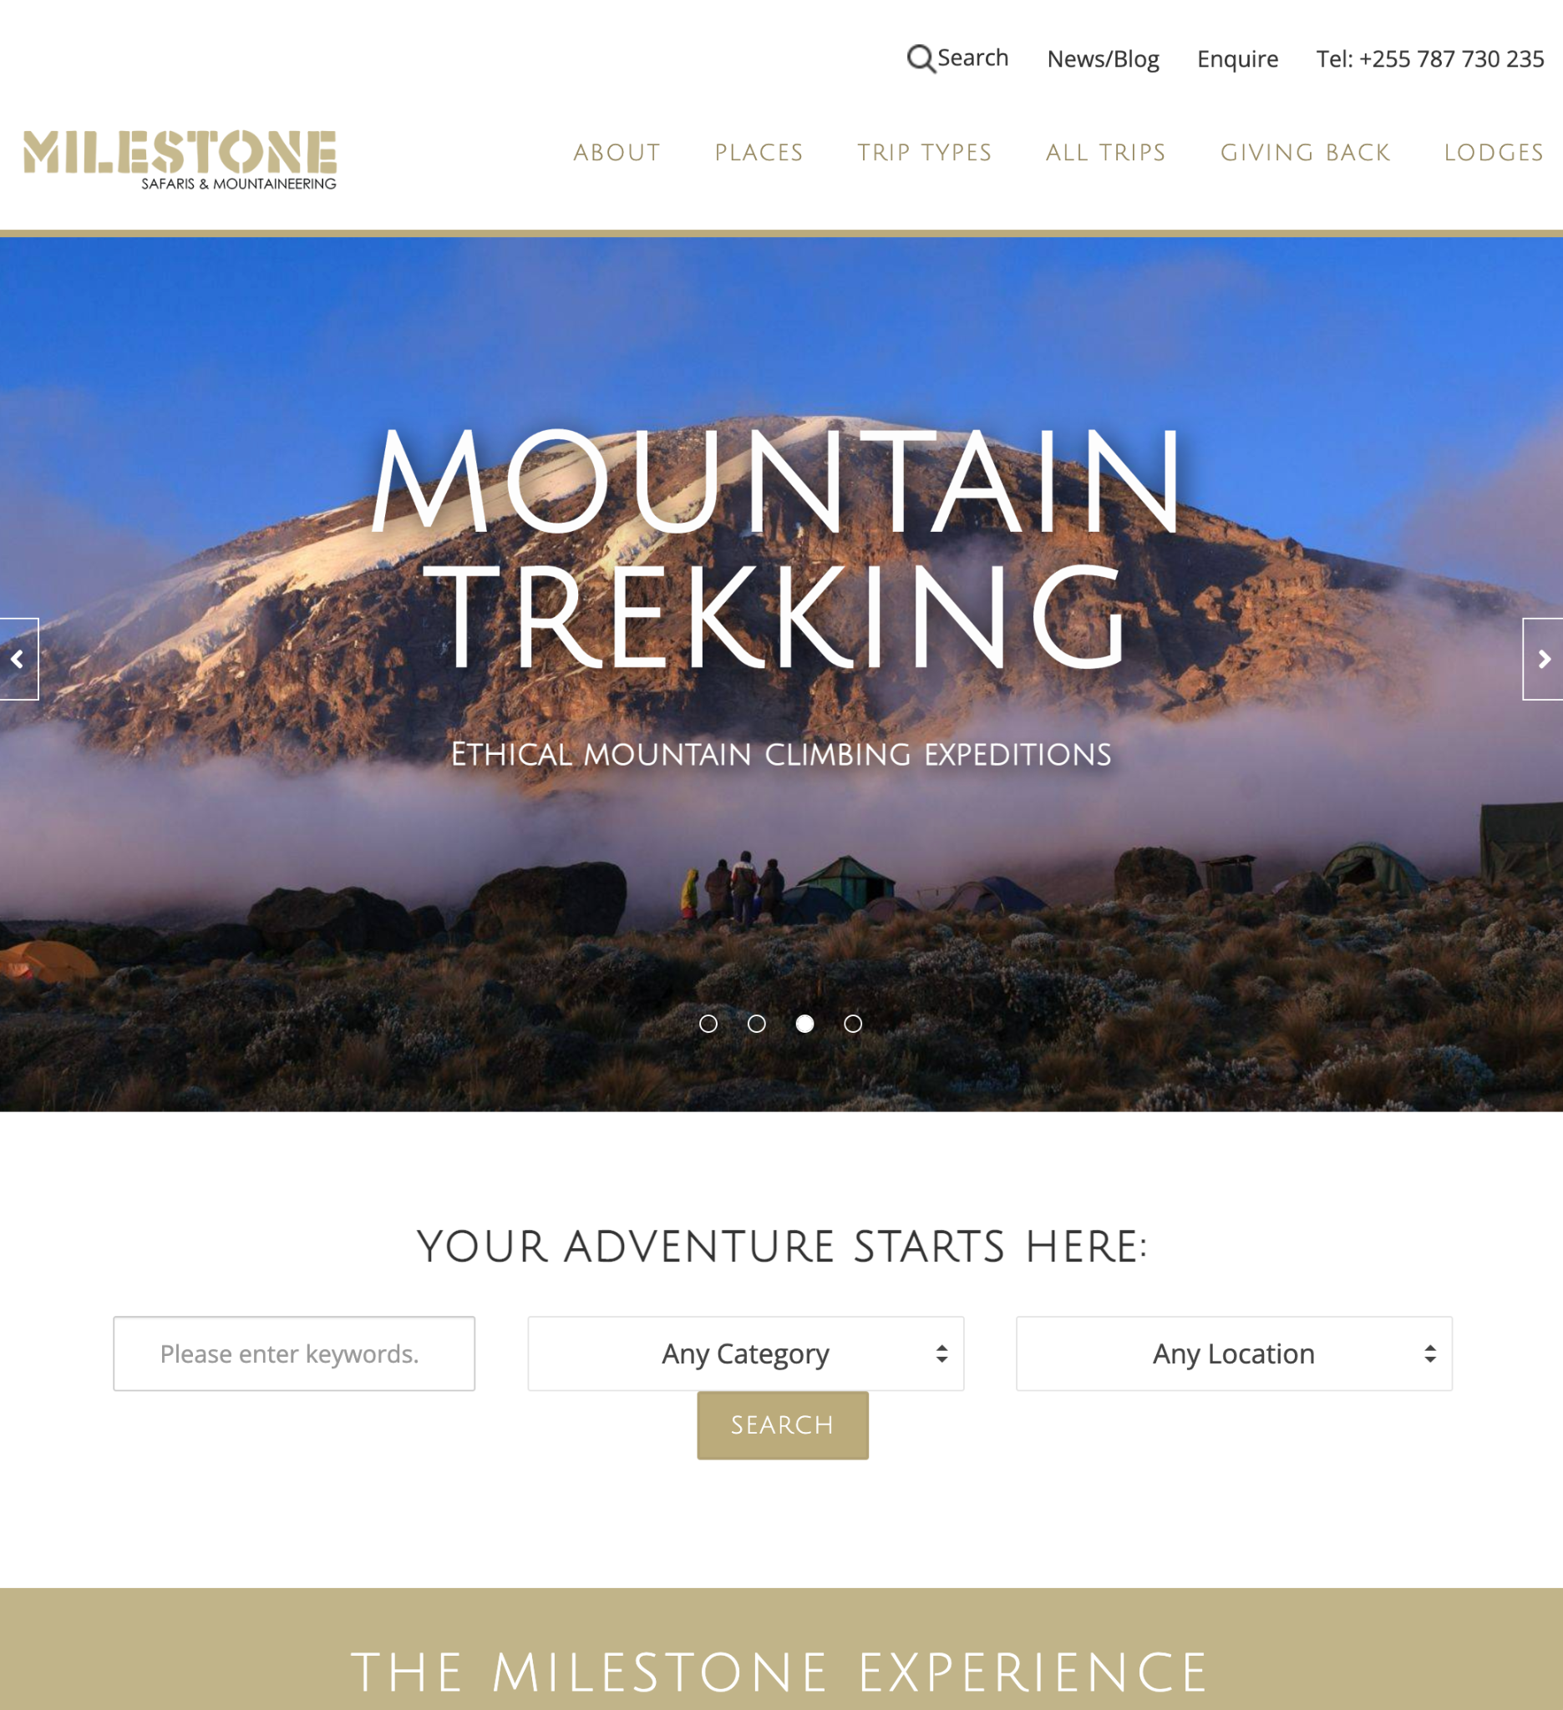
6. Home page
best practices
More than likely going to be the entry point for most visitors
Content to consider: “your elevator pitch”, featured products, reviews, latest news
Use strong “calls-to-action”
Showcase your top tours
Notes:
Useful talking points and angles to consider:
Statistically, most website visitors will land on a tour operator’s home page first, before viewing other pages. This means that your home page has an important job - to introduce your business and convince visitors to stick around!
When creating content and choosing images for your home page, take your time and select the images and products that best describe your company and products
Slide References:
The screenshot is from Milestone Tours’ website. It instantly shows that they are an adventure and trekking company, rather than a company selling the same safaris and experiences as other operators. The visitor won’t need to spend minutes on the website to understand why Milestone is a good fit for their needs

Slide 80
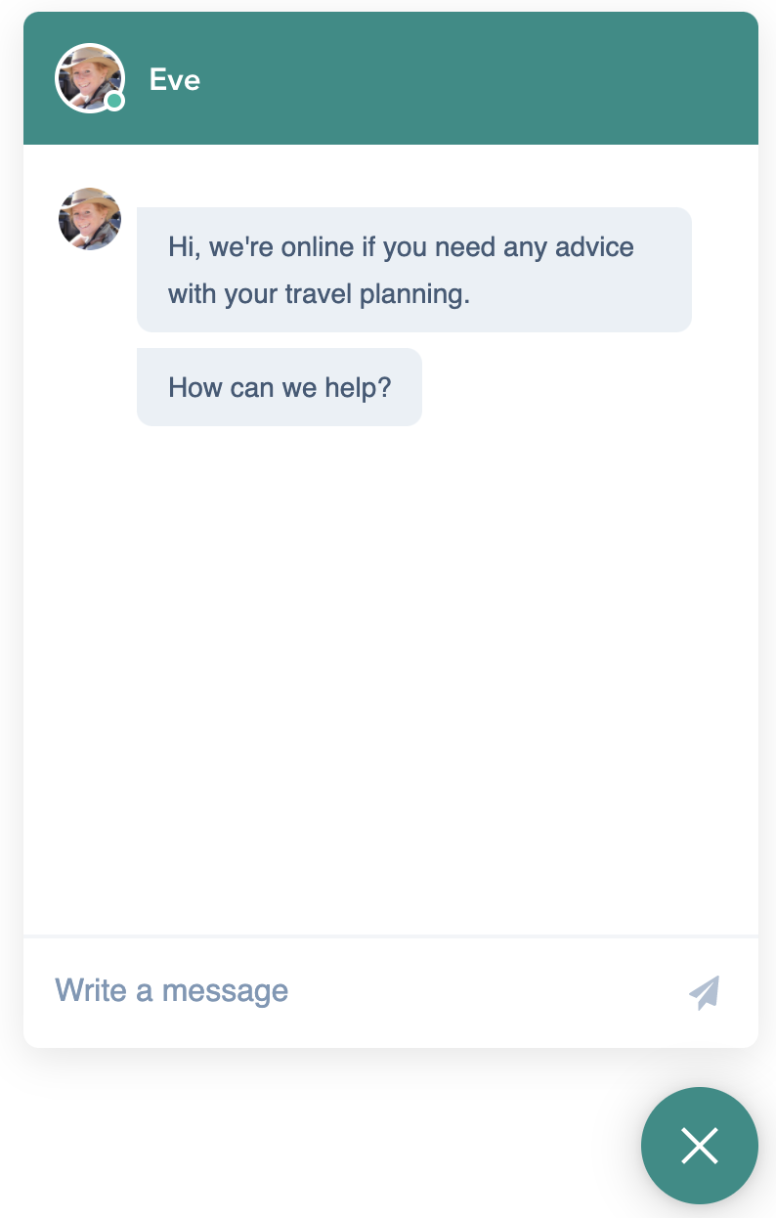
7. Live Messaging and Chat
According to CrazyEgg 38% of consumers are more likely to buy from a company if they offer live chat support.
Find a solution that fits your capacity and budget.
Assign clear roles and responsibilities, define a response policy (how and how quickly do you respond?)
Notes:
Useful talking points and angles to consider:
You a have limited attention span of your website visitors, live chat is an interactive way to communicate with them before they leave your site.
Visitor may often have a basic or quick questions about a tour operator or a destination, Live Chat can be the difference between them leaving, or engaging with a sales consultant and turning into a lead
Live chat should not be used without careful consideration. Ask questions like “who will respond to chat messages on your website”, “how will you handle chat requests that come in after hours?”
The next slide shows options for Live Chat applications
Slide References:
The screenshot is from Timbuktu’s website, showing a personalised chat welcome message, with the photograph of one of their safari experts, ready to assist

Slide 81
Website messaging options
Facebook Messenger
Pros: Free, Integrated to your Facebook page
Cons: Slow, heavy to load
Tawk.to
Pros: Freemium, good features
Cons: An additional tool or app
WhatsApp
Pros: Widely used and trusted
Cons: limited integration into CRM and business systems
Notes:
How to facilitate this slide:
This slide shows three examples of free chat or live messaging integrations to use on websites. These are not the only ones available, but mere suggestions for tour operators who wish to start working with this communication channel.
There is no “perfect solution”, which is why each examples lists advantages and disadvantages

Slide 82
8. Build trust and confidence
Give your website visitors reasons to stick around
Build trust and create a personalised experience
Notes:
Useful talking points and angles to consider:
The average website visitor only views 2.5 pages of a tourism industry website (Statistic by LittleData)
Compare your website to your office or front desk - how do you want someone to feel when they walk in? How can you apply this same approach on your website?
The next slides show examples of this in practice

Slide 83
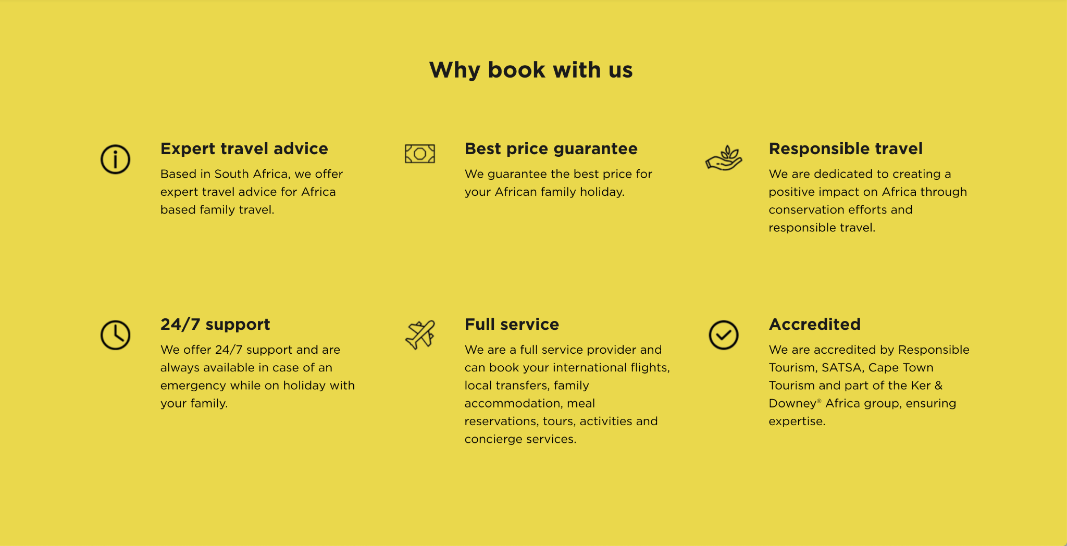

Slide 84
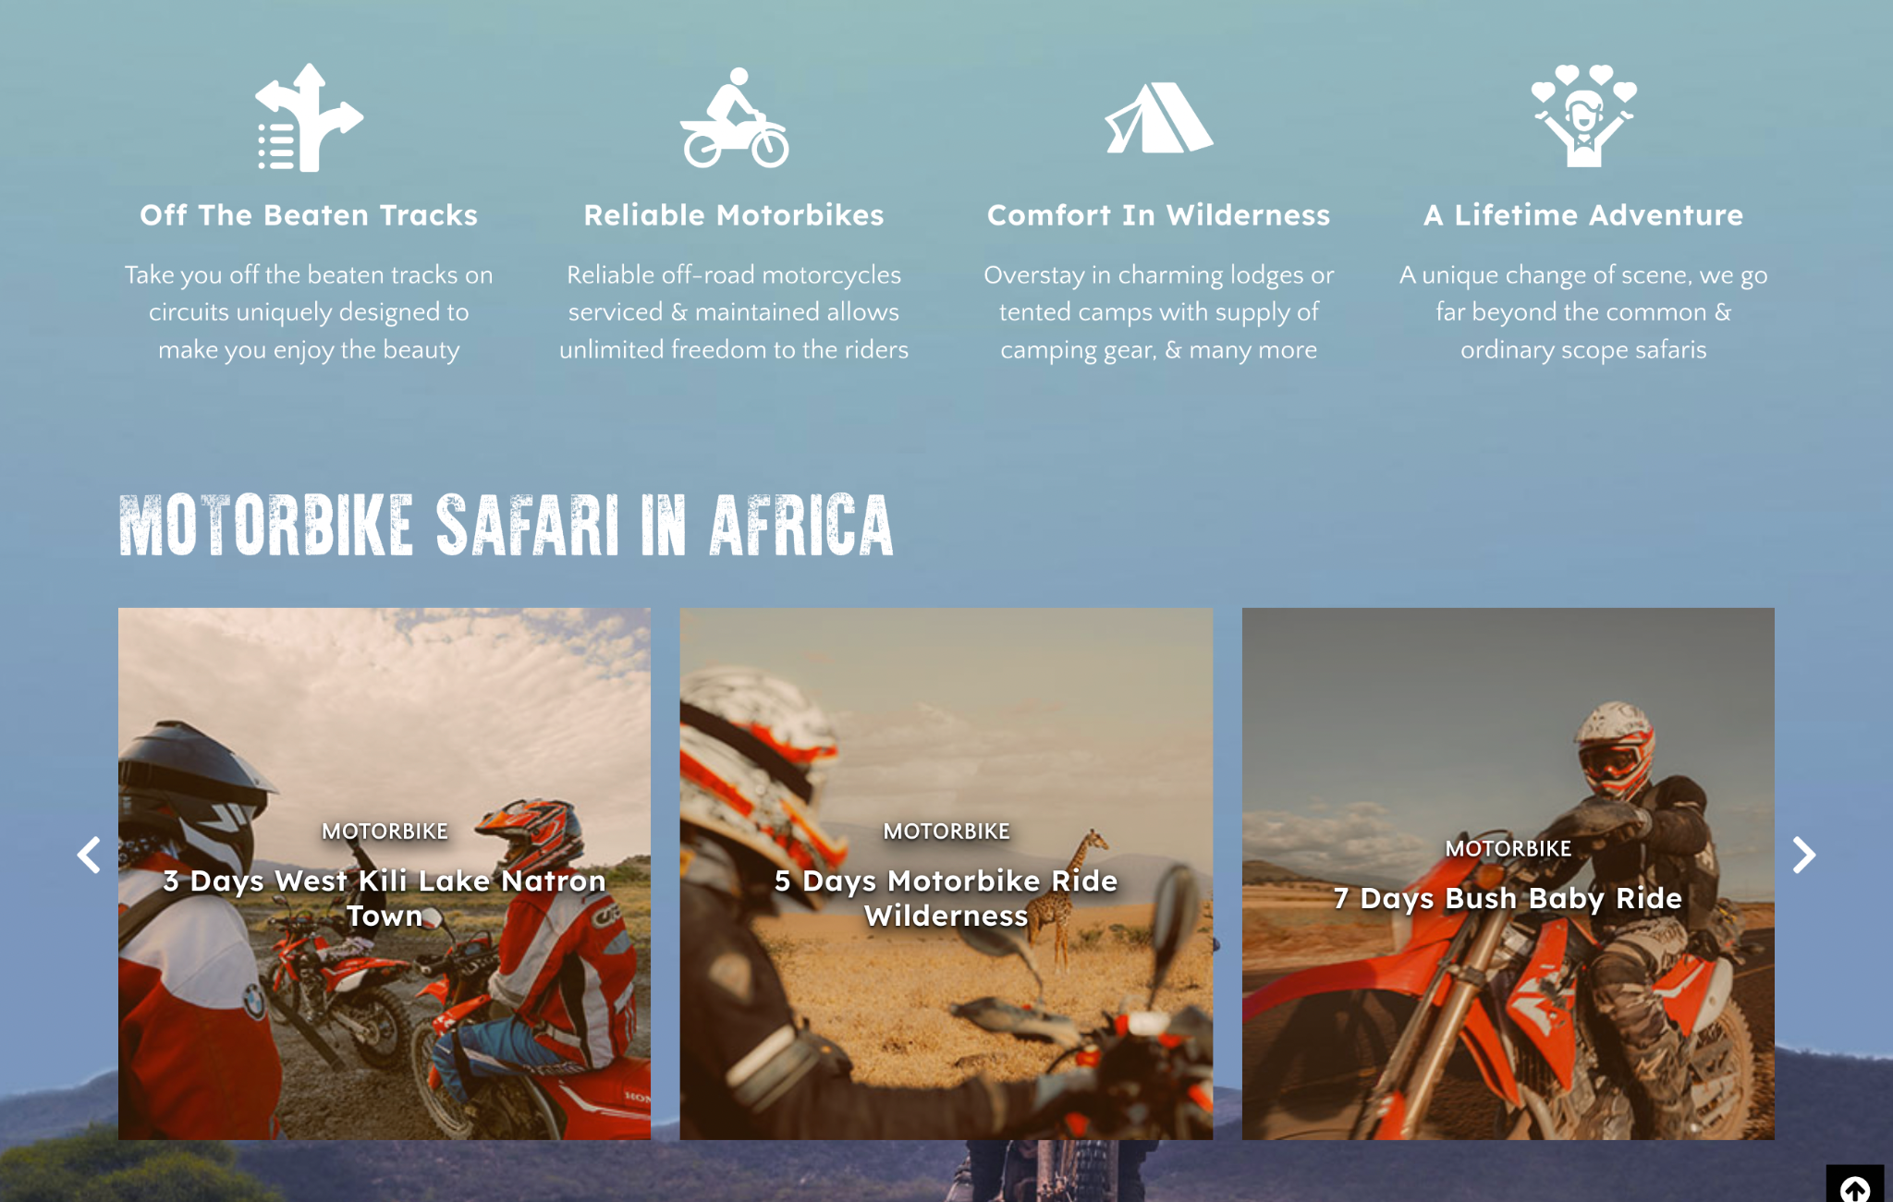
Notes:
How to facilitate this slide:
Another example of how tour company clearly shares their unique selling proposition in a simple and interesting way
Slide References:
The screenshot is from Motorbike Safaris’ website

Slide 85
Notes:
How to facilitate this slide:
Showing off your industry and trade partners can build trust
Slide References:
The screenshot is from Guilt Edge’s website

Slide 86
Notes:
How to facilitate this slide:
Showing off your credentials and awards can build trust
Slide References:
The screenshot is from Go2Africa’s website

Slide 87
Group Assignment
Using the same persona as Assignment 1, come up with an effective homepage concept. Include the following:
Which message and image(s) will you use?
What other information will you include on your home and why?
What other specific instructions will you give to the person building your website, to ensure that you comply with the latest best practices?
15
3
2
15 Minutes Discussion
Use a notepad or flip chart to plan your concept, using the points above.
3 minutes Feedback / group
Nominate a team member to present your concept
Recap
What did we learn from the activity?
Notes:
Learning outcome for this assignment:
Participants are able to evaluate the messaging and content on a website, to determine whether it effectively speaks to marketing personas, while applying best practices. The ideal outcome would be if participants sketched or illustrated a website mockup or concept, and used the theory from the session to gain confidence in briefing a webmaster (eg. The website should be responsive, the website should be optimised for fast lading)
How to facilitate this assignment:
Make sure each group has it’s persona table from assignment
Participants break away in their groups, and have 15 minutes to create their home page concept. They can write, and draw
Each groups has to nominate a person to present their persona and share their findings in 5 minutes
Give participants opportunity to share feedback and review the concepts of other groups to make it conversational and to encourage learning from each other
Complete the assignment with a “what did we learn” moment. Participants should be encouraged to apply this to their own businesses within their own teams after the session.
Prepare:
Participants should already be assigned to groups
Each group must be provided with a blank paper or flipchart

Slide 88
What about B2B?
Consider the website content and features an international agent or buyer will find useful:
Professional company profile
Information on accreditation and awards
Staff profiles
Sustainability policy
Notes:
How to facilitate this slide:
While the course content is primarily focussed on marketing to travel to a B2C audience (selling to the traveller directly), it is worth acknowledging that many tour operators sell to agents or buyers (B2B) as a primary or important market.
This slide outlines some website considerations for tour operators who target agents
Useful talking points and angles to consider:
Discuss the the differences between online personas of travellers and travel buyers. How do these differences impact the information and features they look for when visiting a tour operator website.

Slide 89
?
Questions and Answers
?
?

Slide 90
Module 4
Social Media: Facebook,Instagram and YouTube
Notes:
About this module
This module offers a basic introduction to three of the most wide-used social media channels for Tour Operators to include in their marketing efforts. Key topics covered:
Why social media is important for tour operators
Best practices for using Facebook, Instagram and YouTube
How much time to spend on this module
Allow 60-90 minutes for facilitation and discussion, excluding the assignment at the end of the module.
Keep in mind
These are the most popular social media channels that target audiences in international markets use.
This programme has been funded and developed by CBI, a Dutch government body that promotes tourism from Europe

Slide 91
Course Modules
Module 1
Module 5
Digital Marketing Foundations
Digital Marketing Toolkit: SEO and Blogging
Module 2
Module 6
Branding for Digital Success
Digital Marketing Toolkit: Reviews and Online Booking Platforms (OTAs)
Module 3
Module 7
Digital Marketing Toolkit: Your website
Digital Marketing Toolkit: Email Marketing
Module 4
Module 8
Digital Marketing Toolkit: Social media marketing
Practical Technical Skills (Using technologies like Zoom)

Slide 92
What you’ll learn
Knowledge
Understand the Facebook Profile and Business Page environment
Understand the different types of content to consider for your social media strategy
Skills
Be able to update and optimize social media channels based on best practices
Plan and create effective social media posts on Facebook and Instagram
Notes:
How to facilitate this slide:
You do not need to spend much time on this slide. It's simply a high level summary of the next slides.
Guide participants through the module’s learning objectives, and be sure to verify the effectiveness of the session during the Q&A slide.
By the end of this session, participants will have done at least one social media update, on Facebook or Instagram. This will give confidence.

Slide 93
!
€
$
UGX
BOOK
Sees social media posts about your company created by you (or someone they follow)
Follows you on social media. Engages with your posts for more information.
Searches a hashtag related to your destination or product e.g. #exploreuganda
Clicks on a targeted paid social media ad by your company. Contacts you via direct message.
Awareness
Interest
Desire
Action
Notes:
How to facilitate this slide:
The participants should now be familiar with the customer journey and how messaging changes at each stage.
Explain the different feelings that a potential customer has before making their travel booking and how social media can be used to connect and inform customers at each stage.
Useful talking points and angles to consider:
There is some overlap between stages and some customers will not pass through every stage.

Slide 94
Group Discussion
1,000 Likes or 10 active followers - which has more value? Why?
Notes:
How to facilitate this slide:
The purpose of this discussion is to say that engagement with a small number of followers is far more likely to win business than having thousands of followers who don't interact with your content.
People who are new to social media may be tempted to buy lots of followers and/or invite their friends to follow them.
Facilitate a discussion for 5 minutes.

Slide 95
Why is social media important?
3.78 billion social media users worldwide. (World population was 7.9 billion per December 2021)
Americans spent more than an 1,300 hours a year on social media, according to Uswitch.
You have to be active on social media. Your customers are, and so are your competitors.
Notes:
How to facilitate this slide:
Remind participants that social media is constantly evolving. They need to Google latest trends, such as “How long does the average person spend on social media every day?”

Slide 96
How well do you know the world’s biggest website?
Notes:
How to facilitate this slide:
We spend a lot of time looking at Facebook since it is the channel that people are most familiar with on a personal level. Understand the basics of Facebook, and they will understand the basics of communication via social media.
The title of this slide is a reminder of how powerful Facebook is.

Slide 97
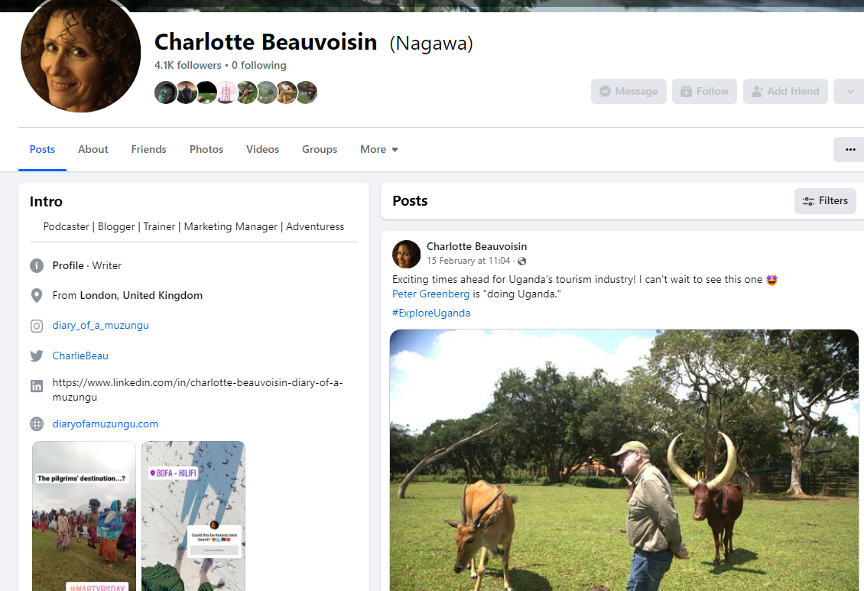
Introduction to Facebook
Facebook is the world’s most popular web site
The average user spends 50 minutes a day on Facebook
It is very popular but it is also very competitive
Video and photos are most visible in people’s newsfeeds
Publish an update 3 or 4 times a week
Notes:
How to facilitate this slide:
These are just a few introductory facts. They will change and need to be updated over time.
Personalise your slides by adding screenshot of a Facebook user. We start with looking at personal accounts.

Slide 98
Your personal profile - Best Practices
What would your marketing personas want to learn about you as a person?
Which social media does your persona check most?
Notes:
How to facilitate this slide:
It's important that any publicly visible information is positive.
Use your real name.
Link to your Facebook business page and/or website.

Slide 99
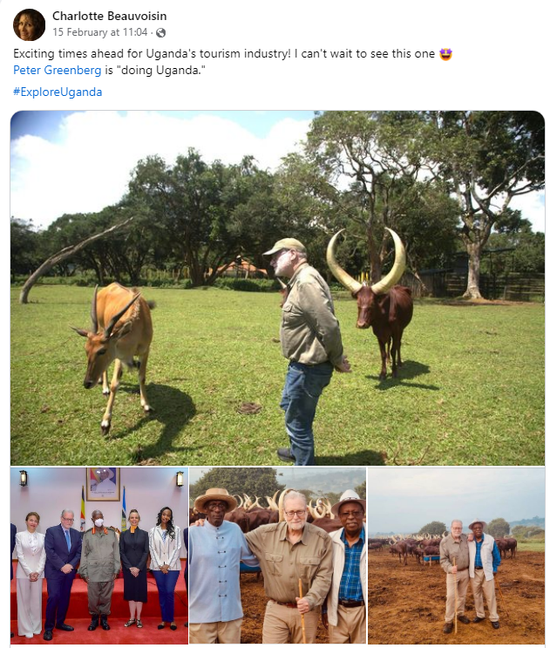
Personal branding and managing your reputation online
It is common for clients and employers to look you up on social media.
Don’t accept a friend request without checking who the person is.
Be selective in what you post online. Or select the audience.
If you promote your company on your personal Facebook page, be aware that you have a certain responsibility to be positive.
Notes:
How to facilitate this slide:
Personalise your slides by adding screenshot of a typical Facebook post.
The purpose of this slide is to show that you must protect your reputation online as you never know who is looking you up.

Slide 100
Your Business Page - Best Practices
What would your marketing personas want to learn about your business on Facebook?
Notes:
How to facilitate this slide:
This slide could be a a short discussion in which you ask participants what they might look for.
A business page should have:
the company mission
links to other social media and website
an overview of services company offer, focusing on USPs
the best content pinned at the top
Remind participants how important it is to get inside mind of the target customer.

Slide 101
Think of Facebook and Instagram as one channel
Facebook and Instagram are becoming a unified marketing platform, with a central place from where you can manage your posts, advertising, Pages and Accounts.
Notes:
How to facilitate this slide:
Meta is the name for the organisation that owns Facebook, Instagram and WhatsApp however these individual channels continue operating under the original names.
The message from these two slides is that the channels are converging.
This means that:
strategy and management should be approached together.
social media is constantly evolving.

Slide 102
Set yourself up for Success
Your Personal profile
Facebook Business Manager
Business Account (Your Tour Company)
Notes:
How to facilitate this slide:
Get the foundations right by optimising your personal Facebook profile.

Slide 103
Introduction to Instagram
Instagram is the world’s biggest growing social media site.
1 billion people are active on Instagram
500 million active every day
Instagram has the highest engagement rate. It is 10 times higher than it is on Facebook
Notes:
How to facilitate this slide:
These are just a few introductory facts. They will change and need to be updated over time.

Slide 104
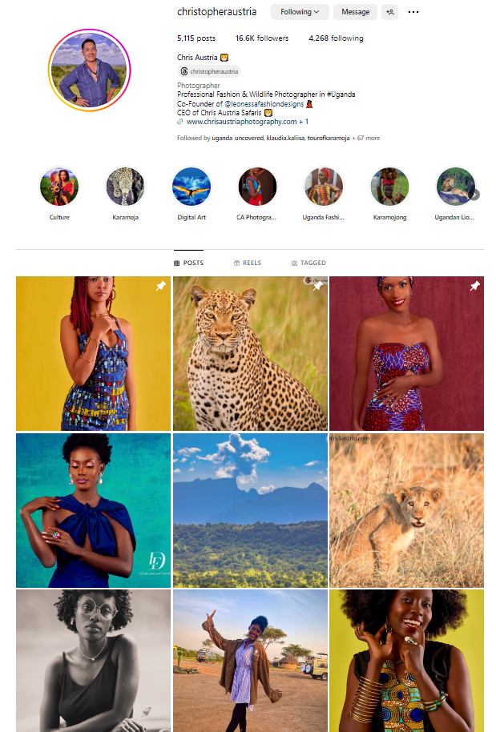
Instagram Basics
Mostly used on mobile.
High-quality photo content has a long lifespan on Instagram
Users quickly scroll through their photo feeds, so you need great visuals to catch their attention.
Include keywords as #hashtags.
Publish one or more updates per day:
Posts
Stories
Reel
Notes:
How to facilitate this slide:
Personalise your slides by adding screenshot of an Instagram user.
Check that the audience understands what hashtags are.

Slide 105
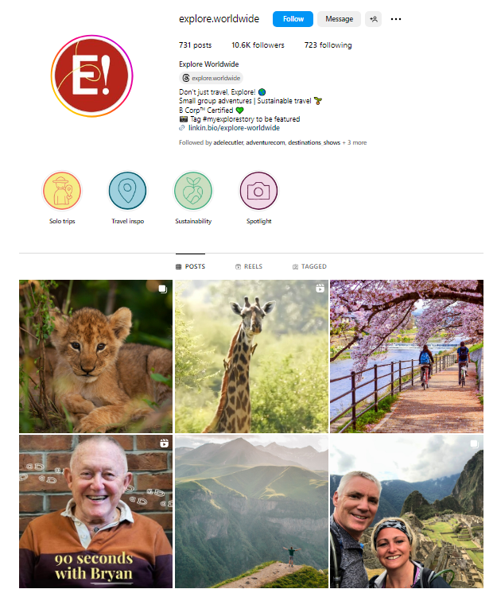
Your Instagram Bio
Take time to write an interesting bio
Include emojis 🤩
Add links to popular content
Include hashtags
Add your email address
Add Highlights
Notes:
How to facilitate this slide:
Personalise your slides by adding screenshot of an Instagram bio.
Talk the participants through the different elements that appear in a bio.
Encourage them to think carefully about the limited space available to them.
The bio should appeal to the target customer.

Slide 106
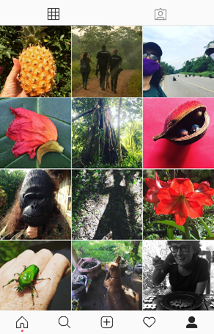
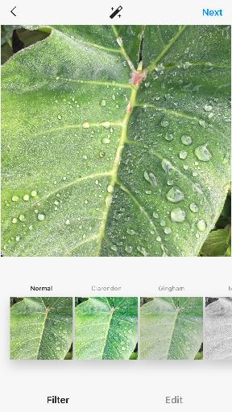
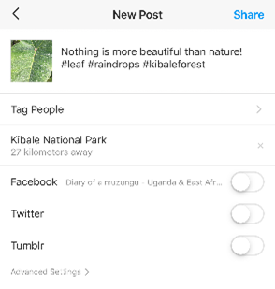
How to post on Instagram
Notes:
How to facilitate this slide:
Personalise your slides by adding screenshots from an Instagram account.
Explain the differences between
Posts
Stories
Reels
This screenshot shows:
How a post looks in a feed.
The options to edit / filter within the app.
Instagram can be tricky to illustrate in the classroom setting.

Slide 107
Live screen share
Notes:
How to facilitate this slide:
Live casting from your phone is one way to illustrate how different Instagram features work.
Another option is to get all the participants to create Instagram content during the training. (However, this requires strict facilitation as once people start using their phones, they get distracted by other apps).

Slide 108
Creating effective social media content
Notes:
How to facilitate this slide:
In this section, we introduce some ideas for creating content.

Slide 109
Traveller-generated content
A combination of technology, connectivity, and a culture of sharing, means that millions of authentic and relevant marketing messages are created each month.
These are marketing messages that businesses and brands simply can’t fabricate.
Personalise your slides: add photo of a traveller
Notes:
How to facilitate this slide:
Travellers take millions of photographs when they travel and they love sharing their adventures with friends and family on social media.
Personalise your slides by adding photo of a traveller e.g. taking a photo or holding a phone.

Slide 110
How to structure a Facebook check-in
Use good photos / video
Check-in using the ‘teardrop-shaped’ GPS marker
Add emojis
Add feelings
Tag people (selectively)
Notes:
How to facilitate this slide:
A check-in on Facebook is one of the simplest ways to raise the profile of a hotel or destination. The check-in can be done on a personal page or a business page.
This is a powerful feature for tourism businesses who can encourage their customers to check-ins while on one of their trips.

Slide 111
Live screen share
Notes:
How to facilitate this slide:
Use either a personal or business page account to walk the participants through a check in on Facebook, step-by-step.
How to add a photo or video.
Where to put the hashtags.
How to select your location.
How to add personality to your updates by using emojis and / or activities/ feelings.

Slide 112
Group Assignment
Using the same persona as Assignment 1, post a social media update.
Discuss the structure, and message of a social media update.
Include: photo(s) / video, message, call to action, hashtags, location, feelings, emojis 😎
One person from each group does a check-in on Facebook OR an update on Instagram.
15
5
15 Minutes Discussion
Use a notepad or flip chart to plan your concept, using the points above.
5 Minutes Feedback
Nominate a team member to present your concept.
Notes:
Time Allowance:
Minimum 40 minutes depending on number of groups and participants
Learning outcome for this assignment:
Everyone will practice how to do a simple social media update on Facebook or Instagram.
How to facilitate this assignment:
Participants break away in their groups, and have 15 minutes to discuss how they will structure and write a social media update.
One person per group will post it on any of: their personal Facebook or Instagram page, or their business page.
Each group has to nominate one person to present their persona.
Each group will share their social media update and take five minutes to present their findings to the others.
Give participants opportunity to share feedback and review the concepts of other groups to make it conversational and to encourage learning from each other
Complete the assignment with a “what did we learn” moment. Participants should be encouraged to apply this to their own businesses within their own teams after the session.
Prepare:
Participants should already be assigned to groups.
Make sure each group has its persona table from assignment 1.
Each group must be provided with a blank paper or flipchart for brainstorming.

Slide 113
Facebook & Instagram Advertising
Use advertising to target your marketing personas, based on their demographics, interests, and activity
Targeted and affordable
The simplest way to do an advert is to ‘Boost Post.’
Notes:
How to facilitate this slide:
As this is an introductory level course, we don’t deeply dive into it. In this section we simply show the potential for targeted advertising on Facebook.

Slide 114
Live screen share
Notes:
How to facilitate this slide:
A short practical demonstration on boosting a post to a specific audience utilising persona information participants have used earlier in the training.

Slide 115
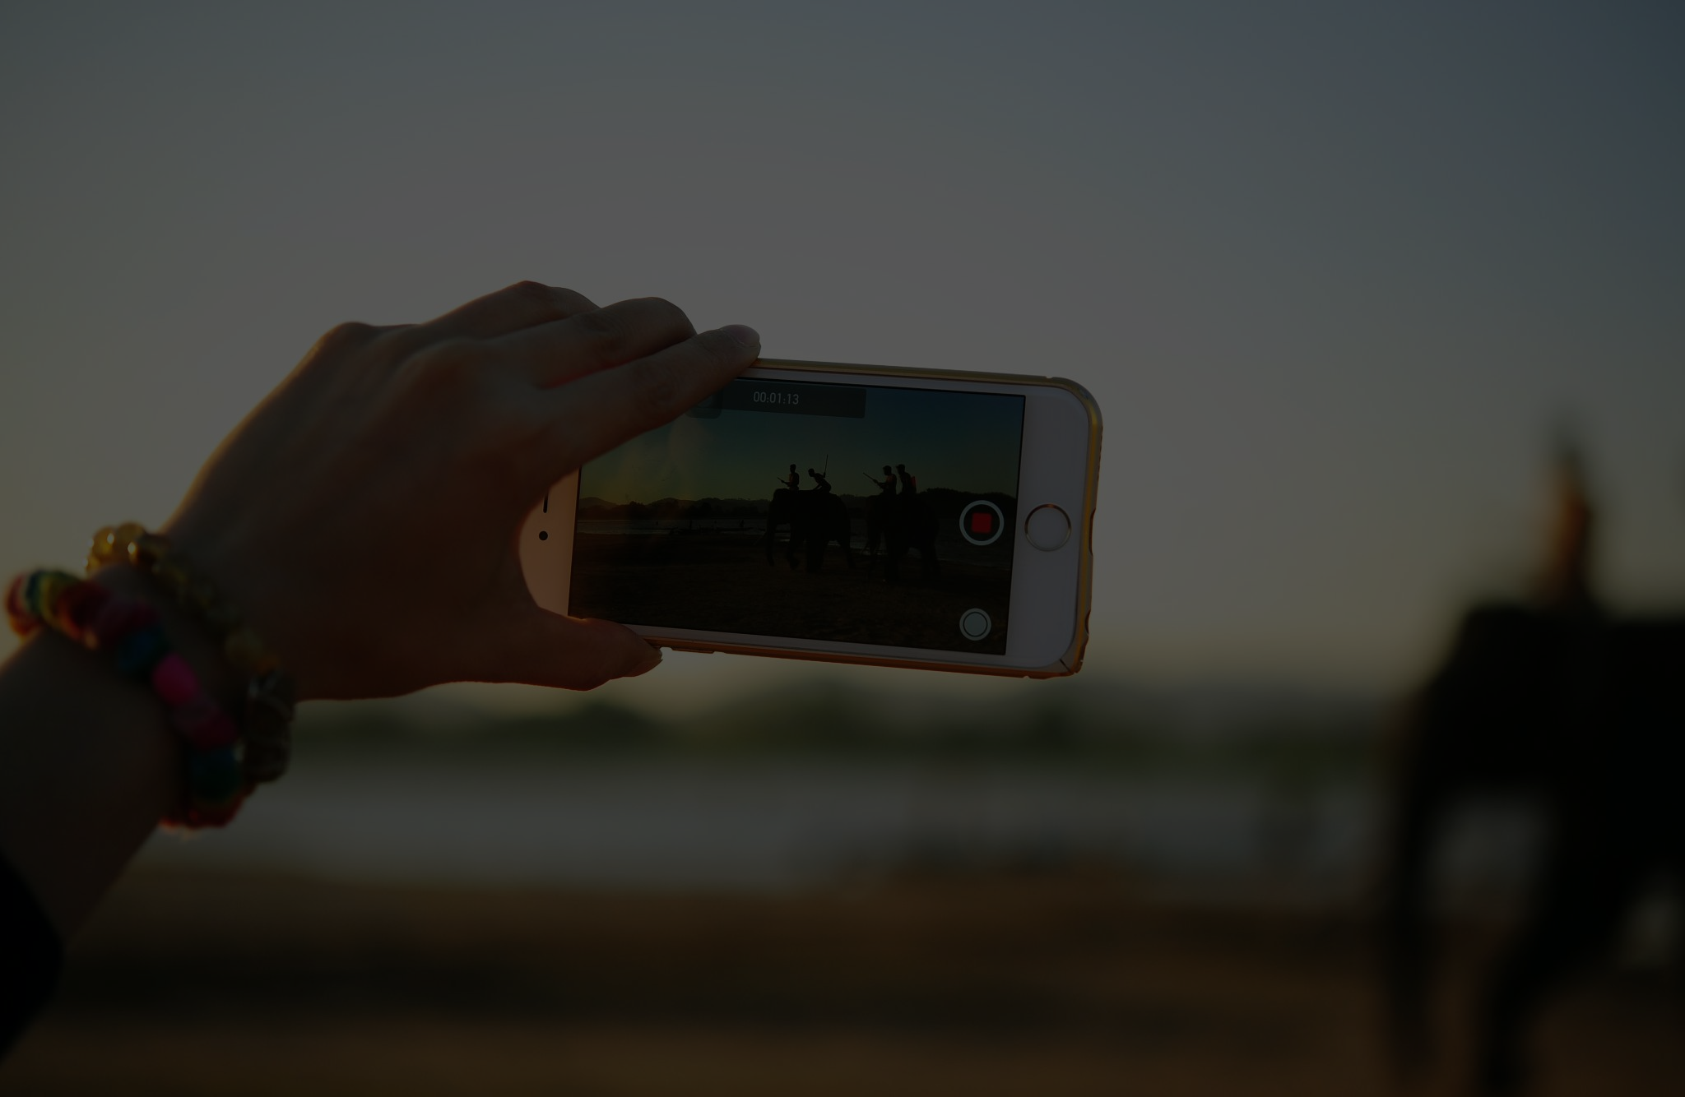
YouTube
Notes:
How to facilitate this slide:
Although YouTube is the best-known video channel, video is trending across all channels. It's a great medium for sharing travel content.
The aim of this module is to draw participant's attention to the power of video and the way in which it can be used.
We aim to get participants thinking about creating their own video content. The format is accessible by anyone who has a smartphone.

Slide 116
Introduction to YouTube
Second biggest search engine in the world.
Huge audience - Almost 5 billion videos are watched every day.
International target markets are active looking for holiday inspiration on YouTube.
Opportunity for travel brands to create raw, unedited videos.
Notes:
How to facilitate this slide:
These are just a few introductory facts. They will change and need to be updated over time.
Is the target demographic active on YouTube?
Or do they consume video on other channels? E.g. Instagram reels.

Slide 117
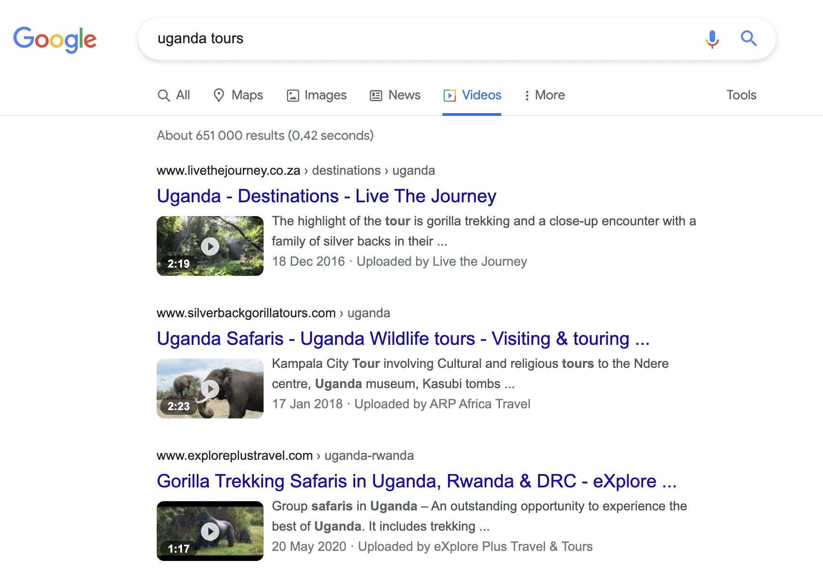
If you add YouTube videos to your website, you have the chance to rank in the Video Category of Google searches. This makes YouTube very powerful for SEO.
Notes:
How to facilitate this slide:
YouTube is owned by Google.
Websites that have YouTube content are rewarded with higher Google rankings.
Prepare:
Option: you might prefer to run this section of slides as a live screen share using different search terms.
If so, set up your laptop so that you can do the live search.

Slide 118
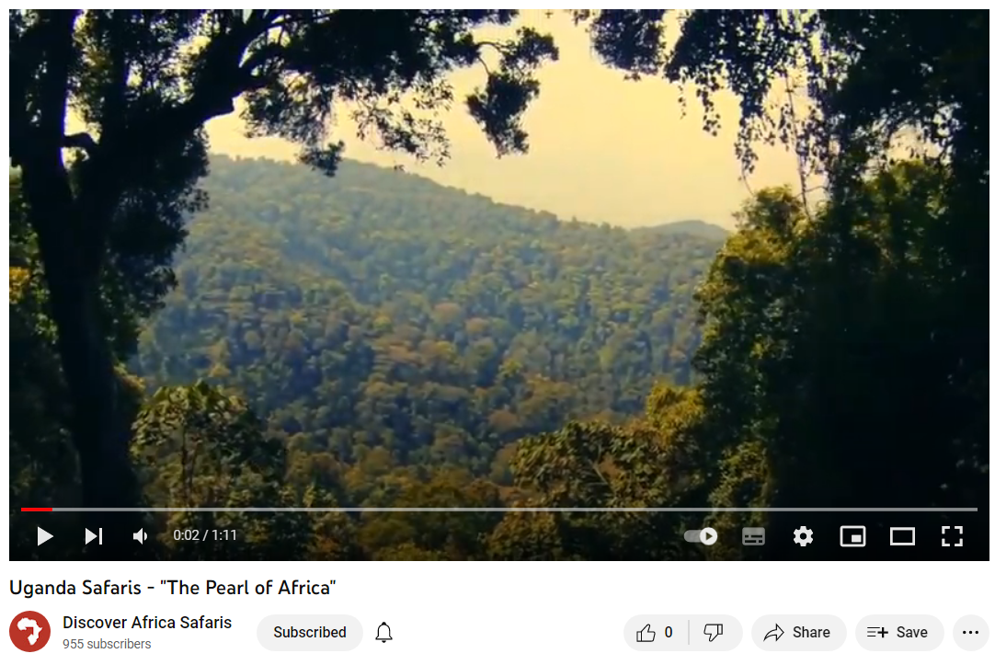
Notes:
How to facilitate this slide:
Sharing the essence of the destination through moving images and sound can be very persuasive.
Prepare:
Set up your laptop so that you can play this - or another - inspiring video. Click on graphic or go to https://youtu.be/iPrr81afmU0

Slide 119
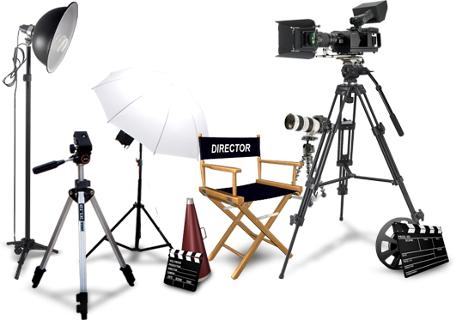
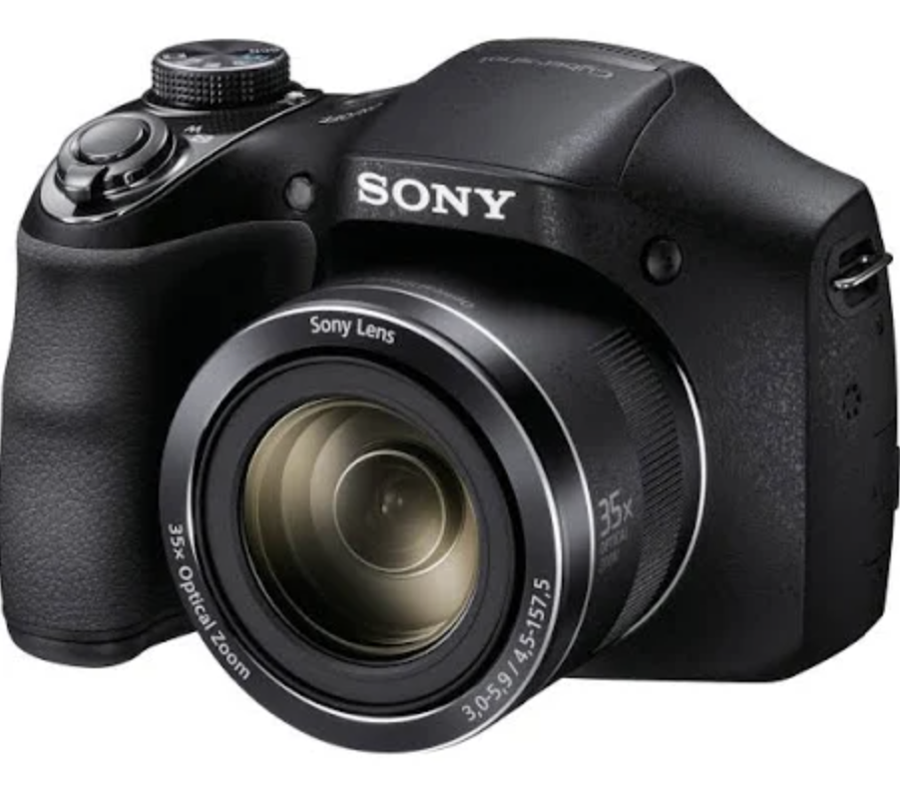
Vs
Notes:
How to facilitate this slide:
Video recording is far more accessible than it used to be. Promotional videos used to require professional cameramen, equipment, big budgets and planning. Nowadays, anyone with a camera or smartphone can create their own video content.
The trend is to create short form content and publish most of it immediately. Originality and timeliness win.

Slide 120
Notes:
How to facilitate this slide:
This is an example of viral video content from Bwindi.
This video encapsulates the once-in-a-lifetime experience that travellers seek.
It was filmed by a tourist, probably using a smartphone. This shows how powerful "in the moment" content is.
Useful talking points and angles to consider:
Is it possible to create content that goes viral?
NOTE: this video was pre-COVID and current rules state you must stay 10 metres from the gorillas.
NOTE 2: the downside of showing this video is that customers may come to Uganda expecting the same interaction and be disappointed.

Slide 121
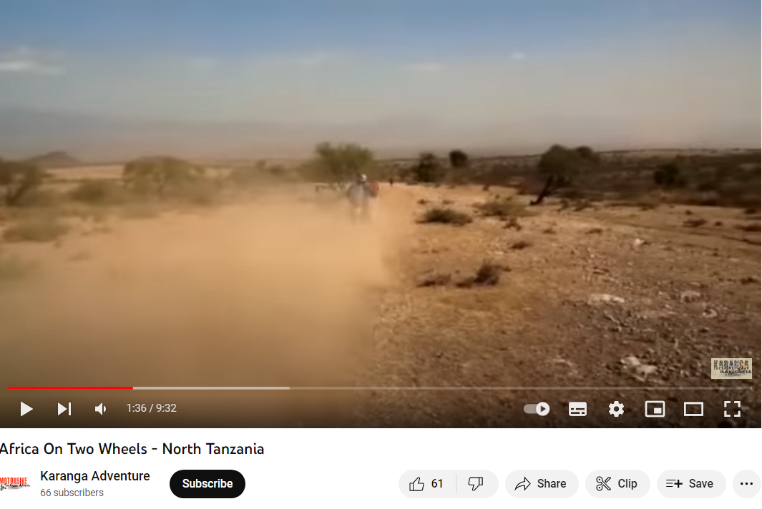
Notes:
How to facilitate this slide:
This is an example of how a Tanzanian tour operator (featured in a previous module) is using video to promote their motorbike tours.
This is one example. Personalise your slides with a YouTube video followed by a discussion about what was good, and what could be improved.
Prepare:
Set up your laptop so that you can play the video. Click on graphic or go to https://youtu.be/Avlqi42dGMA
Discussion:
What is good about this video?
What could be improved?

Slide 122
Notes:
How to facilitate this slide:
This is an example of how one Ugandan tour operator is using video to promote their destination: Karamoja. This video is shared through their YouTube channel.
Prepare:
Set up your laptop so that you can play one of the Kara-Tunga videos. Click on graphic or go to https://youtu.be/UfWI50H6t3w
Useful talking points and angles to consider:
How else could you share this video content?
Facebook Stories + posts
Instagram Stories + Reels
WhatsApp
WhatsApp status updates
Embed in website

Slide 123
Personalise your slides: add example of a travel brand whose YouTube content is focused on specific market segments.
Notes:
How to facilitate this slide:
Personalise your slides. Add a YouTube video example of a travel brand whose YouTube content is focused on specific market segments.

Slide 124
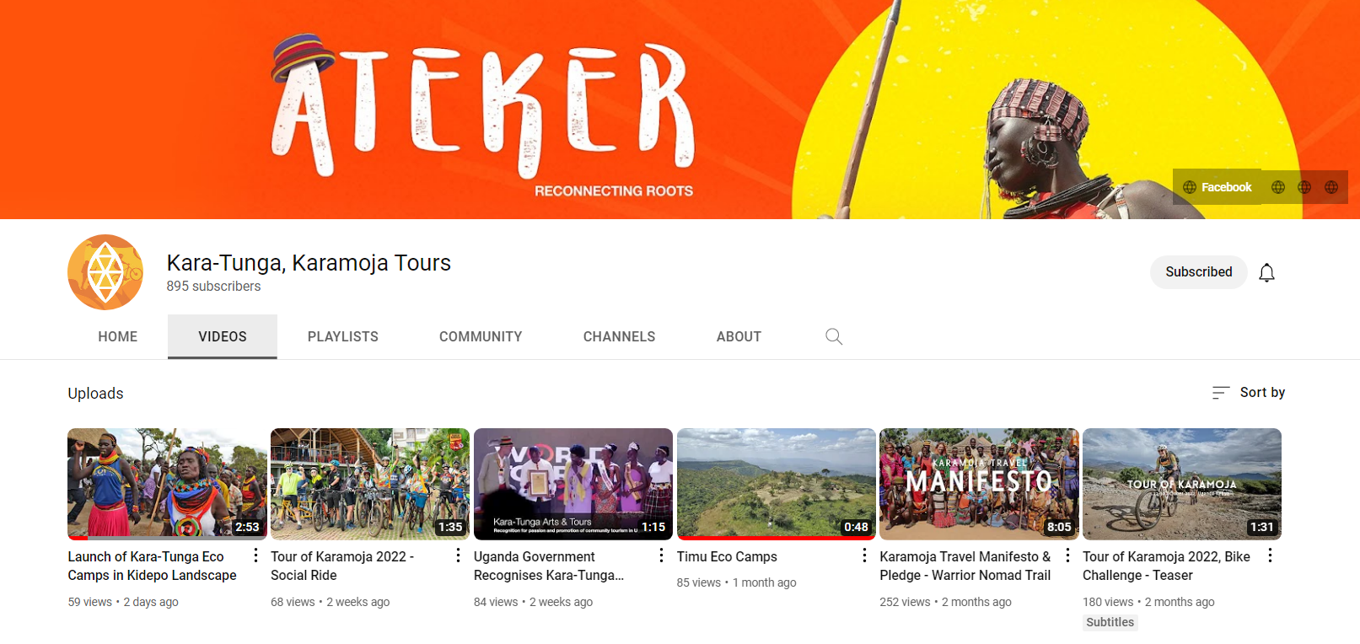
Notes:
How to facilitate this section:
YouTube channels can be customised with company branding. Video content can be grouped into playlists.
All video content should be optimised, with the use of appropriate keywords and video descriptions.
Few tourism businesses are likely to have the capacity to create and manage their own YouTube channel. However, it can be a powerful tool.
Useful talking points and angles to consider:
It's useful to remind participants that they might want a video promotion strategy but they do not have to develop all the different tools we recommend to them. The decision to use video must be based on understanding their target market and assessing their company resources (budget / staff / equipment).
Prepare:
Set up your laptop so that you can explore the Kara-Tunga YT channel. Click on graphic or go to https://www.YouTube.com/c/Kara-tunga/featured

Slide 125
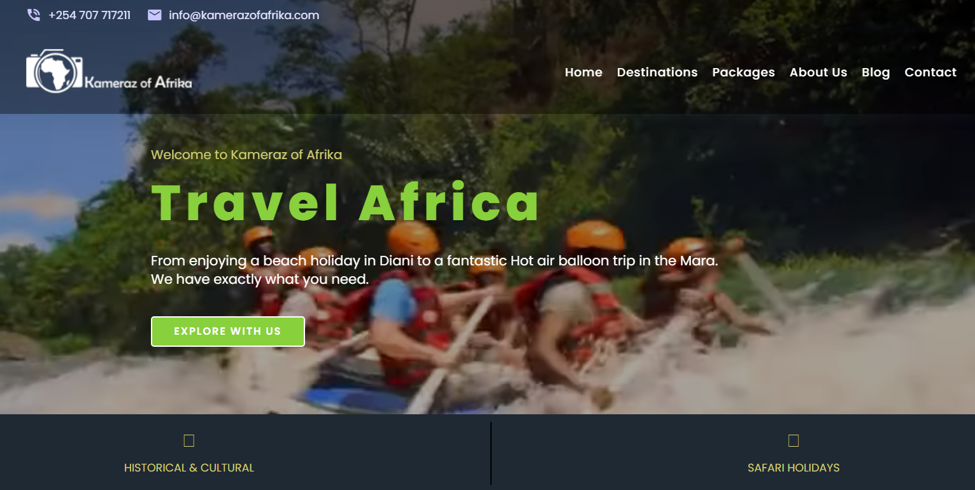
Notes:
How to facilitate this slide:
Video content can be simple yet effective.
In this example, the excitement of a holiday can be captured in just a few seconds. It plays in aloop.
Prepare:
Set up your laptop so that you can view the video banner on the home page. Click on graphic or go to https://www.kamerazofafrika.com/
Useful talking points and angles to consider:
The downside of integrating YouTube in a website is that you may lose web visitors when they click on your YouTube video link. Sometimes, embedding video in your website (as here) is a better solution.

Slide 126
What about B2B?
If you are considering social media marketing to target potential partners, LinkedIn will be an effective platform to invest in.
LinkedIn allows you to find and connect with specific decision-makers in companies
Present yourself as a professional representative of your business and brand
Notes:
How to facilitate this slide:
While the course content is primarily focussed on marketing to travel to a B2C audience (selling to the traveller directly), it is worth acknowledging that many tour operators sell to agents or buyers (B2B) as a primary or important market.
This slide explains opportunity of LinkedIn as a social media platform, for tour operators who plan to reach B2B partners through online channels.
Useful talking points and angles to consider:
Compares to popular social networks like Instagram and Facebook, LinkedIn is a professional network, focussed on connecting professionals.

Slide 127
Questions and Answers
?
?
?

Slide 128
Reflection and Feedback

Slide 129
Thank you for joining us!

Slide 130
Contributors
This project is funded by CBI, the Centre for the Promotion of Imports from developing countries (CBI), part of the Netherlands Enterprise Agency (RVO.nl) of the Ministry of Economic Affairs & Climate Policy

