Slide 1
Sustainability Training for Tour Opєrators in Uganda
June, 2024
1

Slide 2
Contributors
Development of his curriculum is initiated by CBI, the Centre for the Promotion of Imports from Developing Countries (CBI), part of the Netherlands Enterprise Agency (RVO).

Slide 3
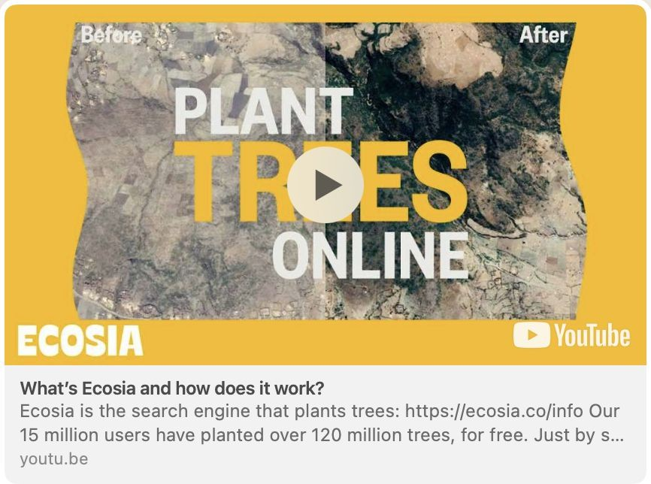
www.ecosia.org
A search engine that does more than plant trees
https://youtu.be/yRDA1ynrHTU?si=JRvCXo0D7coBo40t
3

Slide 4
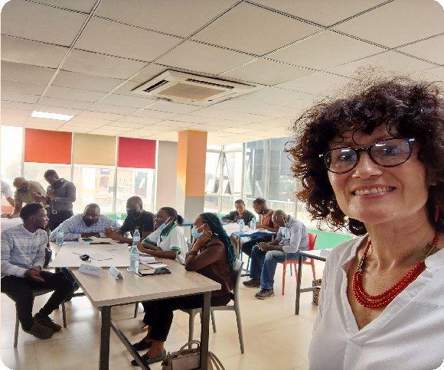
Katharina Bertram
Charlotte Beauvoisin
✔ Co-developer of Digital Marketing curriculum with CBI & EyeOpenerWorks / Ukarimu Academy.
✔ Creator of Diary of a Muzungu and the East Africa Travel Podcast.
✔ "Podcaster and blogger in residence" at Sunbird Hill, Kibale Forest, home to the NGO In the Shadow of Chimpanzees (conservation education, ‘citizen science’ & immersive nature experiences).
Marilyn Jabo
✔ Fair Trade Tourism Auditor
✔ Sustainability Consultant with support to SMEs
✔ Experience in SME Mapping and Investment in Hospitality and Tourism Industry
✔ Your friendly neighbour
✔ Active Stakeholder in the tourism industry of Uganda for over 10 years
✔ Experience as Tour Operator & Hotel Owner
✔ Sustainability Consultant
✔ Sustainability expert & trainer for EyeOpener Works

Slide 5
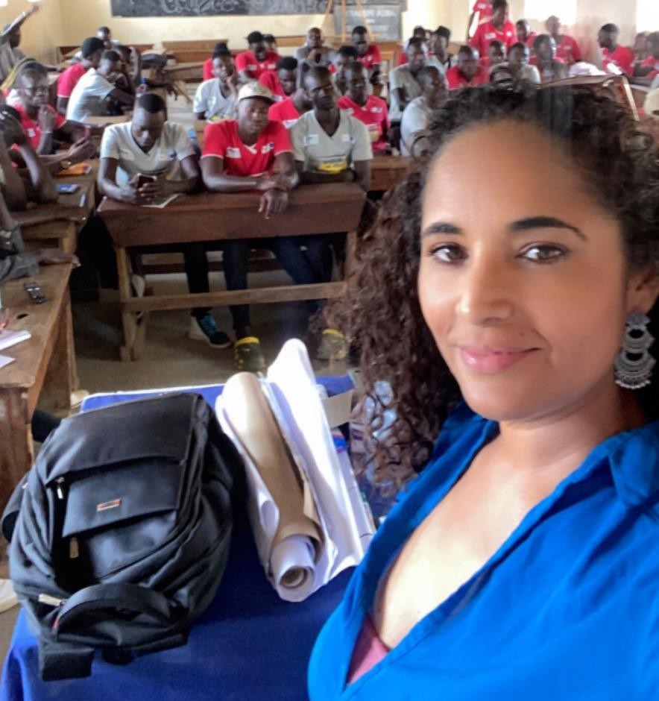
Joshua Ampumuza
Fanny Martinez
✔ CBI sustainability tourism facilitator
✔ Independent digital marketing and business administration trainer
✔ CEO of Back to the Source Tours with a focus on niche marketing campaigns
✔ Hotel mystery guest and consultant
✔ Tourism leader with the Ugandan American Diaspora Community
Freda Yoachael
✔ Sustainability Coach with CBI
✔ Fairtrade Tourism Auditor
✔ Travelife Coach
✔ Project officer on Covid-19 Economic Recovery Resilience Response Program with UTA
✔ Assistant Project Officer on Hotel
Apprenticeship Program with UHOA
✔ Co-Ordinator Tourism Research Development Centre TRDC
✔ Sustainability and financial management consultant with CBI
✔ Supports SMEs in their growth journey in various areas with focus on business development services
✔ Director at Frontier Advisory Partners Limited

Slide 6
Housekeeping
Wifi (Provide wifi login)
Coffee breaks and lunch
Ask questions and participate - we are here to learn
There are no wrong questions
Timekeeping and starting times
The presentation will be shared with you
18

Slide 7
Course Modules
Day 1
✔ Module 1 - Sustainability Basics Refresher
✔ Module 2 - Meeting Sustainability Champions
✔ Module 3 - Operating Environment Mapping and Sustainability Baseline Review
Day 2
✔ Module 4 – Sustainable Tourism Policy
✔ Module 5 – Action Planning
✔ Module 6 – Sustainable Tourism Certification
18

Slide 8
Purpose of this training
Revisit the basic principles of sustainable tourism and review current challenges facing Uganda and your business
Understand the business case for sustainable tourism and your role & responsibilities in the tourism supply chain
Review your impact areas and formalize your own sustainable tourism operations
Understand the need and process of certification
Make sustainability commitments
18

Slide 9
What you’ll learn
Knowlєdgє
Sfiills
✔ Revisit the basic concepts and principles of sustainability
✔ Understanding why practising sustainability is important for your business and tourism in general
✔ Analyse your impact areas and identify steps for improvement
18

Slide 10
Let’s get to know each other…
When the ball gets thrown to you, introduce yourself: Name & Company
Tell us about the most unforgettable travel experience you had!
What are your expectations of this training? What are you hoping to learn?
18

Slide 11
Modulє 1 Sustainability Basics Rєfrєshєr
18

Slide 12
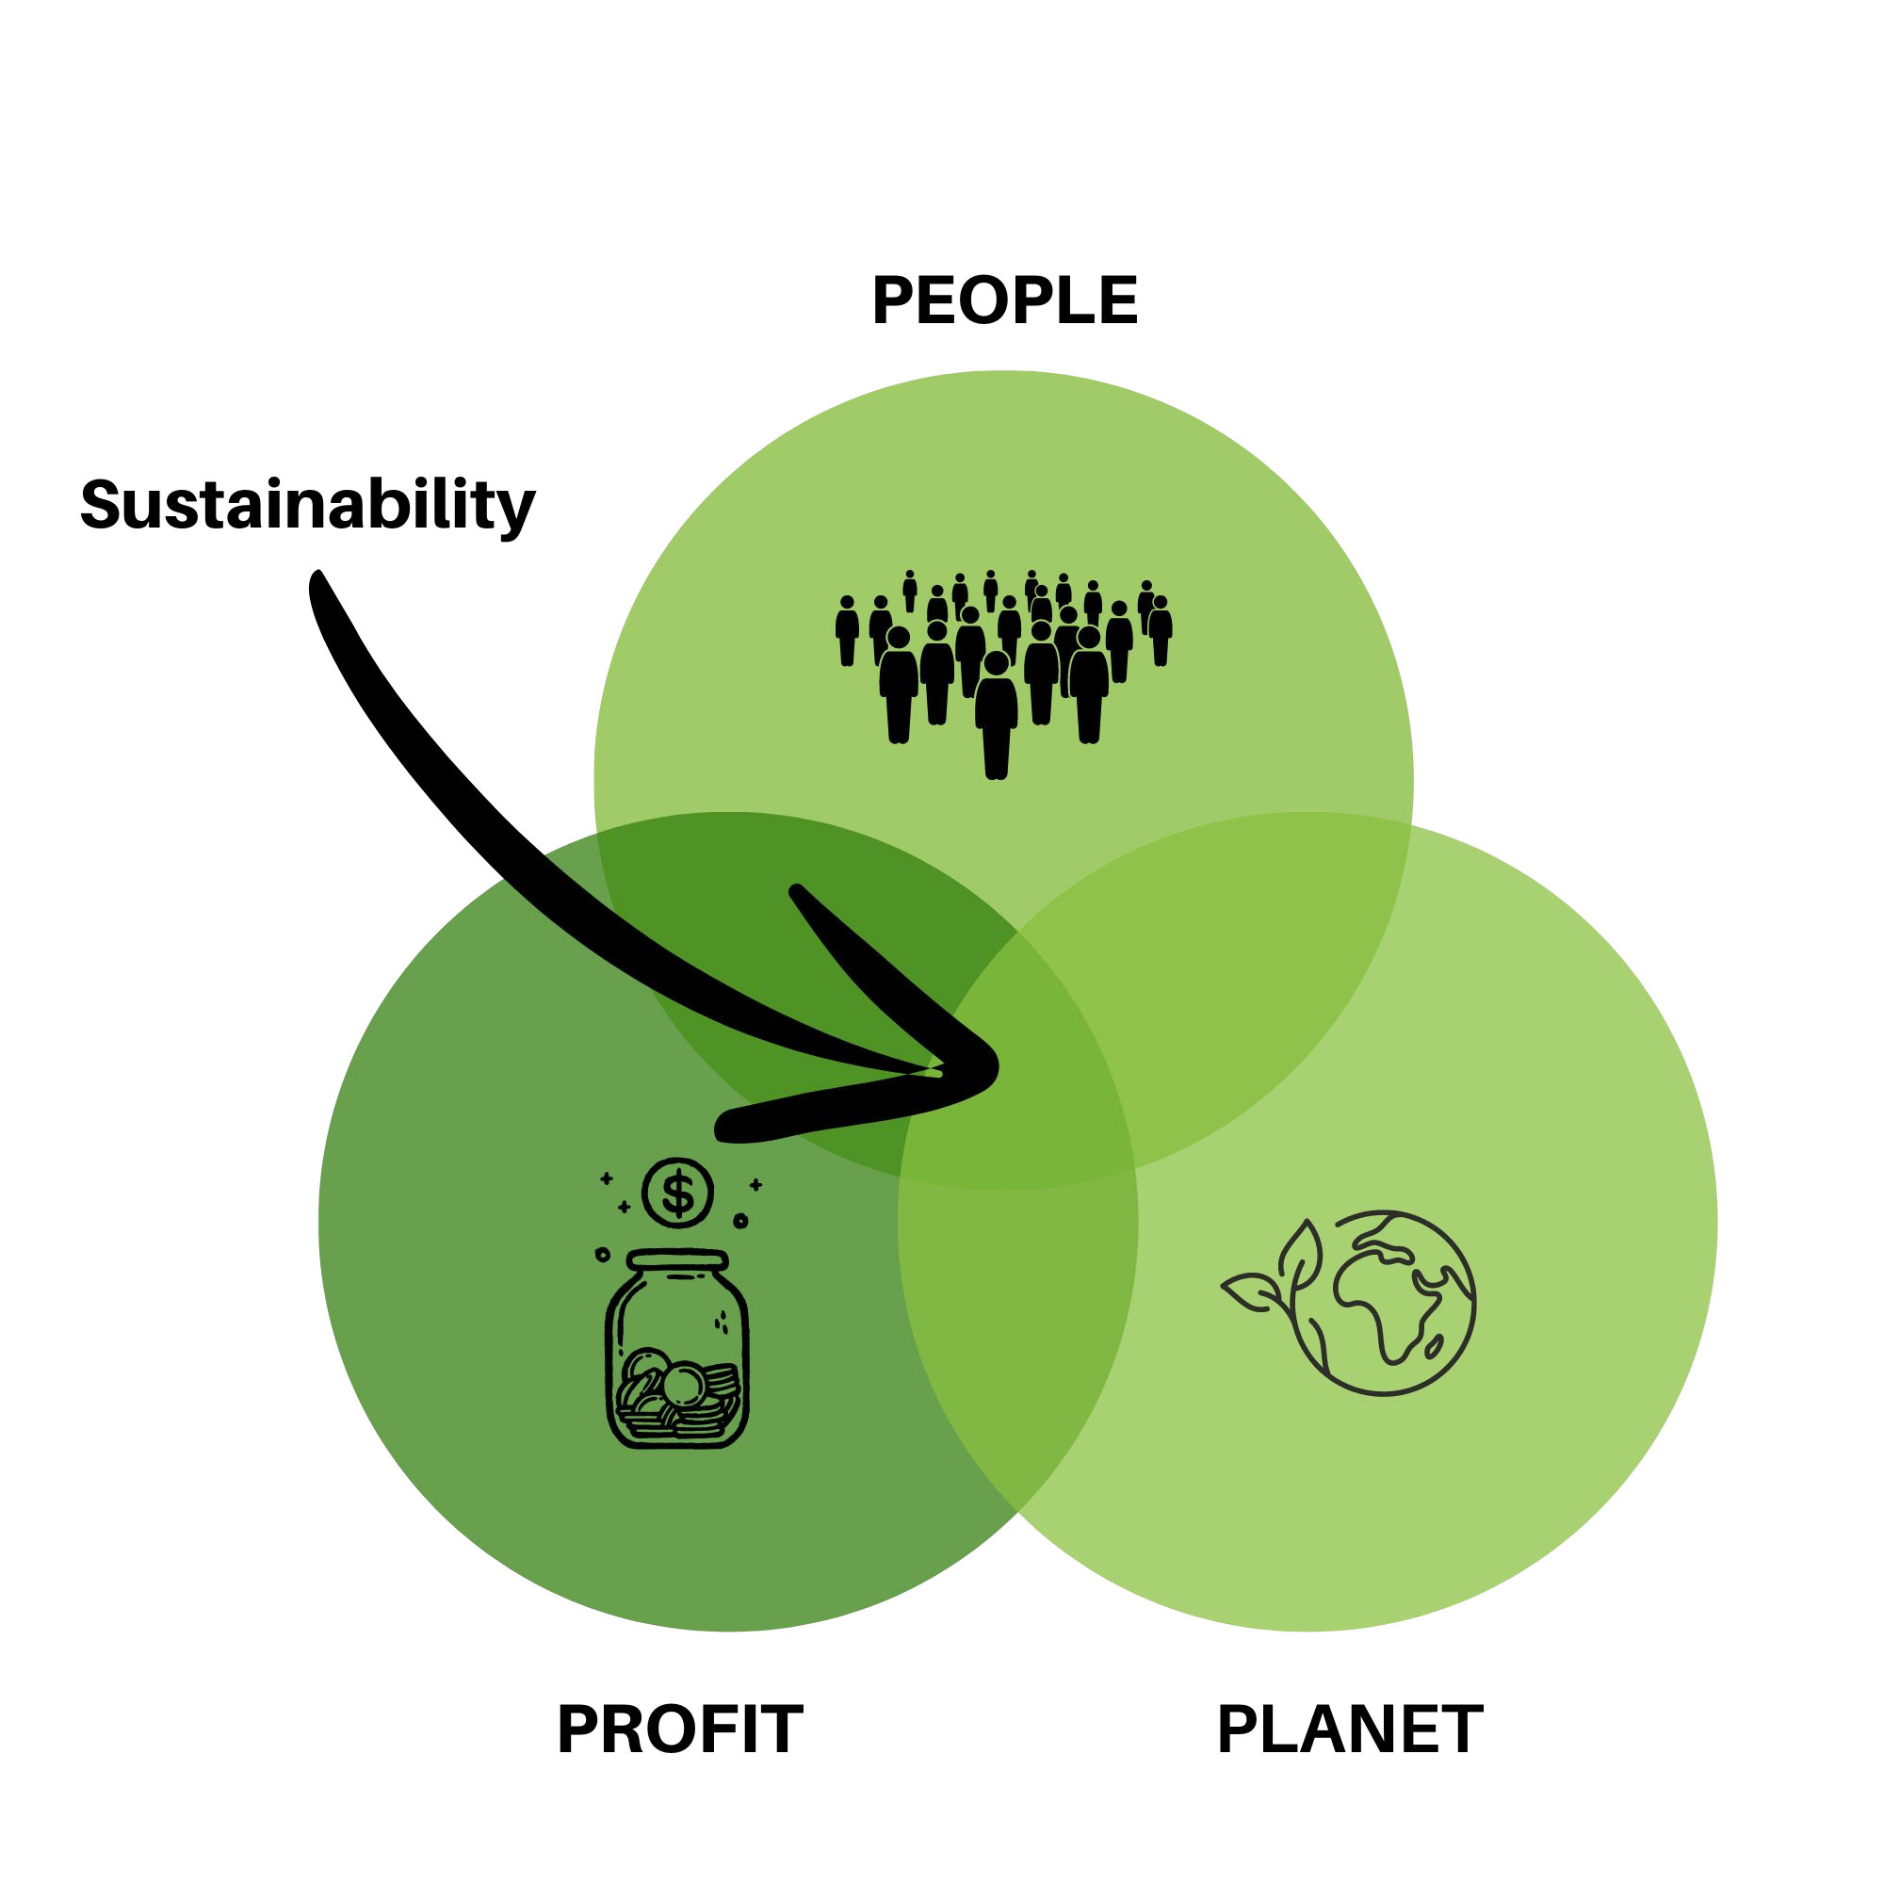
Defining Sustainability
How do you define Sustainability?
‘development that meets the needs of the present without compromising the ability of future generations to meet their own needs.’
Source: UN
18

Slide 13
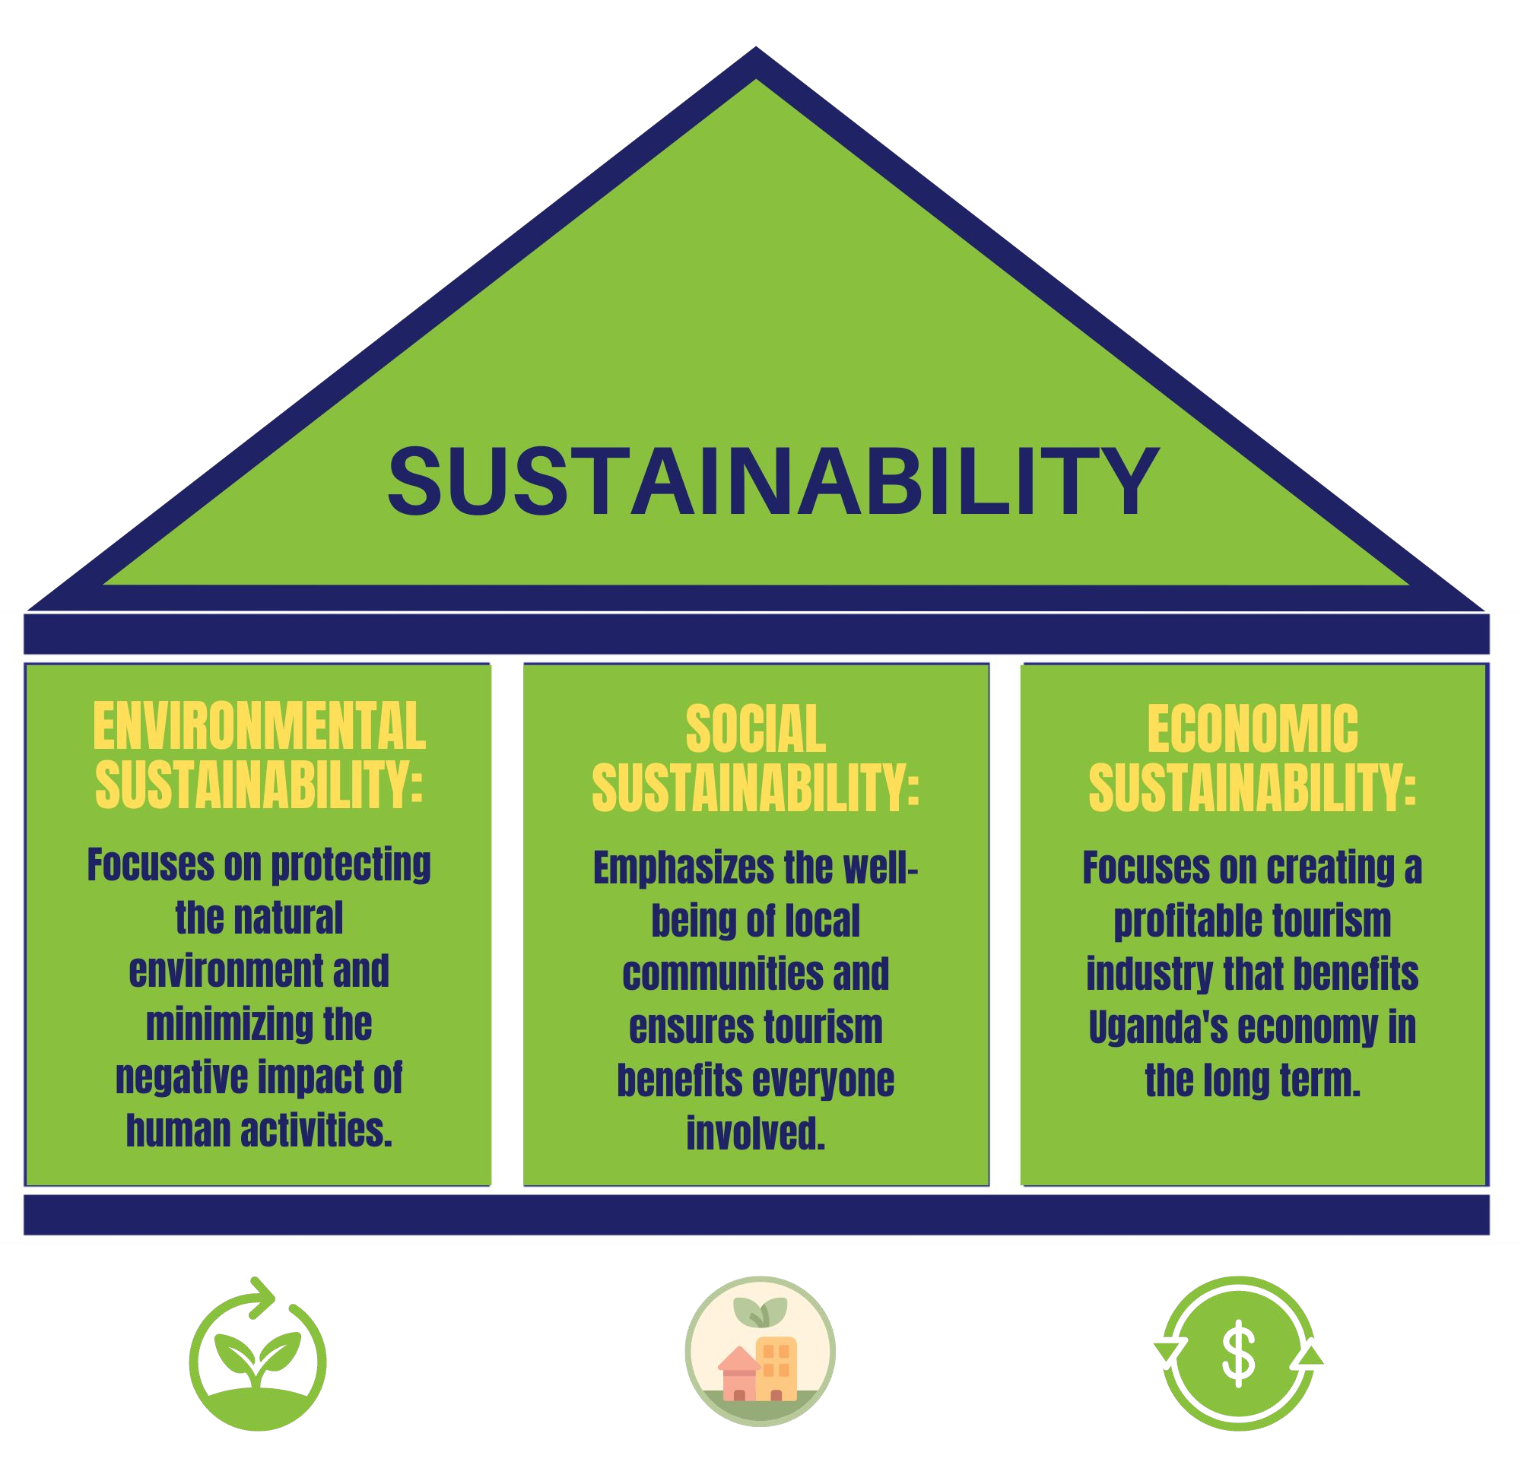
The Three Pillars / Triple Bottom Line
18

Slide 14
Three Pillars: Environmental Sustainability
Protection of the natural environment
Minimizing the negative impact of human activities
Wildlife protection
Conservation efforts
Reducing the carbon footprint of the business & the traveler
18

Slide 15
Three Pillars: Social Sustainability
Emphasis on the well-being of people
Assurance of decent work environment (respect employees rights, pay decent wages, give off days, etc.)
Offer development & training opportunities to staff and communities
Inclusivity & gender equality
Inclusion of communities, culture & traditions in a respectful manner
Promote inter-cultural exchange
Supporting of local businesses
18

Slide 16
Three Pillars: Economic Sustainability
Focus on financial stability & economic growth
Improved resource efficiency (renewable energy, eco-driving, etc.)
Investments in sustainable solutions
Minimizing risks = maximizing resilience
Meet the market demands & be able to charge premium rates
18

Slide 17
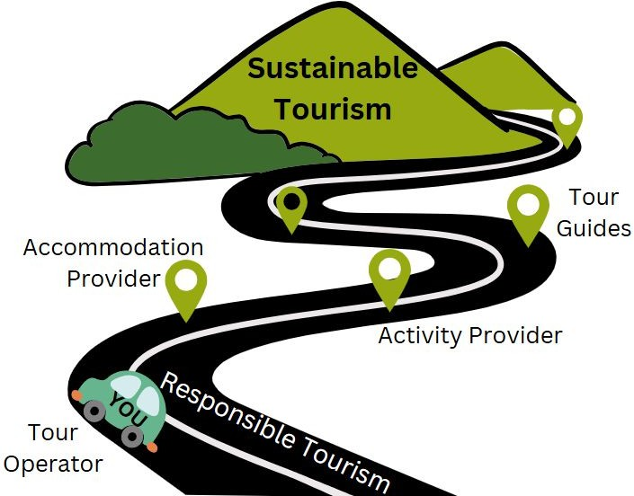
Sustainable Tourism -vs- Responsible Tourism
Responsible Tourism is a dynamic process, a road to a more sustainable tourism destination.
SUSTAINABILITY IS THE GOAL
All tourism stakeholders need to be involved and work together to reach the goal.
18

Slide 18
Responsibility of a tour operator
All stakeholders are responsible for sustainable development.
Influence
TOUR OPERATOR
Influence
ACCOMMODATION
TOUR GUIDES
Promotes and / or provides trade by including in packages or recommending to guests
Provides employment within organisation or by contract
Influence
Influence
Tour operators have influence on other stakeholders & therefore need to be extra cautious about their supplier management.
Influence
RESTAURANTS
ATTRACTIONS
Promotes and / or provides trade by including in packages or recommending to guests
TRANSPORTATION
Promotes and / or provides trade to natural and cultural attractions through tours
Engages boat, bus, train, plane and other transport operators to move guests to / at attractions
> Sustainable Supply Chain Management
(Will be discussed in the next session in detail)
18

Slide 19
Positive s Negative Impact
POSITIVE IMPACTS:
Boosts economy (job creation, vast value chain)
Improves infrastructure (roads, airports, education)
Funds conservation (natural restoration, wildlife protection)
Encourages cultural exchange (understanding, appreciation)
Empowers communities (local businesses, traditions)
NEGATIVE IMPACTS:
Harms environment (waste, deforestation, water, pollution)
Erodes cultures (tourist preferences over traditions)
Widens inequality (unequal distribution of benefits)
Penetrating natural habitats (disturbing flora & fauna)
Commercialising culture (unauthentic presentation)
19

Slide 20
Activity
Use Post-its & write key impacts of tourism in Uganda?
3 positive ones (green post-it)
3 negative ones (red post-it)
5 minutes
Discussion
How can your business maximise positive impacts?
How can your business minimize negative impacts?
20 minutes

Slide 21
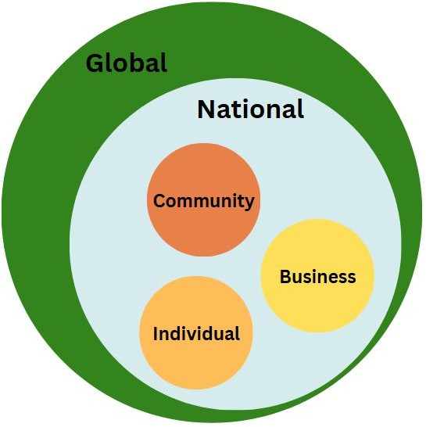
Sustainability: Why does it matter?
Watch the video & note 3 key takeaways on post its
There is a global crisis
We can look at it from different perspectives
No matter which perspective you hold: Each & everyone is responsible and has to act accordingly
“We have to start somewhere”
Establish a goal & make a plan from your perspective!

Slide 22
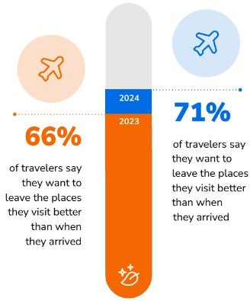
Sustainability: Why does it matter?
Market Demand & Guilt Free Travel
Travelers want to travel more sustainable
Travelers feel guilty when they make less sustainable choices
Travelers want to have a positive impact on the places they visit
Source: Booking Sustainable Travel Report 2024.pdf

Slide 23
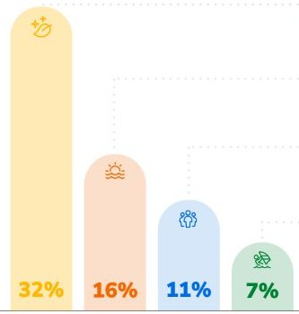
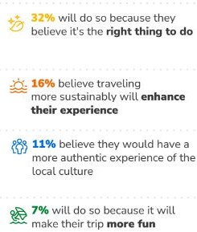
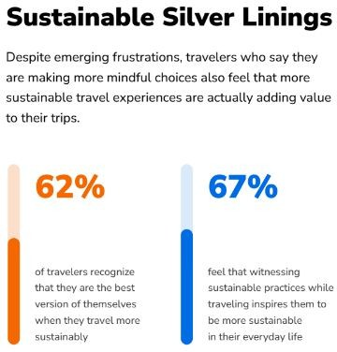
Sustainability: Why does it matter?
Market Demand & Enhanced Travel Experience
Of those who want to travel sustainably
Source: Booking Sustainable Travel Report 2024.pdf

Slide 24
Sustainability: Why does it matter?
Market demand - according to the Expedia Sustainable Travel Study 2022
3 in 5 consumers opt for environmentally friendly lodges
65% would opt for environmentally friendly lodges on their next trip
7 in 10 consumers avoided a destination due to scepticism about the authenticity of their sustainability efforts

Slide 25
Sustainability: Why does it matter?
Market demand - according to the Expedia Sustainable Travel Study 2022
70% of consumers are willing to sacrifice convenience to be a more sustainable traveler
50% of consumers are willing to pay up to 38% more for sustainable travel experiences
More than 40% of consumers want to be informed about more sustainable alternatives
More than 40% of consumers would like to receive information about cultural activities & how to best interact with local communities

Slide 26
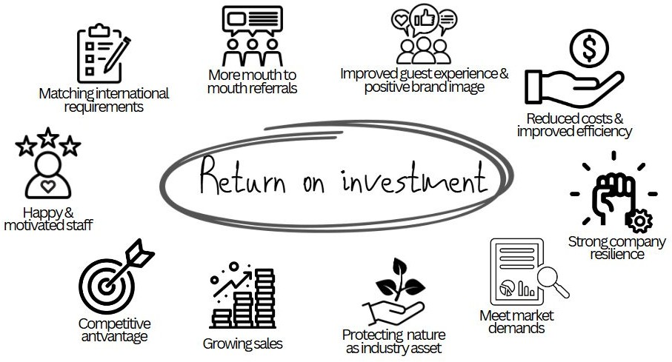
Sustainability: Why does it matter?
Positive impacts on your business:
Cost savings
Competitive advantage due to market demand & mouth to mouth referrals
Improved product quality & more authentic guest experiences
Offering guilt-free travel experiences
Happier staff = more motivated staff
Positive brand image & reputation
Strengthened company resilience

Slide 27
Sustainability: Why does it matter?
Additional Aspects:
Pre-empting government regulations & interventions
Protecting the environment which is the base for your business
Sustainability standards are required by international partners
Tourism has a vast negative impact & has to reduce it as it is simply the right thing to do

Slide 28
Sustainability: Why does it matter?
Let’s summarize! Why should we become a sustainable business?
Responsibility:
It is the right thing to do!
Market demand:
Research clearly shows that the international market expect businesses to take over responsibility
Travelers seek to minimize their carbon footprint & their negative impact on nature
Travelers want to experience culture & interact with communities
Business Case:
Sustainable changes are often cost saving
Clients are willing to pay more for a guilt-free travel experience
Provides a competitive advantage
Creates a more resilient business

Slide 29
Becoming a Sustainable Business: What next?
What is Sustainable Tourism? Why is it my responsibility?
Why does it matter for my business?
Meeting Sustainability Champions
Operating Environment Mapping & Sustainability Baseline Review Tomorrow: Formalizing Sustainability Efforts & Certification

Slide 30
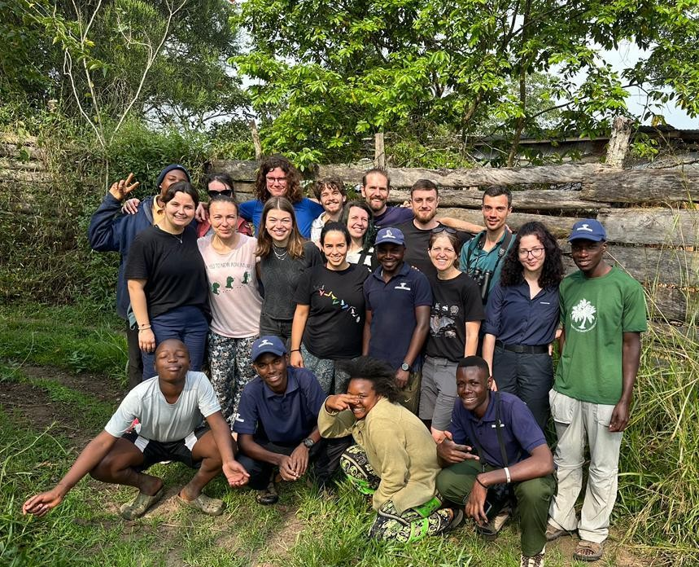
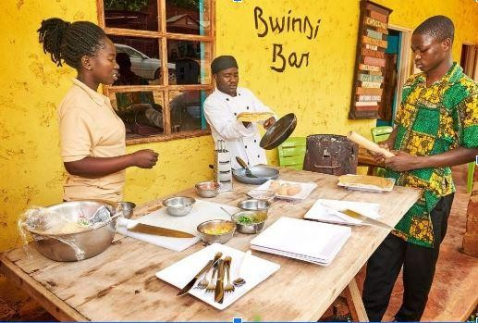
Modulє 2
Mєєting Sustainability Champions

Slide 31
Who are your Sustainability Champions?
DISCUSSION. Why are they important?
What do we mean by a sustainability champion? And why are they important?
Can you name any?
Explain why they are your sustainability champion(s).

Slide 32
Sustainability Champions - a definition
Definition: A person / organisation who doesn’t just do the minimum but is “one step ahead.” A champion:
Recognises the power their business has to effect change
Challenges norms
Responds to trends – and sets them too.
Isn’t scared to take risks
Confidently sets themselves apart from competition
Retains their staff because staff feel valued
Inspires all of us to do more!

Slide 33
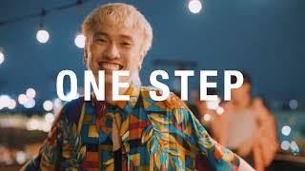
Responsible Tourism Award winners from Africa in 2024

Slide 34
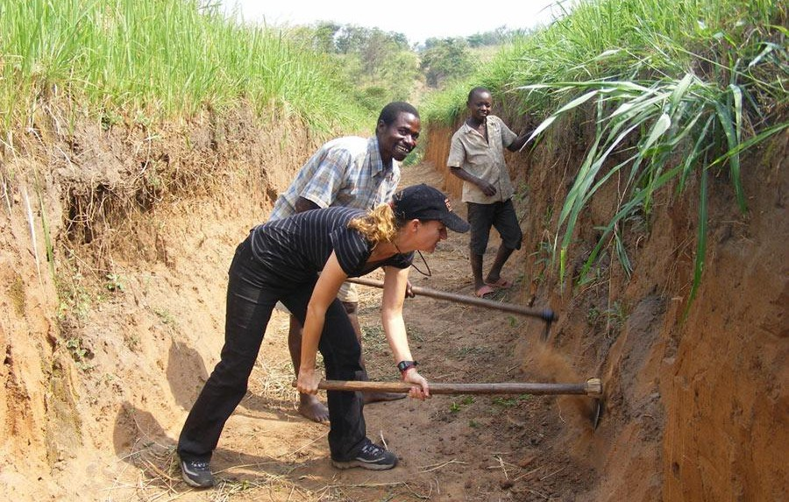
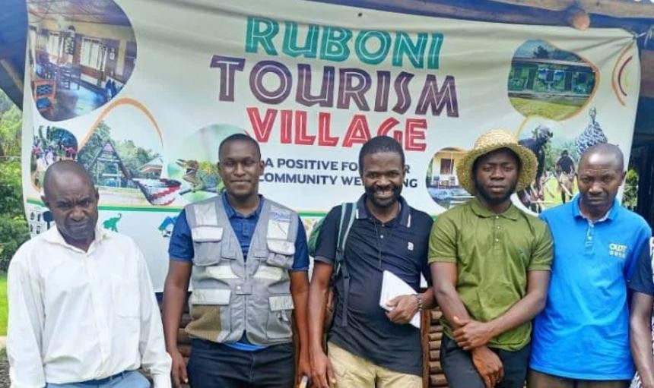
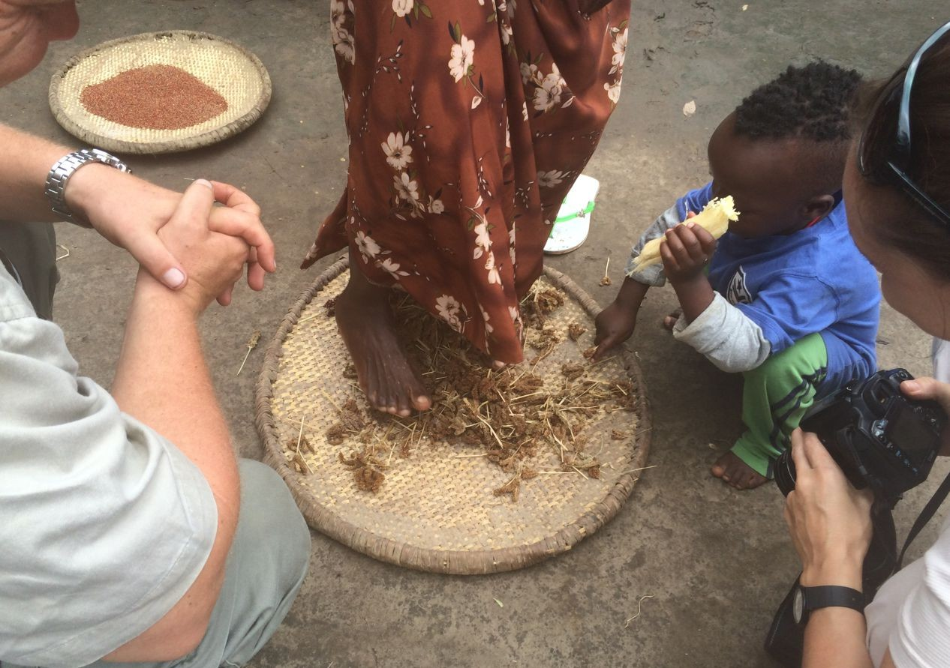
Sustainability champions in Uganda - examples
Award-winning companies include:
Kara-tunga Arts and Tours
Kikonko Lodge, Lake Albert
Matoke Tours DMC
Ruboni Community Camp / Tourism Village
Sunbird Hill / In the Shadow of Chimpanzees NGO
Volcanoes Safaris
Ishasha Wilderness Camp (Uganda Exclusive Camps)

Slide 35
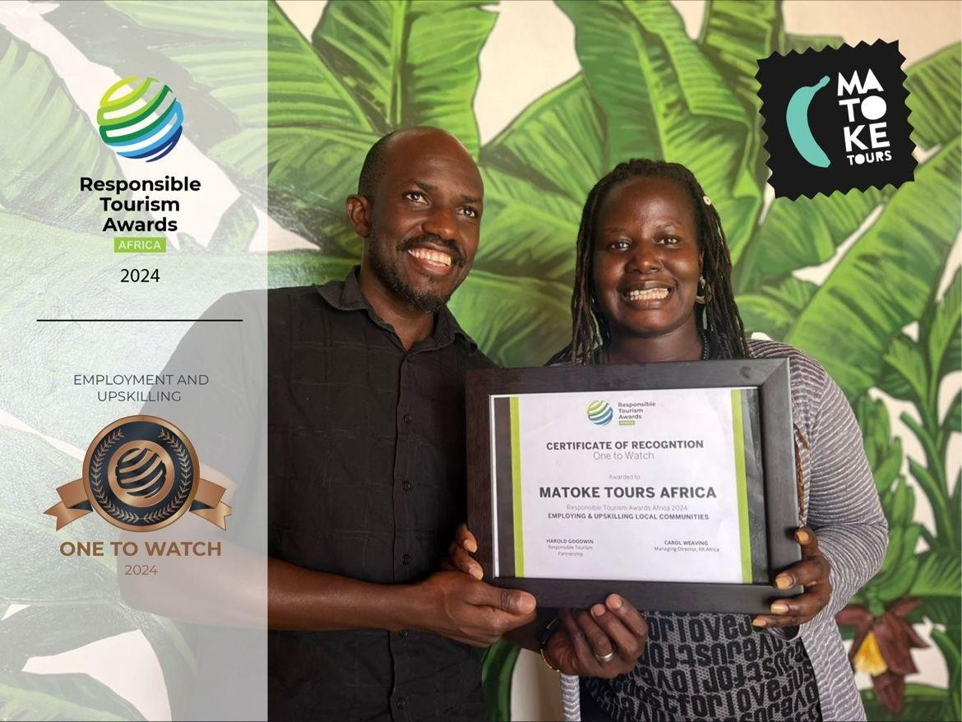
Matoke Tours DMC
“Sustainability is a guiding principle at the core of their business.”
One of Uganda’s leading destination management companies.
Initiatives aim to “trigger a sector-wide participation in a more inclusive tourism industry.”
Women in tourism - for female tour guides (multi-week training, work experience)
Adventure tourism – developing unexplored regions,
creating new itineraries, focus on cultural immersion and low carbon travel
35

Slide 36
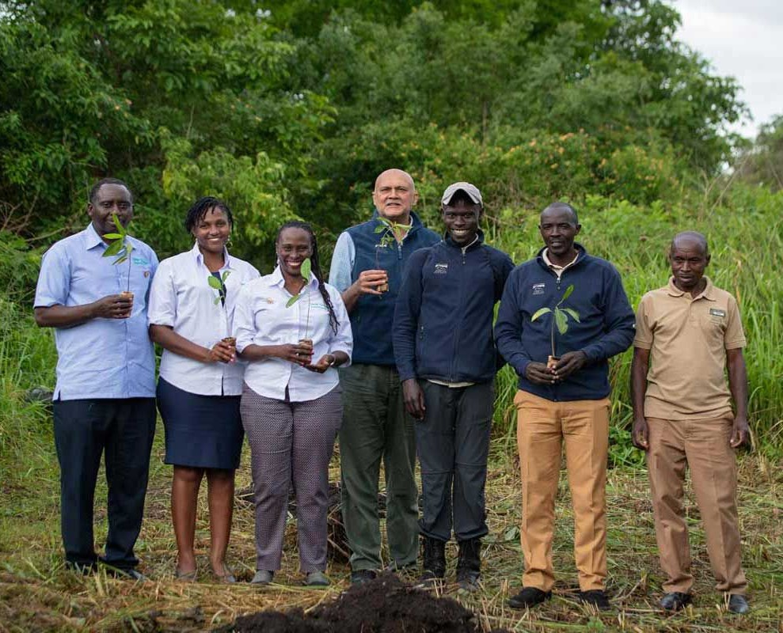
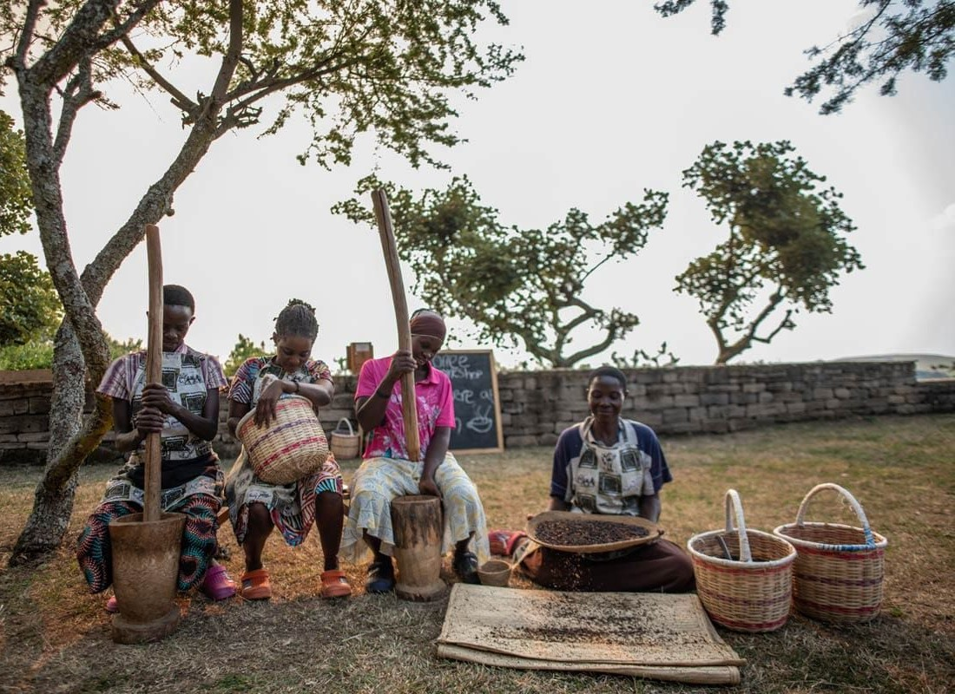
Volcanoes Safaris (Volcanoes Safaris Partnership Trust)
Award-winning projects include:
Conservation & community support: Planting a buffer zone
Tourism experience & creating jobs: Community coffee co-operative.
Creating jobs for disadvantaged communities: Batwa vocational centre
36

Slide 37
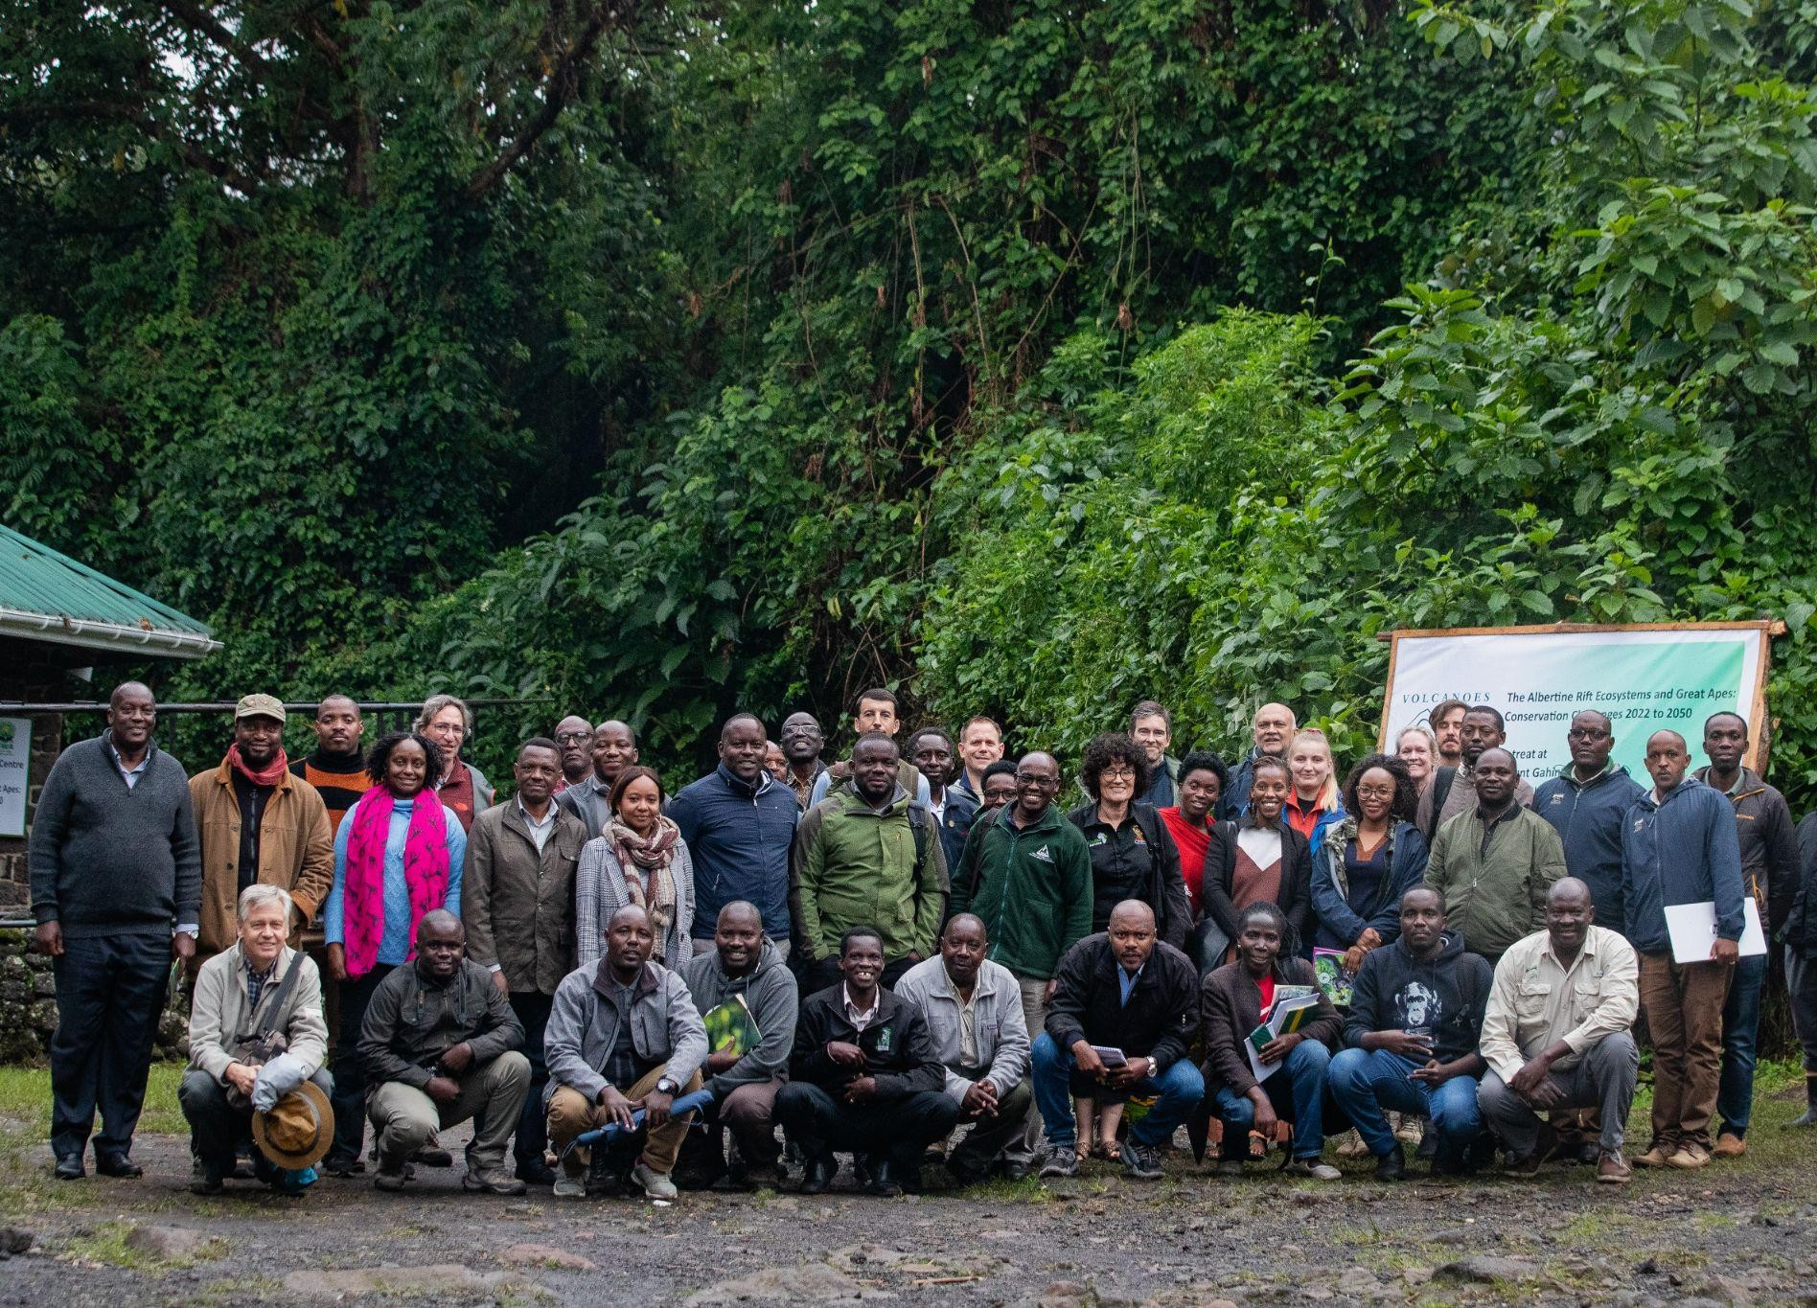
Volcanoes Safaris (Volcanoes Safaris Partnership Trust)
The Albertine Apes Alliance: informal network brings together stakeholders involved in conservation and ecotourism in the Albertine Rift.
1. Follow international guidelines for responsible gorilla tourism.
2. Promote responsible chimpanzee tourism.
3. Support communities around protected areas to improve livelihoods through ecotourism.
4. Raise awareness of pressures on Albertine Rift
protected areas from development and human presence.
37

Slide 38
Sustainability champions in Uganda - examples
Award-winning companies include:
….
….

Slide 39
Sustainability champions in Uganda - examples
Award-winning companies include:
….
….

Slide 40
Sustainability champions in Uganda - examples
Award-winning companies include:
….
….

Slide 41
Module 3
Operating Environment Mapping and
Sustainability Baseline Review

Slide 42
A
Introduction/ Objectives
Source: greentourism
42

Slide 43
Introduction
Objectives of the Module/Session
Equip tour operators with knowledge and skills to operate sustainably
Enhance understanding of the operating environment and potential impact areas
Foster positive influence on the destination, business operations, customers, supply chain and community
43

Slide 44
B
Understanding your Destination and Operating Environment

Slide 45
Understanding your destination and operating environment
Lєarning Outcomєs
Analyze positive and negative effects of Tourism in Uganda
Identify areas where businesses can exert positive influence.
Source: youthtimemag

Slide 46
Understanding your destination and operating environment
Positivє Impacts of Tourism in Uganda
Economic growth and job creation
Cultural exchange and preservation
Infrastructure development
Source: adventuretourismug
46

Slide 47
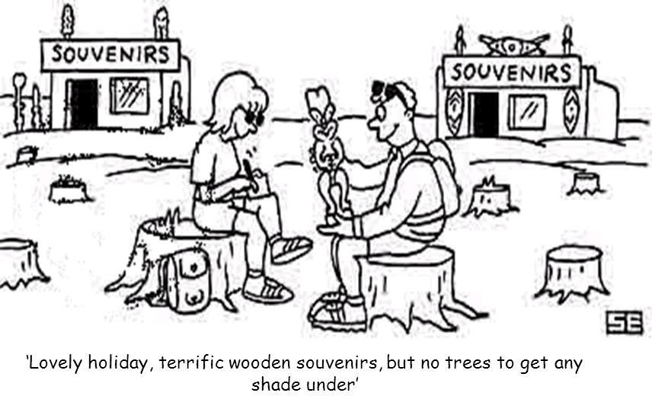
Understanding your destination and operating environment
Nєgativє Impacts of Tourism in Uganda
Environmental degradation
Cultural erosion
Socioeconomic disparities
51

Slide 48
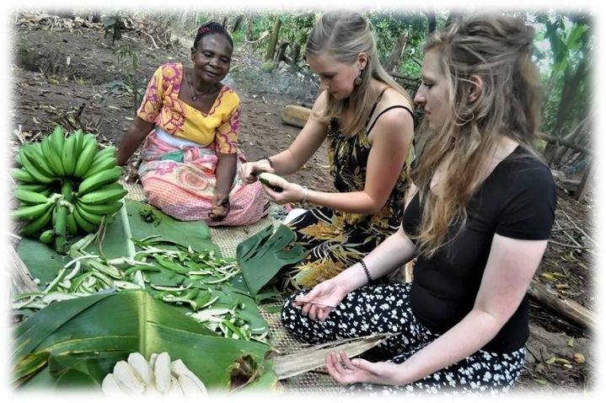
Understanding your destination and operating environment
Potєntial Influєncє Arєas
Conservation efforts
Community engagement and support
Promotion of cultural heritage
51

Slide 49
EXERCISES
Impact Mapping Exercise
Create a map identifying key tourist destinations in Uganda
Highlight areas of positive and negative impacts Discuss in groups how to mitigate negative impacts and enhance positive impacts
Bwindi Impenetrable Forest
Discuss the impacts of gorilla trekking tourism Develop strategies to balance conservation efforts with tourist activities
51

Slide 50
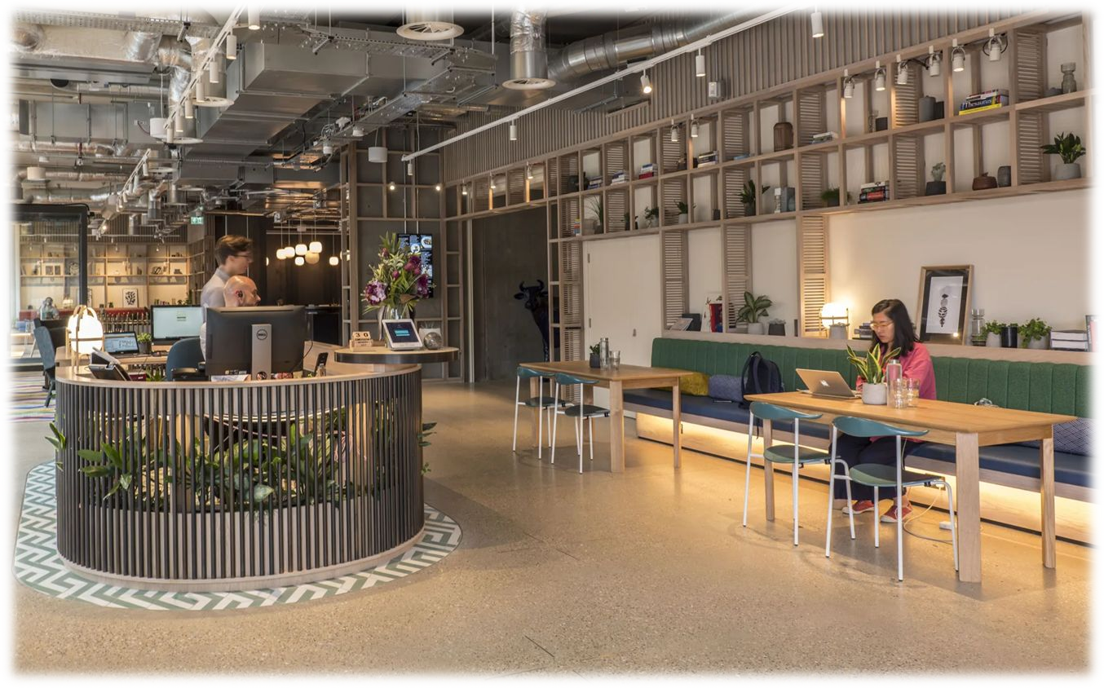
C
My Business Operations
Source: cundall
51

Slide 51
My Business Operations
Lєarning Outcomєs
Understand sustainable practices in day to day operations
Implement strategies for reducing the environmental footprint.
Source: rejournals
51

Slide 52
My Business Operations
Intєrnal managєmєnt
All the activities inside the office of a retail outlet such as energy-saving, waste management, paper management and proper labour conditions for employed staff members. The tour operator is in direct management control
51

Slide 53
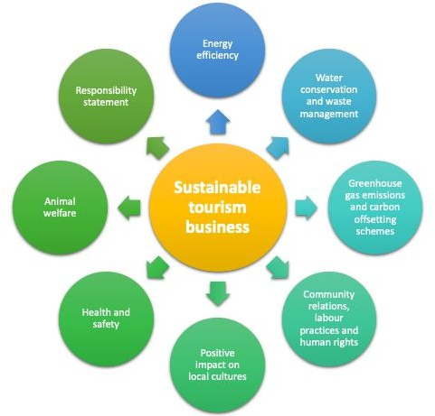
My Business Operations
Intєrnal managєmєnt- What to considєr
Office(s); location(s)
Personnel employed per office or region
Purchasing products and materials
Purchasing of printing materials
Contracts with third parties.
Source: https://www.cbi.eu

Slide 54
My Business Operations
Intєrnal managєmєnt- Kєy ʘuєstions to asfi
Do employees have formal contracts?
Are staff encouraged to use environmentally friendly transport to and fro work?- Sustainable transportation operations
Use of printed documents or soft copy documents?
Energy and water conservation in the office or location?
Waste management and recycling?

Slide 55
EXERCISES
Sustainability Audit of Your office Conduct and audit of your current business operations
Identify areas of improvement and set actionable goals
Eco Friendly Safari Lodge
Analyse the operations of an eco-friendly lodge
Develop a plan to implement similar practices in your business

Slide 56
D
My Customers

Slide 57
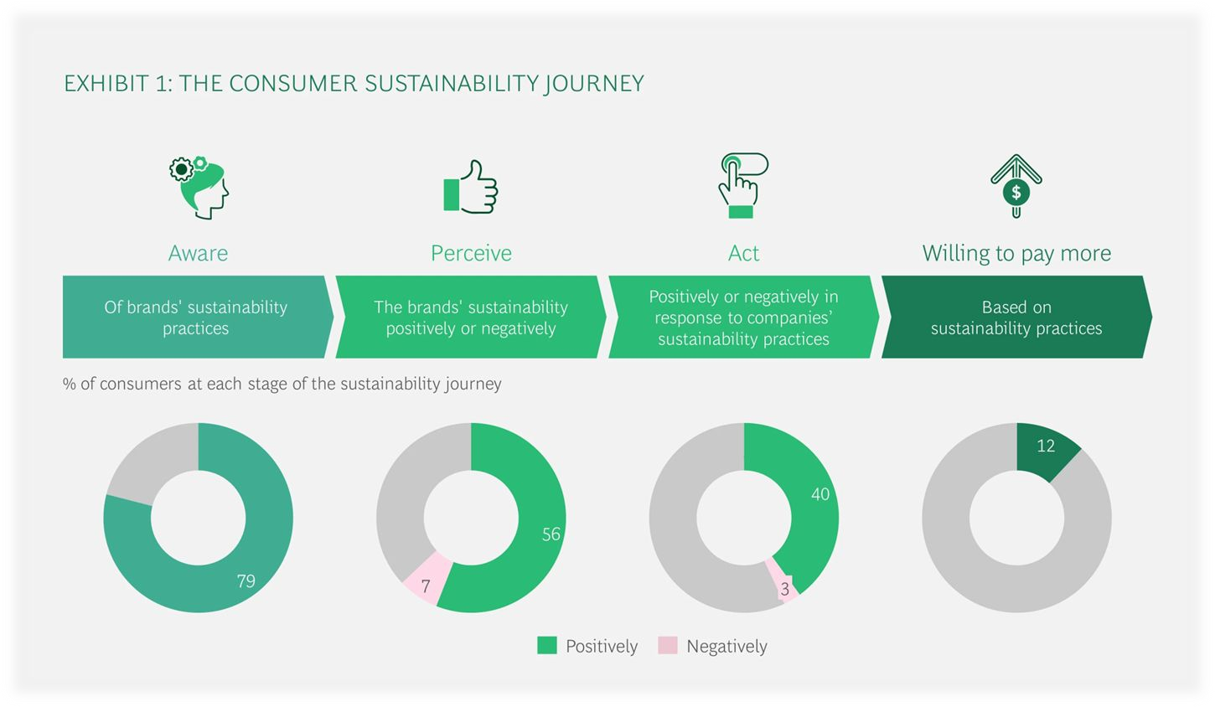
My Customers
Lєarning Outcomєs
To understand the role of the customer in promoting sustainability
Engage and educate the customers on sustainable tourism practices

Slide 58
My Customers
What to Considєr
Customer engagement- Educating local cultures and eco systems
customers about
Encouraging responsible behavior (waste reduction, respecting wildlife)
Collecting and acting on customer feedback regarding sustainability.
The range of messages provided to customers or potential customers before and after booking
The range of mechanisms in place for getting that information to customers
The range of situations where customers receive verbal information

Slide 59
My Customers
Kєy ʘuєstions to asfi
Are sustainability issues addressed in major publications?
Do the travel documents contain information on sustainability within the destination?
Engage and educate the customers on sustainable tourism practices?

Slide 60
EXERCISES
Customer Education Campaign
Design a campaign to educate customers on sustainable practices
Create materials such as brochures, social media posts and signage
Responsible Travel Campaign
Evaluate a successful responsible travel campaign
Adapt and implement key elements in your business

Slide 61
TOUR OPERATOR
Influence
Influence
ACCOMMODATION
TOUR GUIDES
Promotes and / or provides trade by including in packages or recommending to guests
Provides employment within organisation or by contract
E
My Supply Chain
Influence
Influence
Influence
RESTAURANTS
ATTRACTIONS
Promotes and / or provides trade by including in packages or recommending to guests
TRANSPORTATION
Promotes and / or provides trade to natural and cultural attractions through tours
Engages boat, bus, train, plane and other transport operators to move guests to / at attractions

Slide 62
My Supply Chain
Learning Outcomes
To recognize the importance of a sustainable supply chain
Develop strategies for working with sustainable supplies

Slide 63
My Supply Chain
Supply chain managєmєnt
Tour operators can have long term contract with many suppliers. Since not most of these suppliers work in a sustainable way, tour operators need to stimulate their partners towards improving sustainability. This can be done by tour operators through providing information and training, marketing and other incentives and by including sustainability requirements in their contractual conditions
63

Slide 64
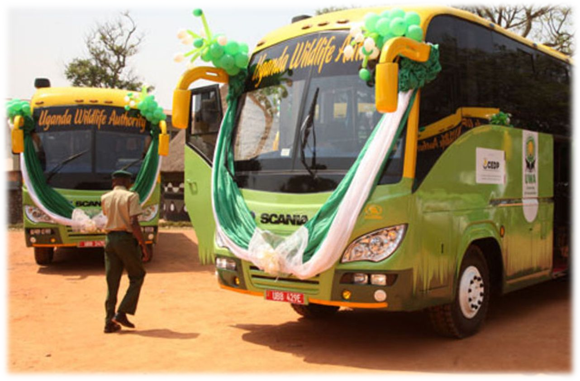
My Supply Chain
What to Considєr-Transportation
Type of transport used in the packages (plane, car, bicycles, bus)
Total distance covered during the travel.
The deployment frequency of a means of transport during the operating season

Slide 65
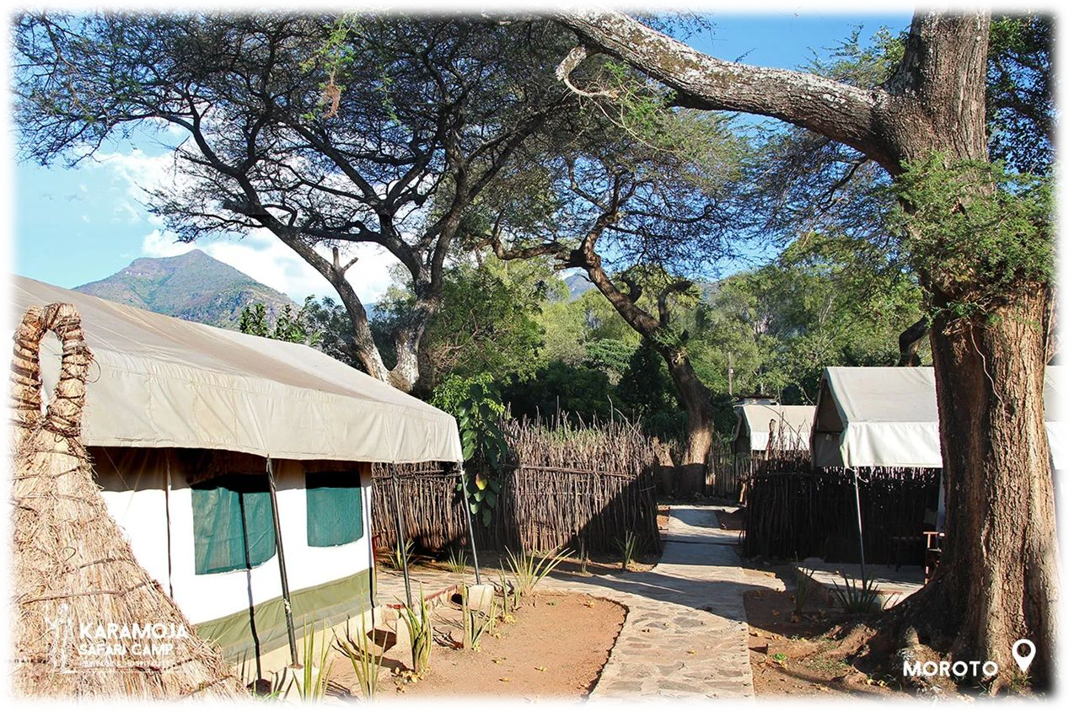
My Supply Chain
What to Considєr-Accommodation
The range of accommodation offered through the company’s products (hotel, hostels, campsites, apartments)
The number of accommodations in different destination and their relevance (number of passengers/year)

Slide 66
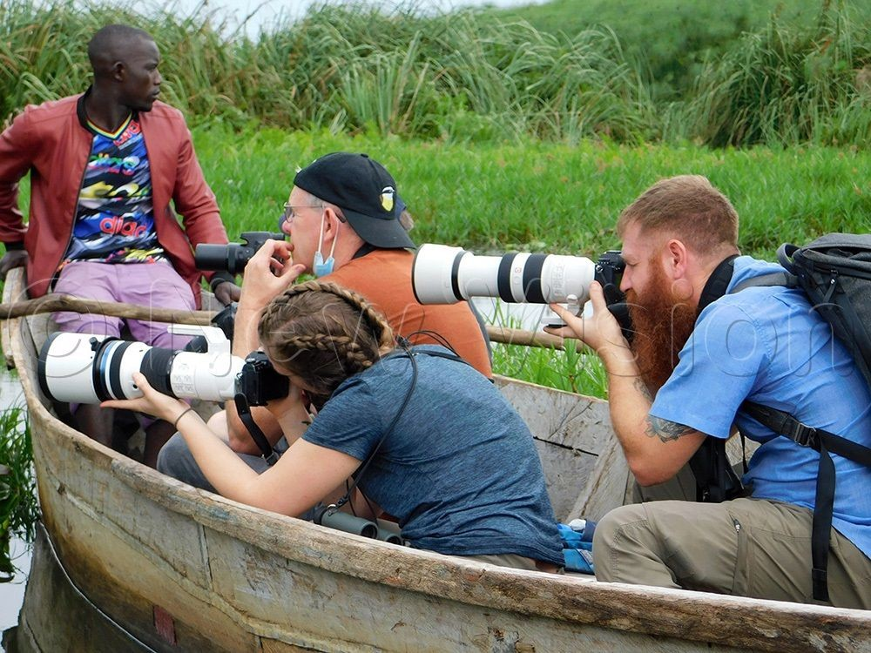
My Supply Chain
What to Considєr-Excursions and organizєd activitiєs
The range of nature of excursions/activities included in the packages(safari, city tours, water sports)
The range of excursions activities not included in the packages but offered by the company through local sales e.g. those that are outsourced.

Slide 67
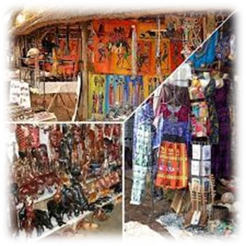
My Supply Chain
What to Considєr-Local Artisans and Crafts
The nature and range of local Artisans you work with.

Slide 68
My Supply Chain
Kєy ʘuєstions to asfi
What is the criteria for selecting my suppliers?
Do you have long term partnerships with local, sustainable business?
Do sustainability clauses have a prominent place in the company’s contracts?
What is the percentage of overnight stays in accommodation with a sustainability certificate?
Is the company helping accommodation to become more sustainable?
How do you track and report the sustainability of your supply chain?

Slide 69
EXERCISES
Supplier Evaluation
List your current suppliers and evaluate their sustainability practices.
Develop a plan to source more sustainable alternatives
Local Artisans and Crafts
Explore a case where a tour operator partnered with local artisans
Discuss the economic and cultural benefits of such partnerships

Slide 70
F
My Community

Slide 71
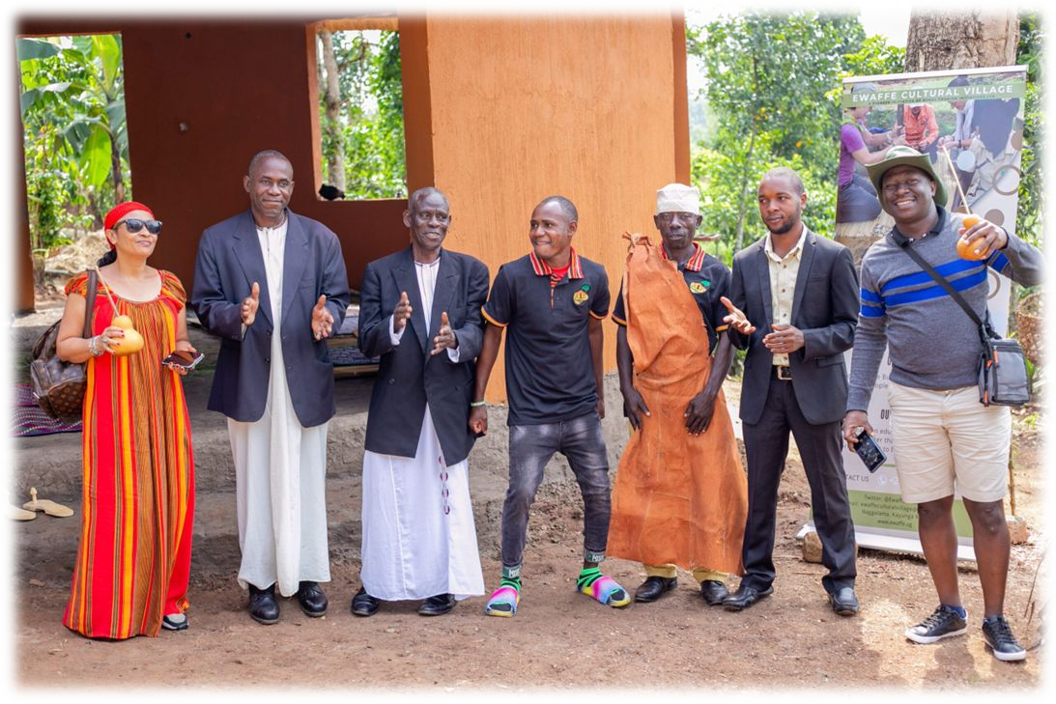
My Community
Lєarning Outcomєs
Foster positive relationships with the communities
Implement community based tourism initiatives

Slide 72
My Community
Collaborations with Destinations
Tour operators can have an impact on the
sustainability of a destination. They can influence local authorities, suppliers individually or collectively towards a more responsible and long-term perspective in developing the destination.

Slide 73
My Community
What to considєr
The most relevant destinations and the number of people per destination
The social and environmental impacts of tourism at these destinations
Community engagement- supporting local development projects
Creating opportunities for community members (e.g. training, employment)
Cultural sensitivity-respecting and preserving local traditions and practices

Slide 74
My Community
Kєy ʘuєstions to asfi
Do I as a tour operator support social and environmental initiatives in destinations?
Does my company train its guides in order to minimize the negative impact on the destination?

Slide 75
EXERCISES
Community Project plan
Identify a local community project that your business can support.
Develop a detailed plan for involvement and support
Community Homestays
Analyze a case of a successful community homestay program
Discuss the benefits and challenges, and how to implement a similar program.

Slide 76
Sustainable Tourism Implementation
Recap:
What is Sustainable Tourism & why is it important?
Get to know Sustainable Tourism Champions from Uganda!
Conduct a baseline review!
Sustainable Tourism Policy
Action Plan
Sustainable Tourism Certification

Slide 77
Module 4 Sustainable Tourism Policy

Slide 78
Sustainable Tourism Policy: What is it?
Framework that ensures that all responsibilities & areas of impact are properly addressed.
Defines a clear roadmap and guidance for implementation of an action plan
Involvement of all stakeholders and company players, while outlining their responsibilities
The key business action areas are:
Internal management (Office and staff)
Product development and management (Tours)
Supply chain management (Tourism products you include in tours)
Customer relations (Guests)
Cooperation with destinations (Community)

Slide 79
Sustainable Tourism Policy: Why is it important?
Makes the sustainability efforts official and structured
Ensures a uniform understanding of sustainability concept within the company
Guides employees & partners and provides clear expectations in behaviour and operations
Holds everyone accountable
Creates a positive brand image & enhances trust and loyalty in all stakeholders and clients
Ensures clients from the get go that they will travel guilt free & provides a competitive advantage during their decision making process
Strengthens company stability and resilience
It is a performance indicator for the GSTC for Tour Operators and therefore
important when it comes to certification
79

Slide 80
Sustainable Tourism Policy: How to get started?
There are no official requirements about what to include in a sustainability policy, in general it should:
Address all key areas of impact identified in the baseline review
Address the main aspects of the five key business action areas:
internal management, product development & management, supply chain management, customer relations and cooperation with destinations
Include a commitment to continual improvement
Set open, honest and realistic goals
Include compliance with laws and regulations and codes of conduct;
Aim to ensure that suppliers contribute to the company’s sustainability aspirations;
Include a commitment to raise awareness about sustainability issues among stakeholders, particularly suppliers and consumers.

Slide 81
Sustainable Tourism Policy: How to get started?
Avoid doing common mistakes:
Do not just define Sustainable & Responsible Tourism, but outline what it means to you as a company!
Why is it important to you & How do you manage your impact?
Do not just provide guidance on how to be a better traveler!
Do’s & Don’ts can be part of your publications, but it directs all responsibility towards the consumer while you do not commit to anything
Do not limit yourself to displaying charity organizations that you support. Only doing this effort is considered greenwashing!

Slide 82
Sustainable Tourism Policy:
How to get started?
Be transparent & realistic!
Remember, your efforts are a journey, no one expects you to be perfect!
Source: Venture Uganda/Responsible Travel
82

Slide 83
Sustainable Tourism Policy: Structure your policy
Create a sustainability mission & vision as general guidance. Keep it simple and make it visual for public display.
Example: Encounter Latin America
83

Slide 84
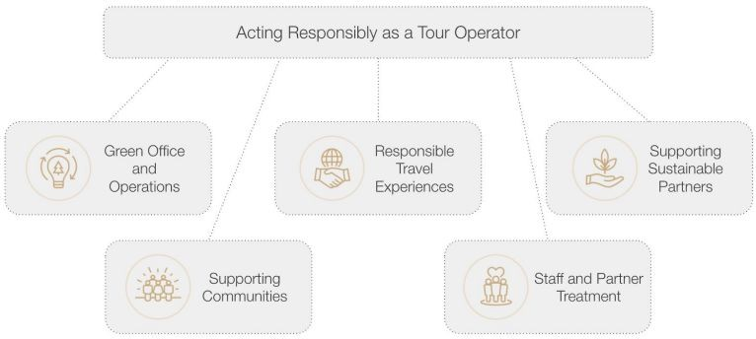
Sustainable Tourism Policy:
Structure your policy
Define criteria as headings
Triple Bottom Line: Social, Environmental, Economical
Company structure
Example: Enchanting Travels
How simple or complex the policy will be is your choice. It usually depends on company size and available resources.
Feel free to start simple and keep working on it.
Important is to formalize your sustainability activities.
84

Slide 85
Sustainable Tourism Policy:
Example!
Source: Venture Uganda/Responsible Travel
Travel will only ever be good if people enjoy it so, we make every effort to provide outstanding holidays and educational visits
We try to be professional and ethical in business. This means treating each other, our partners and clients in a fair and transparent manner and doing what we promise to do.
We are constructive and support others who we believe do good things. For example, we are corporate sponsors of Nature Uganda and The African Bird Club
We try to run an environmentally responsible office through measures like recycling waste,
minimising printing and sharing transport
have a website hosted at a data centre that is a member of The Green Grid
85

Slide 86
Sustainable Tourism Policy:
Example!
Source: Venture Uganda/Responsible Travel
Venture is a Ugandan-registered company with offices in Uganda. We pay taxes in Uganda and
all our profits stay in Uganda.
Although it is not always possible, we prefer to use local suppliers for accommodation, transport, activities etc.
We employ Ugandan staff and are committed to their welfare and development
We promote Uganda as a holiday destination. It is the leading forex earner in the Ugandan
economy
We help Ugandan people and communities to get involved in tourism to boost their incomes,
promote/preserve their culture or activity, or for social interaction
We support our own community in Rukungiri district, for example we have built staff housing at a local school, donated books and sports equipment. We also take clients to visit for a truly authentic experience.
86

Slide 87
Sustainable Tourism Policy:
Example!
Source: Venture Uganda/Responsible Travel
Africa often gets a bad press. We try to counteract this by publishing positive, challenging or surprising news about Uganda and the east Africa region. We are most active on LinkedIn
Clients often wish to make donations during their visits and we use our local knowledge to offer advice on how best to do that. We believe assistance should be fair, genuinely helpful and developmental.
If clients wish to give tips, we encourage them to use staff tip boxes where tips are shared among all staff not just those who have the chance to meet clients face-to-face.
We provide opportunities for clients to interact with local people and learn from each other. This is usually done through community tourism activities, run by community members themselves.
We promote cultural sensitivity for example by advising on appropriate dress and behaviour in a
particular context. We believe visitors should respect local people and their beliefs and, if you wish to challenge them, do so through open, respectful debate.
Hopefully, we inspire guests to ‘re-think’ developing countries and to continue to advocate for, or support, them after going home. For example, by sharing holiday experiences with colleagues, family and friends or through social media.

Slide 88
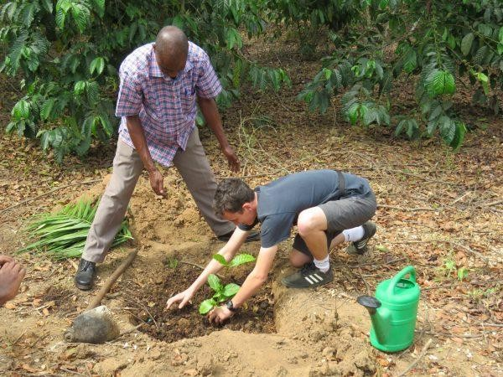
Sustainable Tourism Policy:
Example!
Simply visiting places like national parks contributes to their income and enables them to do their work – conservation
We provide professional guides from whom clients can learn more about Uganda’s natural history, culture and history
We go further by offering clients opportunities to engage with various conservation workers, perhaps on specially arranged private visits or over a private dinner.
Uganda has few true eco-lodges. We try to work with properties that have made some progress, for example, who use renewable energy, harvest rainwater, have organic gardens or source from their communities. We regularly visit our suppliers to check on what they do.
Flights and transport – Ugandan safaris usually involve moving around the country. There is
no infrastructure to support electric vehicles. The best we can do is try and offset these emissions by planting trees in our own forest or elsewhere and we offer clients the opportunity to plant the trees themselves.
We support community tourism and conservation initiatives by taking clients to visit them. These include guided community walks, farm visits, bark cloth making, trips with local fishermen and private forest visits.
We advise our clients on how to recycle and properly dispose of rubbish during their visit. We provide water bottles which can be re-filled in lodges and in our vehicles.
We actively encourage Ugandans to experience and cherish wildlife and nature. If nature is just for tourists and animals are just a nuisance, they will not be valued and protected. For example, we took pupils from a park-boundary school to enjoy a day in the park.
Very many Ugandans don’t take holidays. As this slowly changes, we promote domestic
tourism, getting Ugandans to appreciate and protect their own country.
Source: Venture Uganda/Responsible Travel

Slide 89
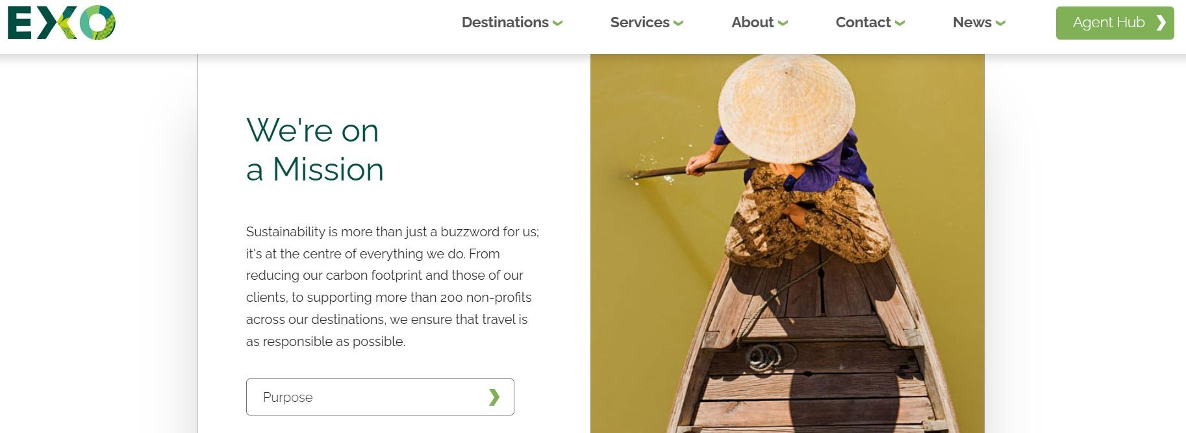
Sustainable Tourism Policy:
Communication
Source: Exo Travel

Slide 90
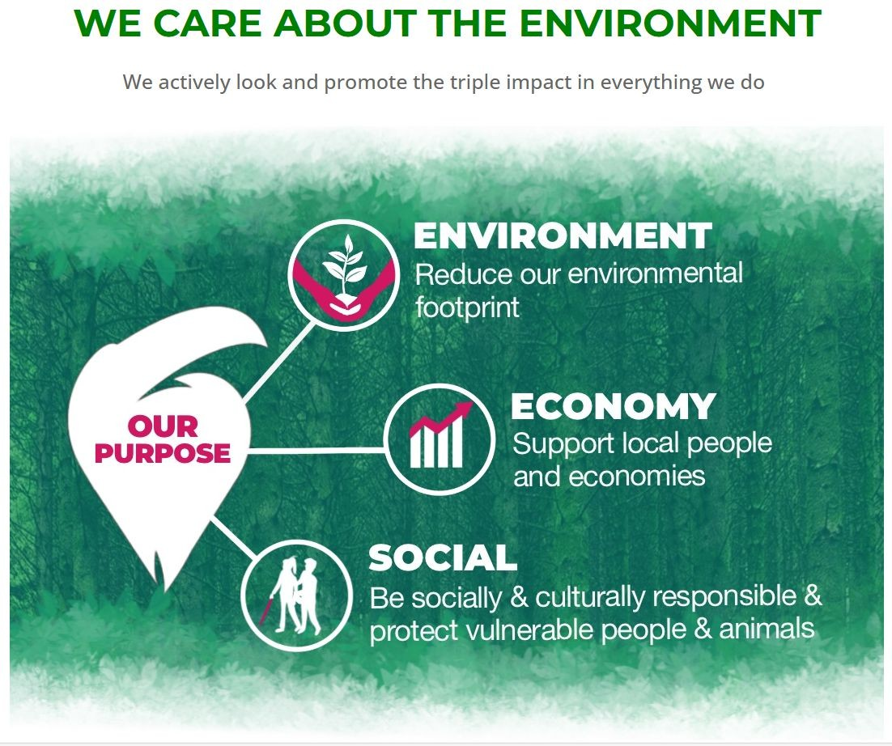
Sustainable Tourism Policy:
Communication
Make it visual & simple
Add the detailed policy as a link
The link should also be added into proposals & other communication with clients > you want them to be aware about your efforts
Inform your suppliers about the implementation of your Sustainable Tourism Policy & clearly outline what you expect from them > Offer guidance & examples if the supplier is new to the topic
Source: Encounter Latin America

Slide 91
Sustainable Tourism Policy:
Group Activity
Form 5 groups & formulate 5 policies for your assigned key business action area:
Group 1: Internal management (Office and staff)
Group 2: Product development and management (Tours)
Group 3: Supply chain management (Tourism products you include in tours)
Group 4: Customer relations (Guests)
Group 5: Cooperation with destinations (Community)
15 minutes

Slide 92
Sustainable Tourism Policy:
Which policies are important?
Remember: Official requirements are not given.
The following policies are expected by the GSTC
Exploitation & harassment of vulnerable groups (children, women, minorities, etc.)
Environmentally preferred purchasing (supply chain management)
Monitoring and reporting structures (Internal & External)
Additionally remember to add:
Compliance to laws & regulations
Commitment to raise awareness
The aim to engage your suppliers in sustainability efforts
Commitment to continual improvement

Slide 93
Module 5 Action Planning

Slide 94
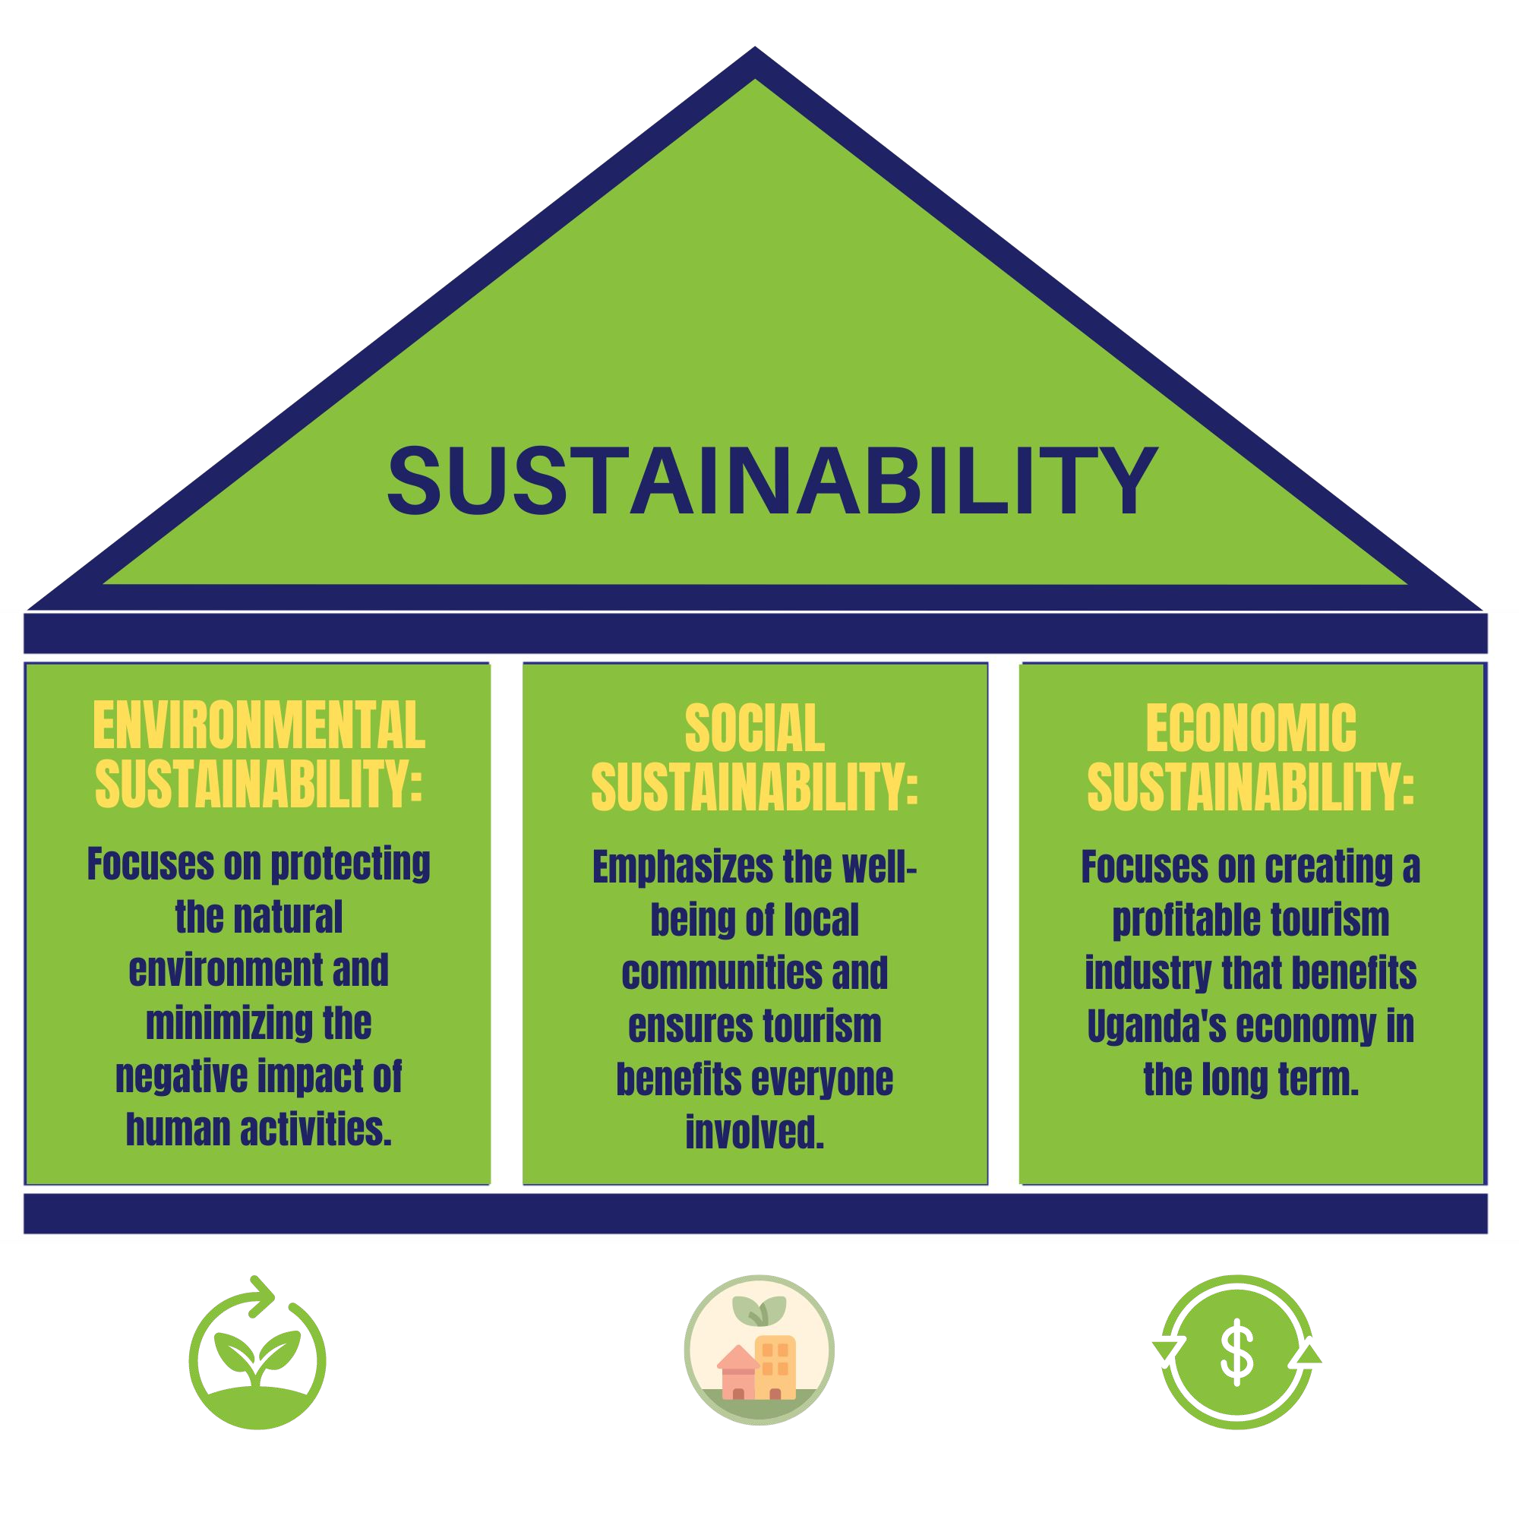
Action Planning
3 Pillars of
What actions should you take to become sustainable?

Slide 95
Developing Action Plans!
Why is it IMPORTANT
An action plan towards sustainability in tourism is not just about environmental responsibility, it's about creating a win-win situation for all stakeholders.
We all benefit: the environment, local communities, the national economy, and tourists seeking a responsible travel experience.

Slide 96
Developing Action Plans!
Ask Yourself These Questions
What do I need to do to achieve the objectives?
WE ARE IN IT
What can be realistically accomplished in 6 months
-and- 1 year / 2 years?
TOGETHER!
Who’ll be involved/committed?
What tools & systems will you set up
How can I support my suppliers with resources?
Do I practice what I preach?
What are the targets set?
By when?
Are the targets achievable?

Slide 97
Keys to Success
1. Successful Action Plans have sustainability guidelines for itself and its partners
that includes:
Dates/Targets
Actions Taken
Measures
Responsibilities
Time Planning
For each aspect, show the plan clearly for your:
Own business operations
Customers
Supply Chain
Community
2. Staff involvement:
The implementation and management of these actions will involve all employees cooperation. We must acknowledges them as driving force for successful and continuous sustainability.

Slide 98
An “Action Plan”… in action
Focus Area: Reducing waste generation on safaris.
Target: Achieve a 50% reduction in single-use plastic waste by the end of the year.
ACTIONS TAKEN:
Eliminate single-use plastic water bottles:
MEASURE: Track the # of plastic water bottles currently used per tour.
RESPONSIBILITY: Tour operator (purchase) & Guides (implementation).
TIMEFRAME: Implement by next safari departure (1 month).
ACTION:
Purchase reusable water bottles for all tourists included in the tour price.
Carry a water dispenser in the safari vehicle as the first and best option.
Partner with local communities to offer filtered water refill stations at designated points throughout the safari.

Slide 99
An “Action Plan”… in action
Focus Area: Reducing waste generation on safaris.
Target: Achieve a 50% reduction in single-use plastic waste by the end of the year.
ACTIONS TAKEN:
Reduce single-use plastic packaging for snacks and toiletries:
MEASURE: Monitor the amount of plastic packaging used for provided snacks and toiletries.
RESPONSIBILITY: Tour operator (procurement) and hotel partners (meal packaging).
TIMEFRAME: Implement within 3 months.
ACTION:
Source snacks and packed meals with minimal or biodegradable packaging.
Offer refillable containers for commonly used toiletries (sunscreen, insect repellent) or partner with eco-friendly brands with minimal plastic packaging.

Slide 100
An “Action Plan”… in action
Focus Area: Reducing waste generation on safaris.
Target: Achieve a 50% reduction in single-use plastic waste by the end of the year.
ACTIONS TAKEN:
Promote responsible waste disposal:
MEASURE: Conduct post-trip surveys to gauge tourist understanding of waste disposal practices.
RESPONSIBILITY: Guides & Tour operator (communication and resources).
TIMEFRAME: Implement on the next safari departure.
ACTION:
Train tour guides on responsible waste disposal practices throughout the safari.
Provide tourists with reusable bags for waste collection and clear information on designated waste disposal bins.

Slide 101
Put the Plan into Action
Consider prioritizing suppliers for involvement in the first stages of the program, based on economic and managerial considerations.
(It may be more practical to begin with just a few destinations and/or selected suppliers, rather than trying to introduce the program everywhere at once).
Recognize that suppliers may have different priorities for improvements and are likely to make progress at a different pace.

Slide 102
Put thє Plan into Action
Understand that change takes time. It is important to focus on achieving continuous improvements, rather than trying to achieve everything all at once. The key is to initiate programs with all suppliers to improve their performance and see measurable improvement over time.
Consider working with other partners, including public authorities, NGOs and other tour operators operating in the same destination, to help encourage sustainability performance improvements amongst all suppliers.

Slide 103
Environmєntal Sustainability (1)
Action Planning
Waste Management Actions:
REDUCE single-use plastics. Partner with hotels and service providers that offer refillable water bottles and minimize unnecessary packaging.
EDUCATE tourists on responsible waste disposal. Provide clear instructions on waste segregation at hotels and on the path.
SUPPORT local waste management initiatives. Partner with companies offering composting or recycling services.
Water Conservation Actions:
PROMOTE water conservation practices among tourists. Encourage shorter showers, per request replacing of sheets, and responsible use of water in hotels.
PARTNER with hotels that utilize water-saving fixtures and rainwater systems. Encourage them to share this eco-friendly information with guests during check-in.
OFFER alternative activity options with a lower water footprint (e.g., nature walks instead of boat tours, bicycle tours to local markets instead of vehicle transportation)
In-Action
example
Apply the
same
103

Slide 104
Environmєntal Sustainability (2)
Action Planning
Energy Efficiency Actions:
PROMOTE eco-lodges that utilize renewable energy sources like solar panels.
ENCOURAGE hotels to offer energy-saving options for tourists, such as turning off lights and electronics when not in use.
WORK with service providers to utilize fuel-efficient vehicles whenever possible. Explore options for carbon offset programs.
Responsible Wildlife Viewing Actions:
EDUCATE tourists on responsible wildlife viewing practices. Emphasize maintaining safe distances,following designated paths, and avoiding disruptive behavior.
PARTNER with guides trained in responsible wildlife viewing practices and conservation efforts.
SUPPORT wildlife sanctuaries and conservation organizations that prioritize animal welfare.
104

Slide 105
Environmєntal Sustainability (3)
Action Planning
Engaging Service Providers & Hotel Partners Actions:
DEVELOP A SUSTAINABILITY POLICY: Outline your commitment to environmental sustainability and expectations for partners.
ORGANIZE TRAINING WORKSHOPS: Educate service providers and hotel staff on sustainable practices they can implement.
OFFER INCENTIVES: Partner with eco-friendly businesses offering competitive rates/discounts, feature them on website and promotional material.
TRANSPARENCY AND COMMUNICATION: Promote your partners' sustainability efforts to attract responsible tourists.
104

Slide 106
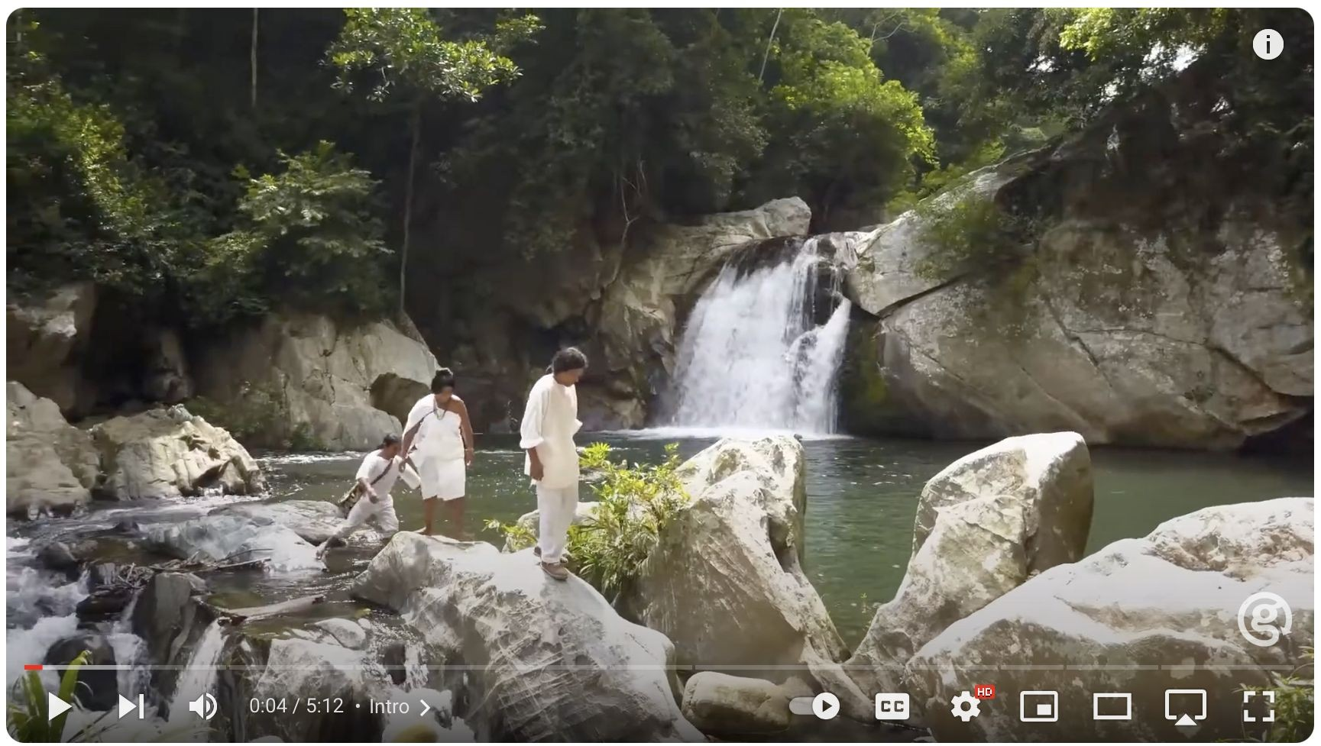
Here is how G Adventures is committed to giving travellers an incredible experience while leaving a positive impact in the places they visit.
www.gadventures.com
104

Slide 107
Social Sustainability (1)
Action Planning
Community Partnerships Actions:
PARTNER with locally-owned businesses for services and supplies (transportation, guides, food products).
SUPPORT community-run initiatives, like homestays or cultural experiences directly benefiting locals.
OFFER opportunities for local artisans to sell their crafts to tourists through organized markets or partnerships with hotels.
Cultural Sensitivity Actions:
EDUCATE tourists on Ugandan customs and traditions. Provide information on appropriate dress
code and respectful behavior.
HIRE local guides who can share their knowledge and perspectives with tourists authentically.
SUPPORT the preservation of cultural heritage by incorporating visits to historical sites or traditional performances in tours.
107

Slide 108
Social Sustainability (2)
Action Planning
Community Development Actions:
OFFER training and employment opportunities within your company for local people. Prioritize fair wages and skills development.
PARTNER with NGOs or local organizations on community development projects like education initiatives or infrastructure improvements.
CONSIDER offering a portion of your profits to support local social causes.
NOTE:
Build long-term partnerships with community members and businesses.
Ensure transparency and fair compensation in all collaborations.
Promote cultural exchange with respect and authenticity.
108

Slide 109
Social Sustainability (3)
Action Planning
Engaging Service Providers & Hotel Partners Actions:
Develop a Community Engagement Policy: Outline your commitment to supporting local communities and expectations for your partners.
Organize Cultural Sensitivity Training: Educate service providers and hotel staff on cultural sensitivity and responsible interaction with tourists.
Joint Marketing Initiatives: Promote local businesses and cultural experiences with your tours in marketing materials.
Direct Tourist Spending: Encourage tourists to patronize local shops, restaurants, and cultural events.
109

Slide 110
Economic Sustainability (1)
Action Planning
Responsible Pricing Actions:
DEVELOP a pricing strategy that offers competitive rates while ensuring fair compensation for yourself,service providers, and hotel partners.
OFFER transparent pricing that avoids hidden fees and clearly communicates inclusions and exclusions.
CONSIDER offering tiered pricing options to cater to different budgets and attract a wider range of tourists.

Slide 111
Economic Sustainability (2)
Action Planning
High-Quality Experiences Actions:
INVEST in training and upskilling for your staff to ensure exceptional customer service.
PARTNER with reliable and professional service providers who offer high-quality experiences.
MAINTAIN strong relationships with hotels that offer clean, comfortable stays and positive guest experiences.
CONTINUOUSLY innovate and develop new tours and experiences that cater to evolving tourist interests.

Slide 112
Economic Sustainability (3)
Action Planning
Long-Term Growth Actions:
INVEST in marketing and promotion to attract responsible tourists who value sustainable practices.
UTILIZE online platforms and social media effectively to reach a wider audience.
ENCOURAGE repeat business by exceeding tourist expectations and fostering loyalty.
SEEK out opportunities for collaboration with other Ugandan tourism businesses for joint marketing or package deals.
Community Investment Actions:
PRIORITIZE fair wages and employee benefits to attract and retain skilled staff.
PAY taxes responsibly and comply with local regulations.
CONSIDER supporting local businesses by sourcing supplies or equipment from Ugandan companies.
EXPLORE options for reinvesting a portion of profits into local infrastructure development or educational initiatives.
112

Slide 113
Economic Sustainability (4)
Action Planning
Engaging Service Providers & Hotel Partners Actions:
Develop a Fair Business Practices Policy: Outline your commitment to transparency, fair compensation, and responsible business practices with partners.
Establish Long-Term Contracts: Negotiate beneficial contracts with service providers and hotels to ensure stability and mutual growth.
Joint Marketing & Promotion: Collaborate with partners on marketing initiatives to reach a wider audience and promote each other's offerings.
Data Sharing & Feedback: Share customer feedback and performance data with partners to identify areas for improvement and ensure a consistently
high-quality experience.
113

Slide 114
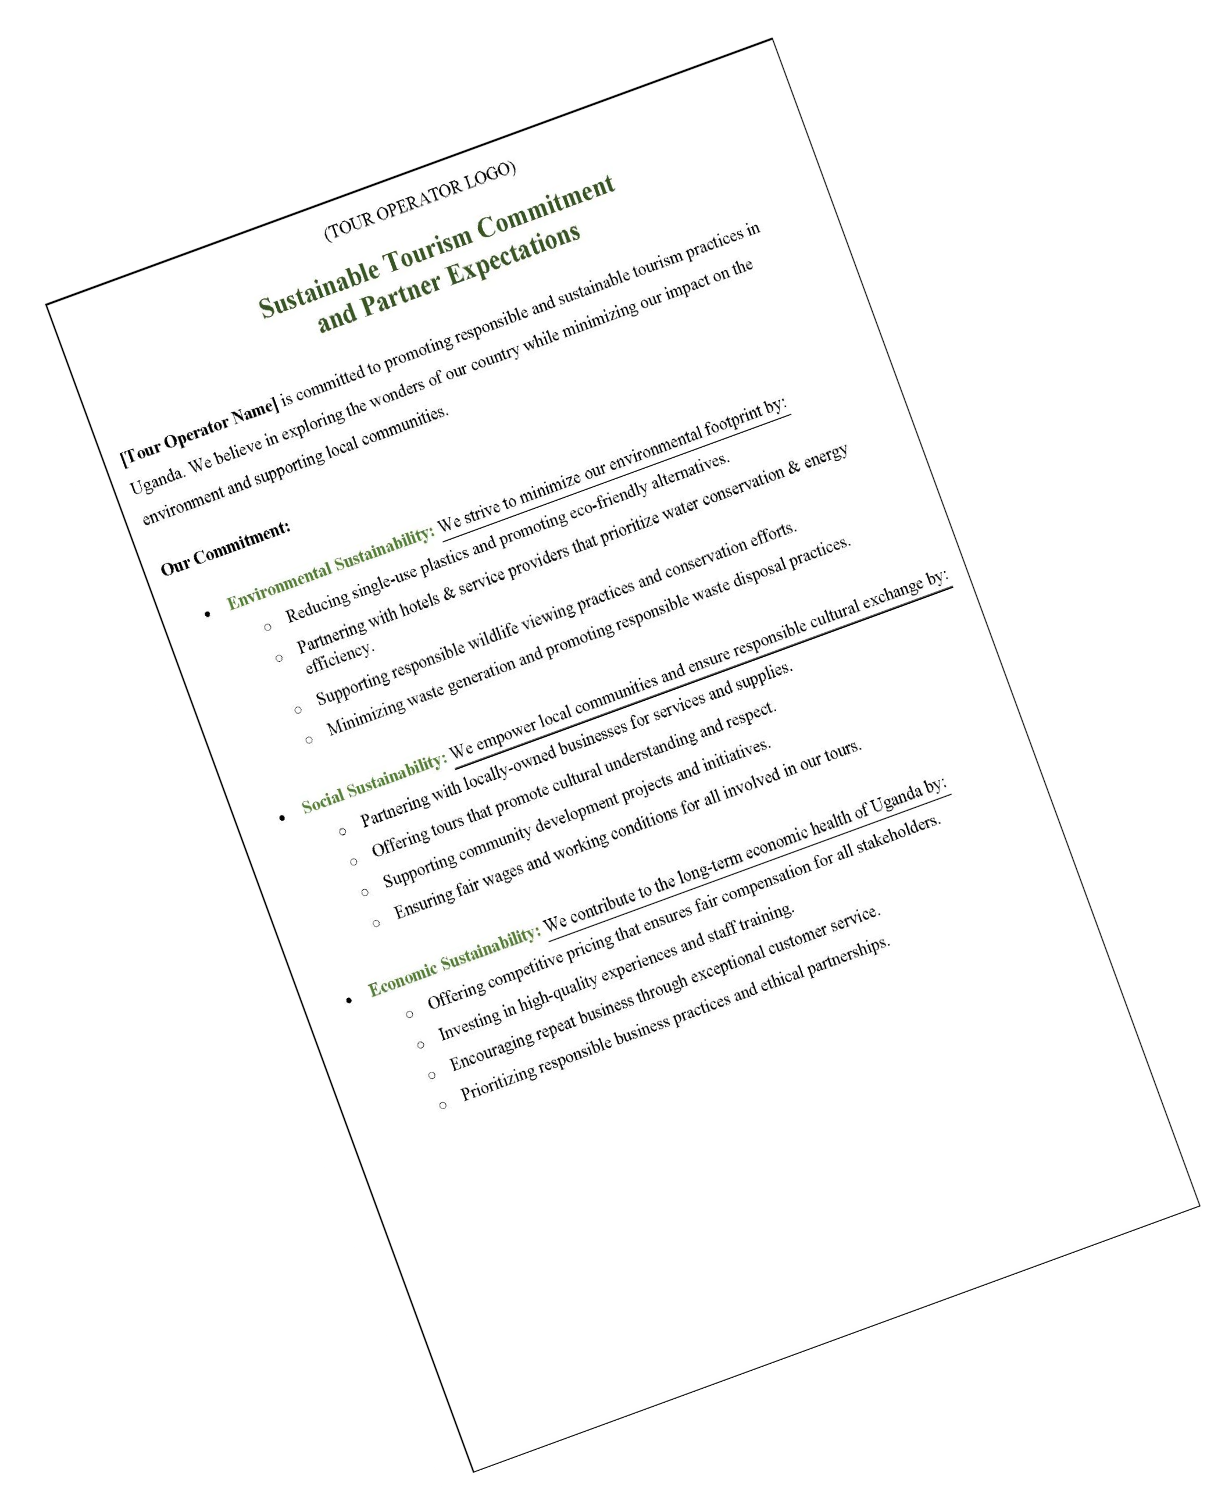
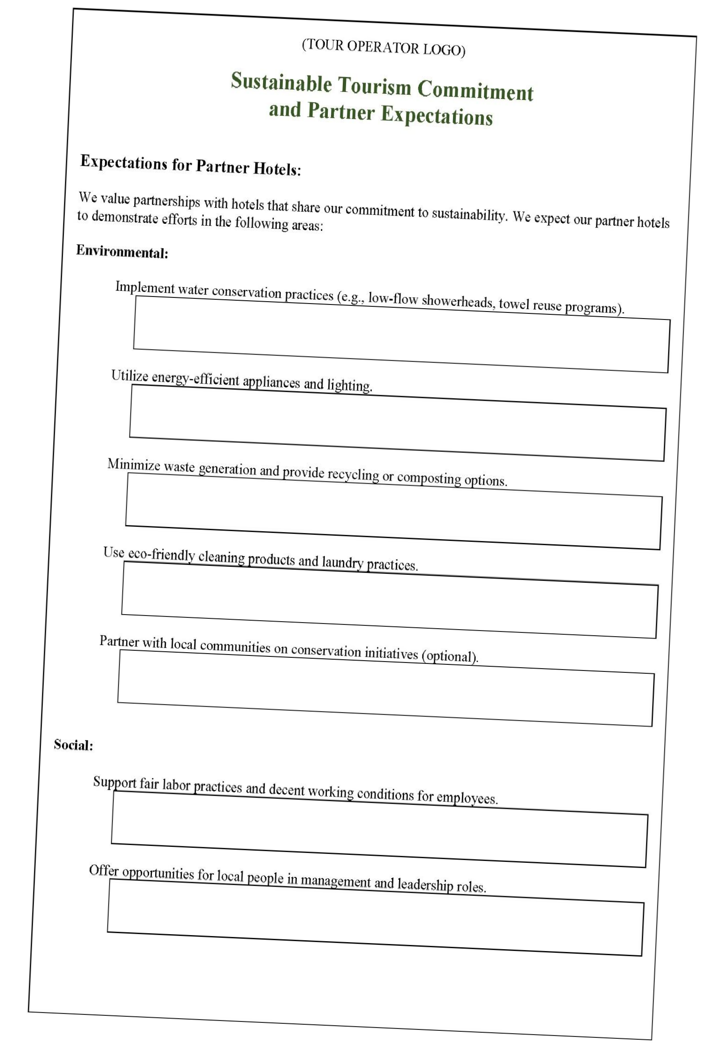
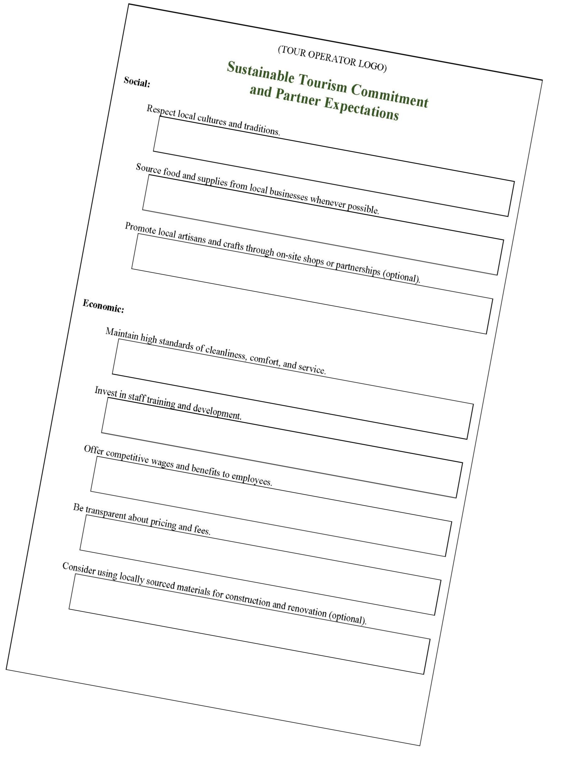
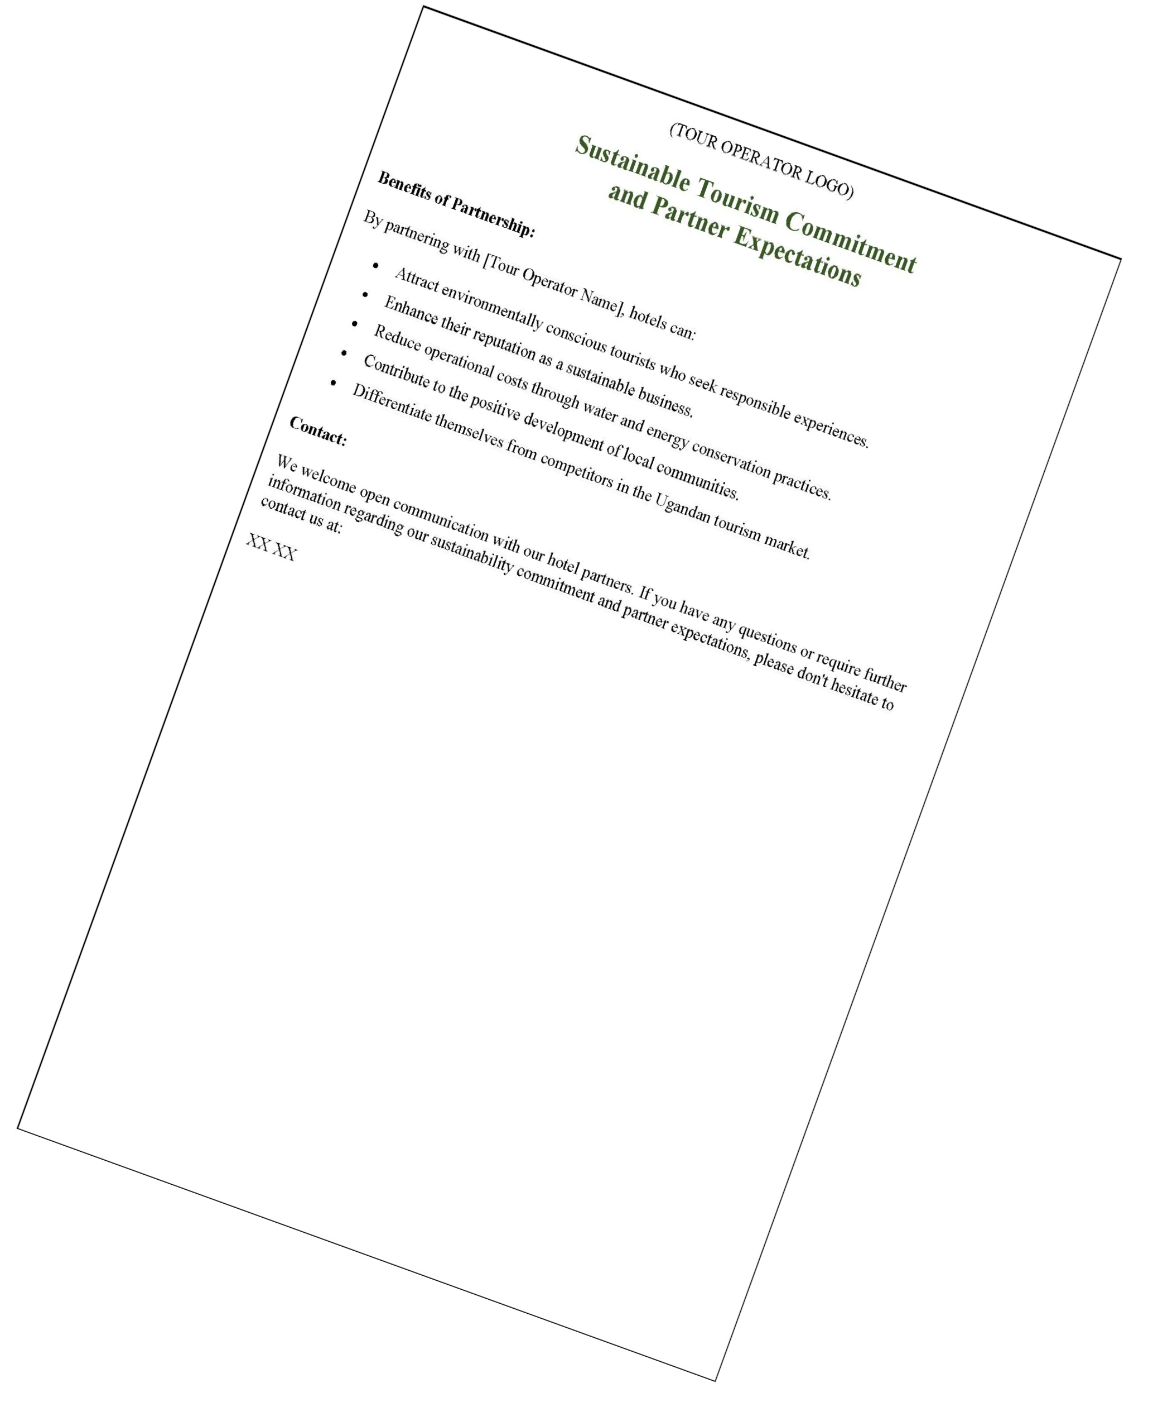
Develop a Sustainability Action Plan and Guidelines
Create a CLEAR DOCUMENT/FORM that outlines your commitment to sustainability and your expectations from partner.
Include guidelines on key areas like waste management, water conservation, energy efficiency, and responsible sourcing.
Provide examples of best practices and ideas for each area.

Slide 115
Interactive Activities
Group Activity: (10 Minutes)
Brainstorm ideas and solutions that can be accomplished in the short-term and long-term goals to becoming more sustainable throughout your business (in your office, in the field, and/or with your service provider partners.

Slide 116
Module 6 Sustainable Tourism Certification

Slide 117
Sustainable Tourism Certification
Introduction to certification schemes in sustainable tourism :
What is the Global Sustainable Tourism Council (GSTC)?
What makes a good certification program?
Which certification schemes are available for tour operators, which ones for hotels and guesthouses?
Which certification schemes could I work with as a Ugandan business?
What can certification do for my tourism business?
Understanding the different certification stages
Overview over costs and time necessary for certification
Step-by-step explanation of the process of becoming certified
117

Slide 118
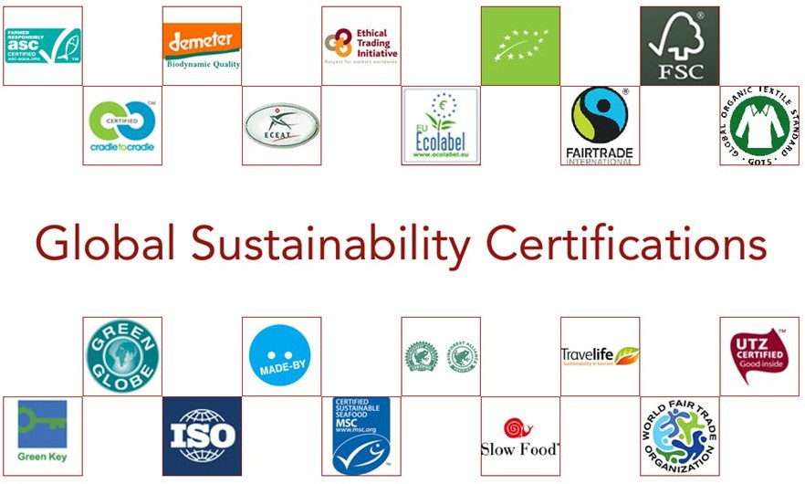
Sustainable Tourism Certification
What is certification?
Is a voluntary procedure by which a
facility, product, process, or service is
assessed, subject to an audit, and
issued a written guarantee stating it
meets specific standards. It grants a
“marketable” logo to those meeting or exceeding basic standards.
It is a voluntary, third-party
assessment, through an audit, of a
tourism enterprise or destination for conformity to a standard.
Source: Conscious Travel Guide
117

Slide 119
Sustainable Tourism Certification
Tourism businesses and certification
There are many certification schemes within sustainable tourism around the world (250 at least!) but only a small number of tourism products globally are actually certified (1%).
There are global, regional and national standards. In some destinations you can choose from several options, in some from one or none.
Some only offer hotel certification, some for destinations and all sorts of tourism products (accommodation, activities & tour operators etc.).
Source: 12 good reasons to certify your destination | Northflash
117

Slide 120
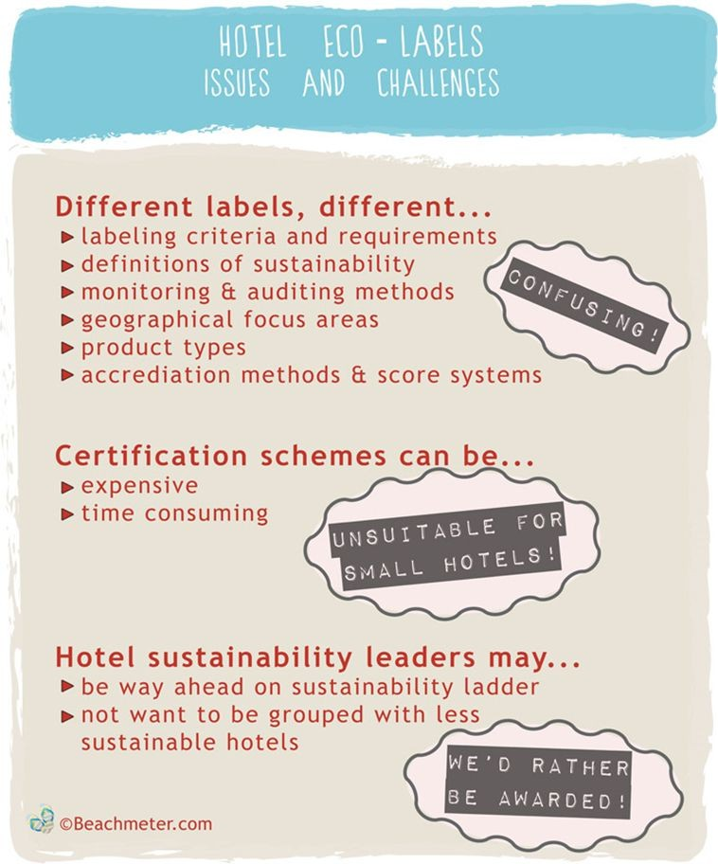
Sustainable Tourism Certification
Sustainable tourism certification gets a lot of criticism for being expensive, exclusive and difficult to achieve.
BUT is also pushed as the most effective tool through which a destination or tourism business can work on sustainability.
Both statements are true. You will need to research what it can bring you.
Watch: the Labelscape video‘s on sustainable tourism certification and what it could bring you
Read: Glenn Jampol – The Pros and Cons of Sustainable Tourism certification
Source: Beachmeter
120

Slide 121
Sustainable Tourism Certification
Global Sustainable Tourism Council (GSTC)**: The GSTC offers criteria and guidelines for sustainable tourism certification worldwide. Their criteria cover areas such as sustainable management, socio-economic impacts, cultural heritage, and environmental conservation.
GSTC does NOT conduct certification. That is the job of the many Certification Bodies throughout the world; it’s job is to accredit those that certify.
The Global Sustainable Tourism Council (GSTC)’s goal is to create and promote a common standard for tourism certification.
The GSTC is a non-profit organization whose mission is to:
promote sustainable tourism practices
support the application of the GSTC criteria and
develop basic standards for sustainable development in the tourism sector at the global level.
It is seen as the leading organisation for sustainability certification and accreditation in tourism and enjoys a high reputation in the industry worldwide.
121

Slide 122
Understanding the GSTC
Two sets of GSTC Criteria:
GSTC Industry Criteria (for hotels and tour operators) GSTC Destination Criteria
GSTC is involved in Certification, Accreditation and Recognition. What is the difference between the three?
+Certification = a third-party assessment of a tourism enterprise or destination to a standard (Does the business meet the criteria?)
+Accreditation = an intensive verification of a process of certification (How is the audit conducted?)
+Recognition = verification by GSTC that the set of standards used by Certification Bodies comply with (include) the GSTC Criteria (Does the certification standard include at least the GSTC criteria?)
Click on GSTC CEO Randy Durband explaining the difference!
Watch the video: https://youtu.be/-hxxN31xPws
Source: https://www.gstcouncil.org/certification/accreditation-certification-recognition/
122

Slide 123
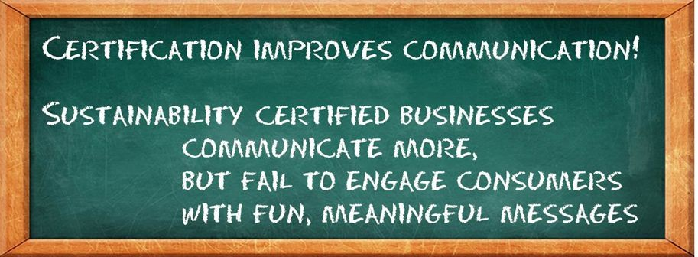
What can certification do for my tourism business?
Benefits can include:
better operations
better product & suppliers
happier & more productive staff
satisfied guests
improved market access!
improved credibility
Use certification primarily as a management tool but also use it as a marketing tool.
Many tourism businesses don’t leverage their certification effectively at all and struggle to communicate what they do well.
Source: Xavier Font, Respondeco 2014
123

Slide 124
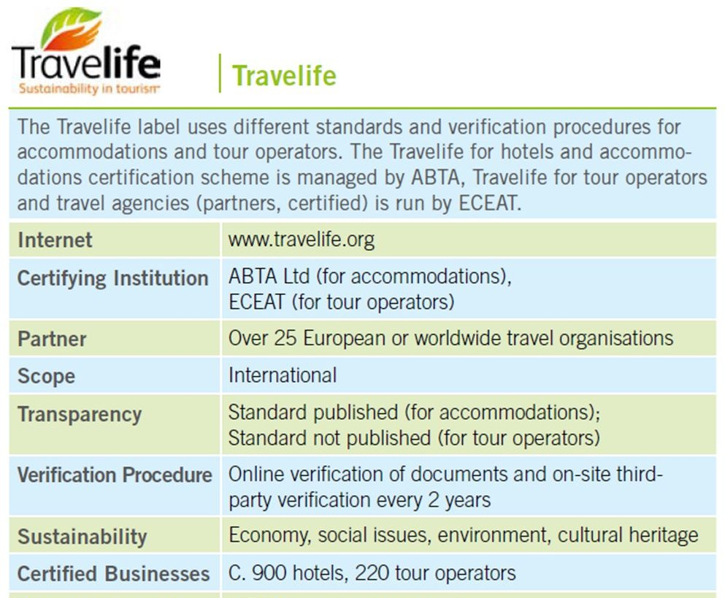
What makes a good certification program?
Questions to ask:
+Do they have a footprint in my destination? Check for other certified companies as well as locally based auditors and certification support.
+Does the standard do more than just get you certified? Check for market access support and active marketing of the label to the travel trade and/or consumers.
+Do they offer certification for my type of tourism business? Check if they certify just accommodation or also other tourism businesses for example.
+Are the criteria available online, are they triple bottom line (not just green) and is the audit done onsite by a 3rd party every couple of years?
124

Slide 125
Step-by-step explanation of the process of becoming certified
Compare and select a certification body
Register and/or contract with a certification body
Self-Assessment or Pre-Assessment (optional)
Submit application/documentary evidence
Desktop assessment and consultation
Onsite audit
Certification Body reports
Non-conformities and corrective actions
Certification issued & logo use agreement
Annual audits & certification renewal
Time and cost varies but give yourself at least a year and budget for around EUR 1000-2500. Costs usually depends on size of your business (based on turnover or number of staff).
Check: the Switchmed guide on sustainable tourism labels!
125

Slide 126
Certification active in Africa
Overview of certification schemes active in Africa/Uganda
125

Slide 127
Which certification schemes exist for tour operators, which ones for accommodation?
Travelife
+Footprint in European source markets & globally
+Holistic focus, 3rd party audit
+For tour operators & hotels
+Affordable
Fair Trade Tourism
+Footprint in Africa
+Holistic focus, 3rd party
TourCert
+Footprint in
German-speaking source markets & globally
audit
+For hotels, activity providers, ^{+Holistic focus, 3rd party}
audit
+For tour operators & hotels
+Expensive
voluntourism, restaurants, attractions
+Affordable
125

Slide 128
Which certification schemes exist for tour operators, which ones for accommodation?
Green Globe
+Footprint globally
+Holistic focus, 3rd party audit
+For accommodation and event venues
+Expensive
Green Key
+Footprint in Europe & globally
+Green focus, 3rd party audit
+For accommodation and campsites
+Affordable
125

Slide 129
Group Discussion / Activity
✔ Are you familiar with any of the certification schemes?
129

Slide 130
Group Discussion / Activity
✔ Do some research on certification options for yourself but also for your suppliers. Go to the websites of the above certification schemes and check the following:
the criteria
the cost and process of auditing
the footprint of certified business in Uganda/Africa
support and benefits provided by the scheme
✔ Which one would you choose for your own company and which ones would you recommend to your suppliers?
130

Slide 131
?
Quєstions and Answєrs
?
?
131

